Slide 2
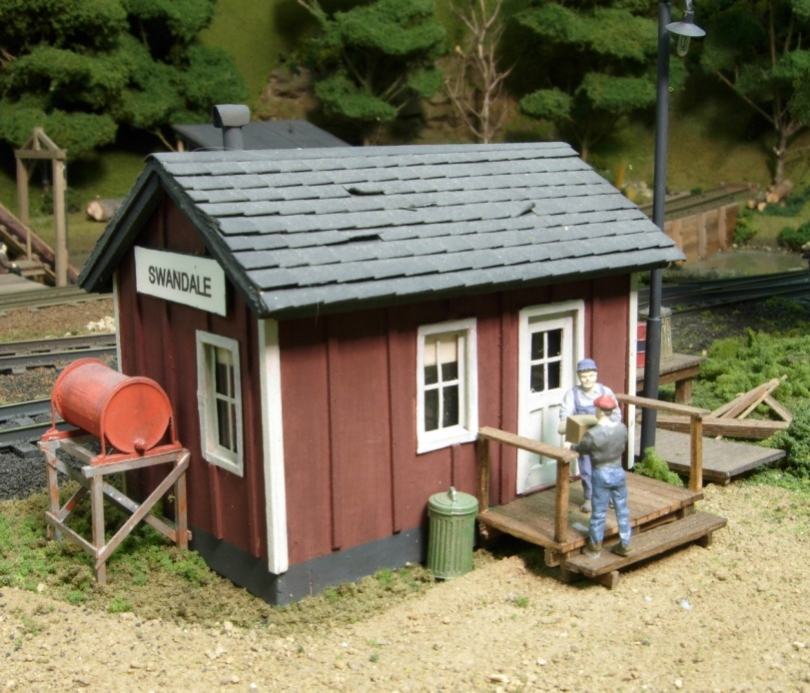
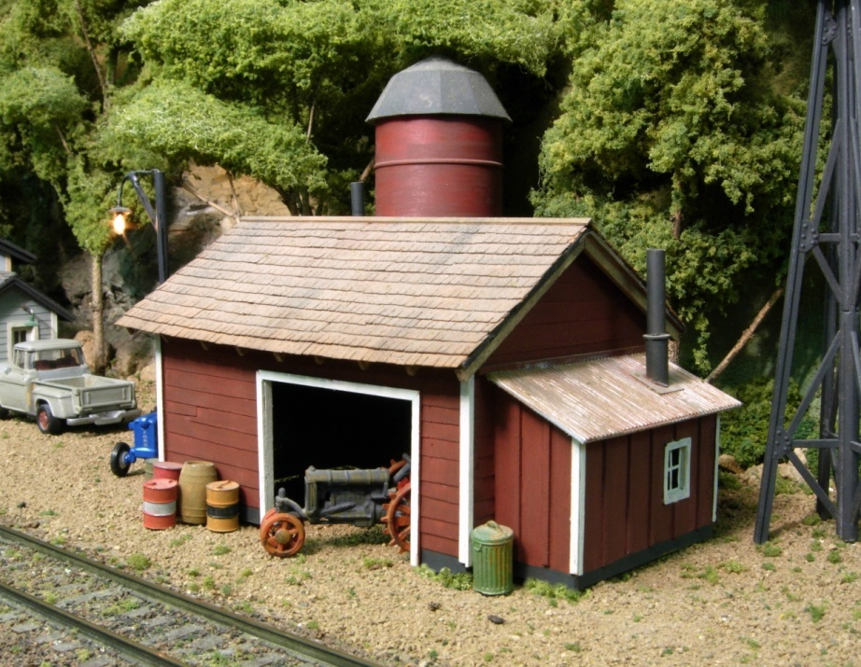
DESIGNING & BUILDING WOODFRAME STRUCTURES with INEXPENSIVE MATERIALS
By Brooks Stover, MMR

Slide 3
CLINIC OBJECTIVE
Describe how I
DESIGN and BUILD
wood framed structures
without breaking the bank!

Slide 4
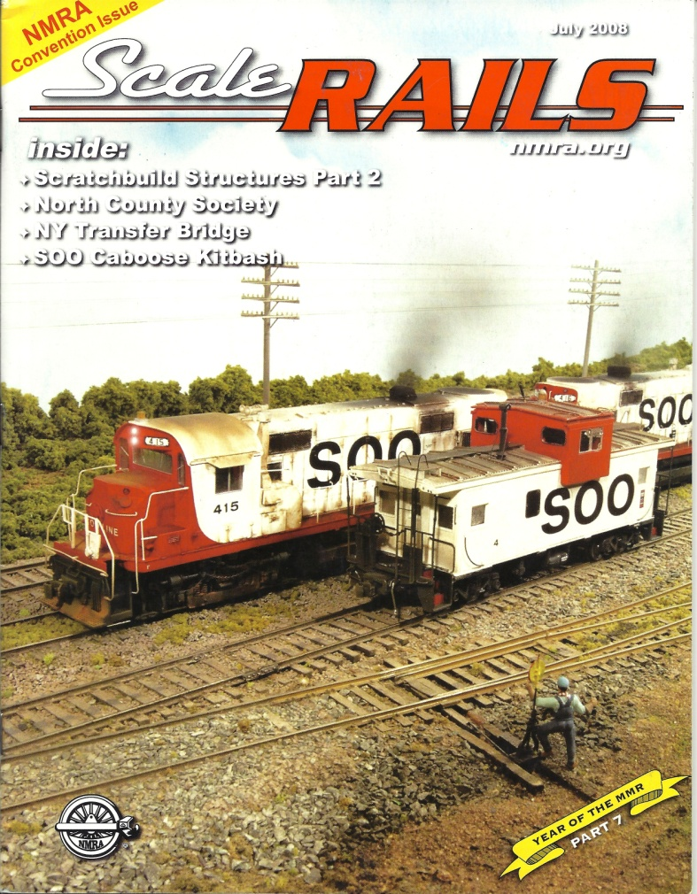
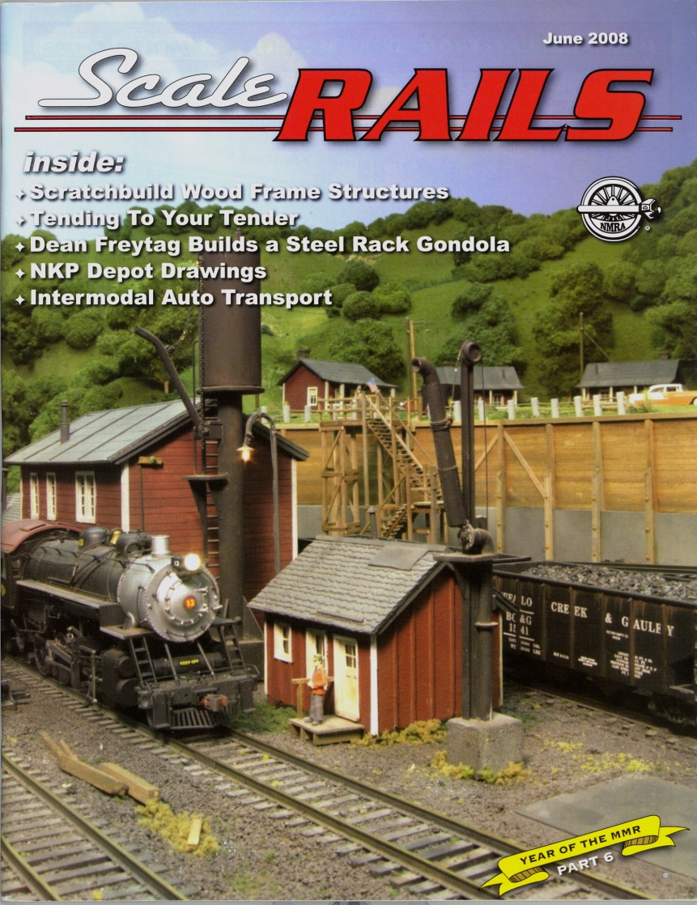
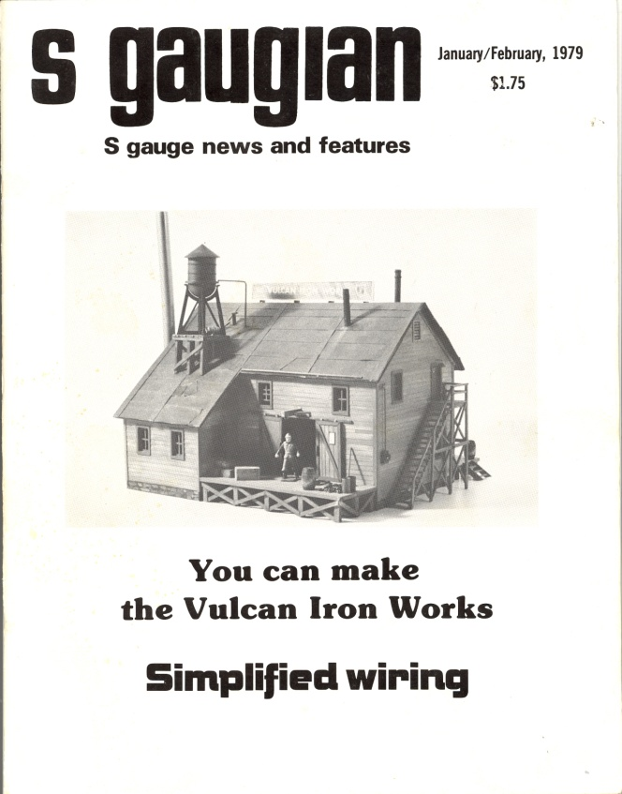
‘been doing this a long time!
January 1979…
…June and July 2008

Slide 5
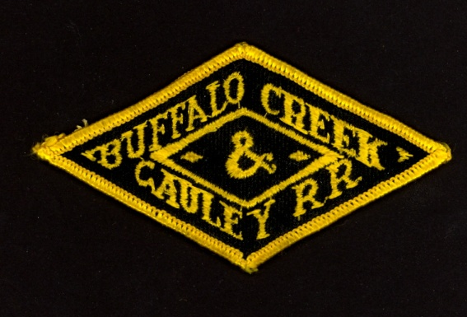


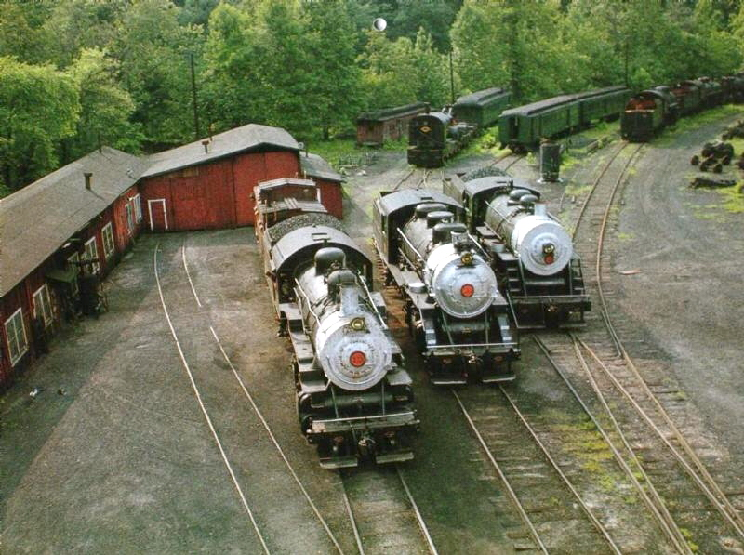
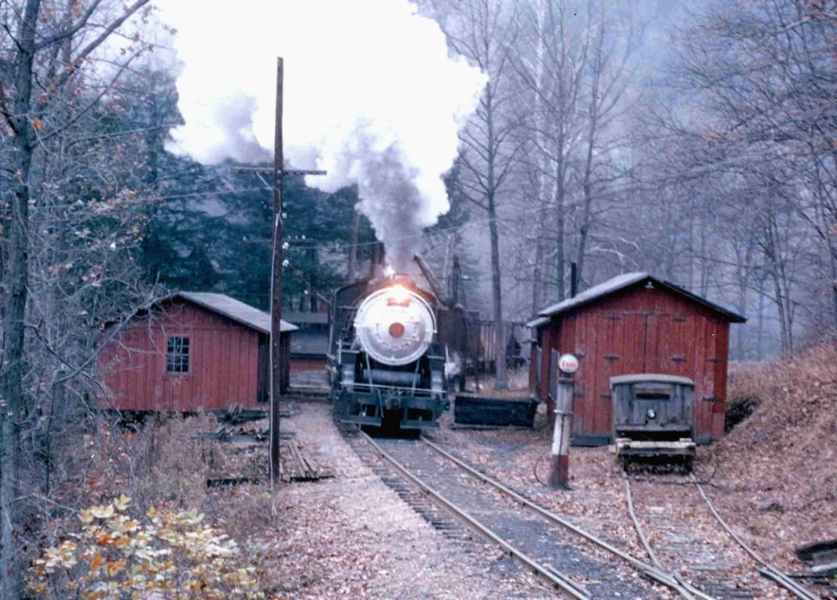

Modeling the BUFFALO CREEK & GAULEY
for 30+ years
It had lots of wood structures with CHARACTER!

Slide 6
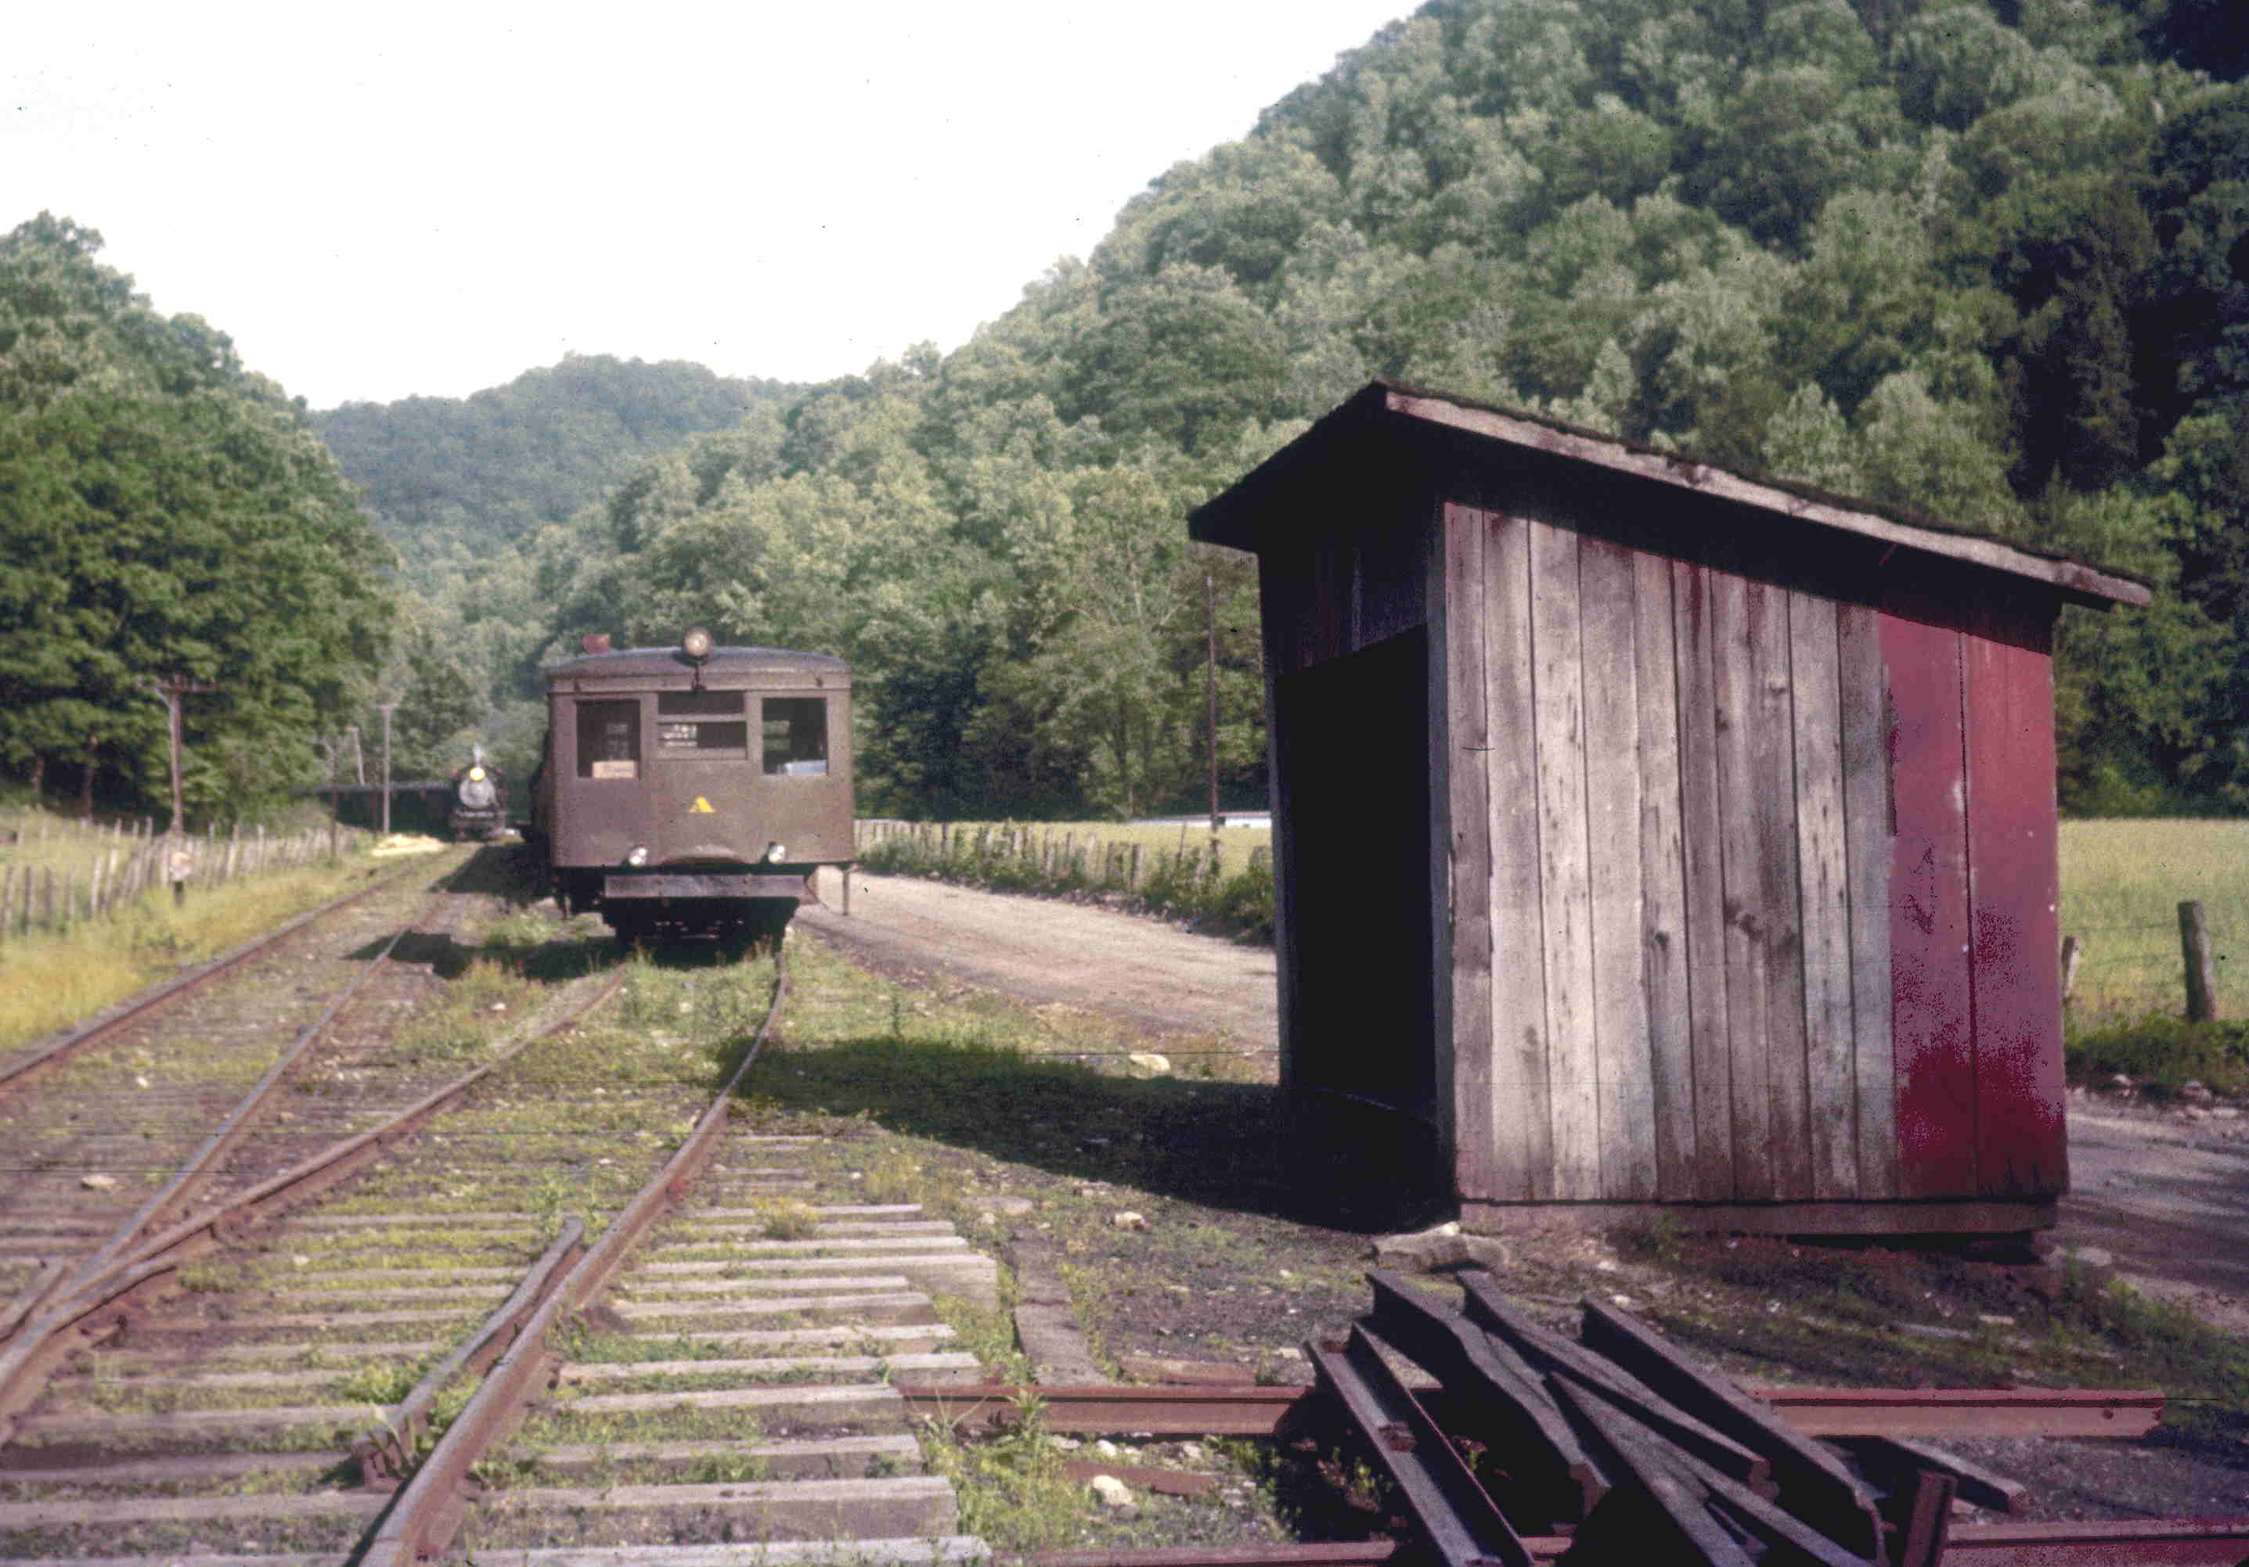
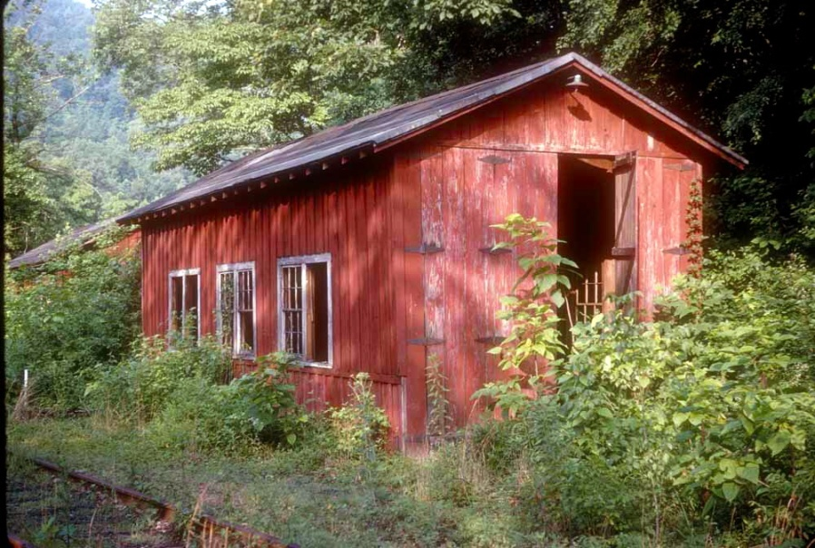
Many
Very Simple Wood-Framed Structures
Tool Storage Shed
Railbus Shed

Slide 7
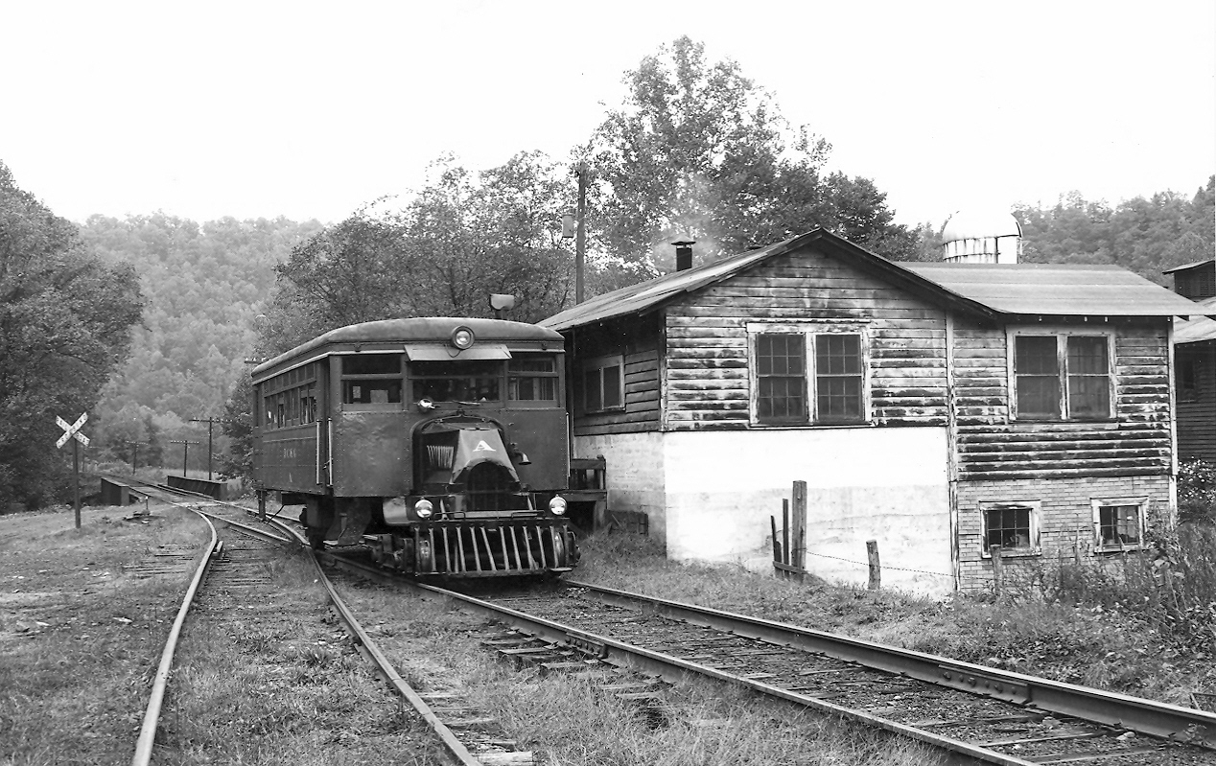
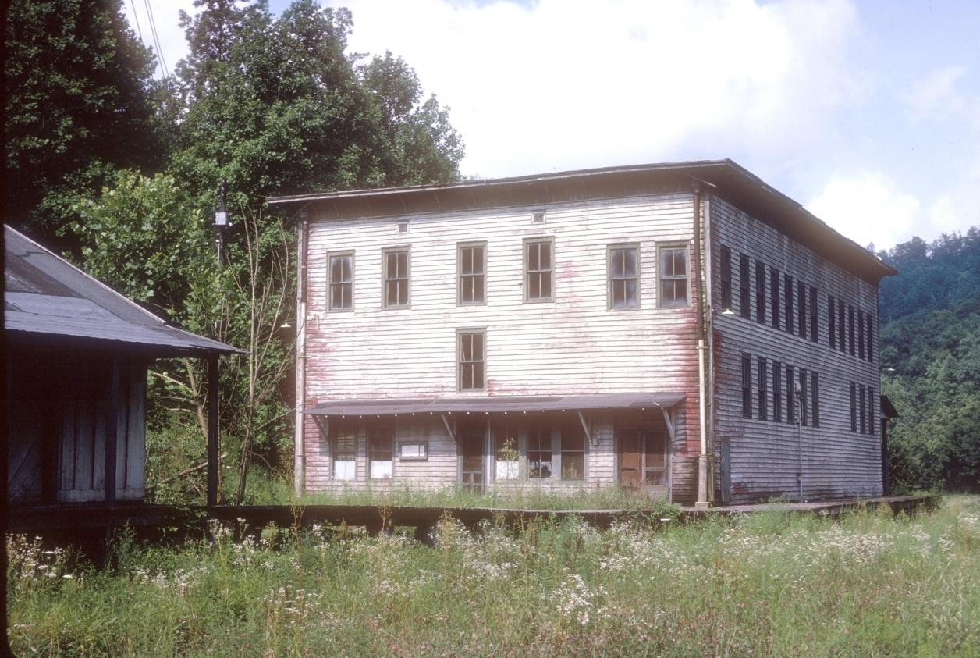
Others structures were larger…but still wood and still full of character
Dairy at Cressmont
Company Store at Swandale

Slide 8


I needed to learn how to model them
…quickly and easily!

Slide 9
OUTLINE
DESIGN
A. THREE basic “FORM Elements”
B. SIX basic “TEXTURE Elements”
CONSTRUCTION
C. Inexpensive MATERIALS
D. CONSTRUCTION Step by Step

Slide 10
OUTLINE
DESIGN
A. THREE basic “FORM Elements”
B. SIX basic “TEXTURE Elements”
CONSTRUCTION
C. Inexpensive MATERIALS
D. CONSTRUCTION Step by Step

Slide 11
A. “FORM” ELEMENTS
Most wood –frame structures can be built from combinations of one or more of these
3 BASIC FORMS
SHED Roof
PITCHED Roof
FLAT Roof

Slide 12
Combine 3 Basic FORMS to Create All Kinds of Structures…
…by Varying Sizes & Proportions

Slide 13

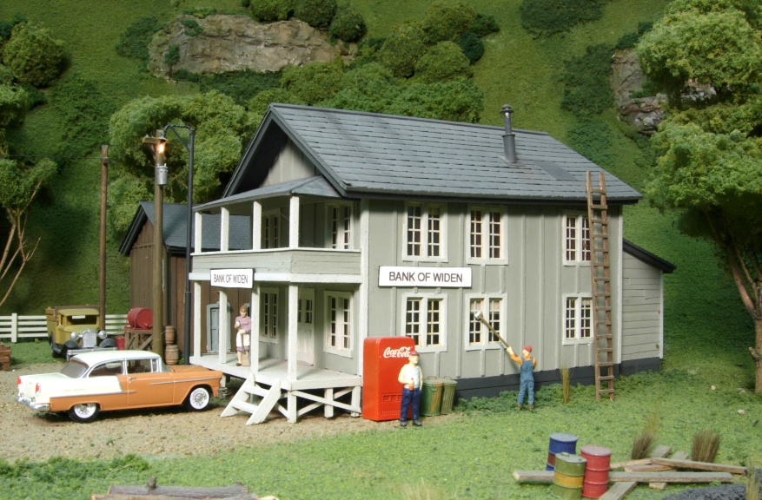
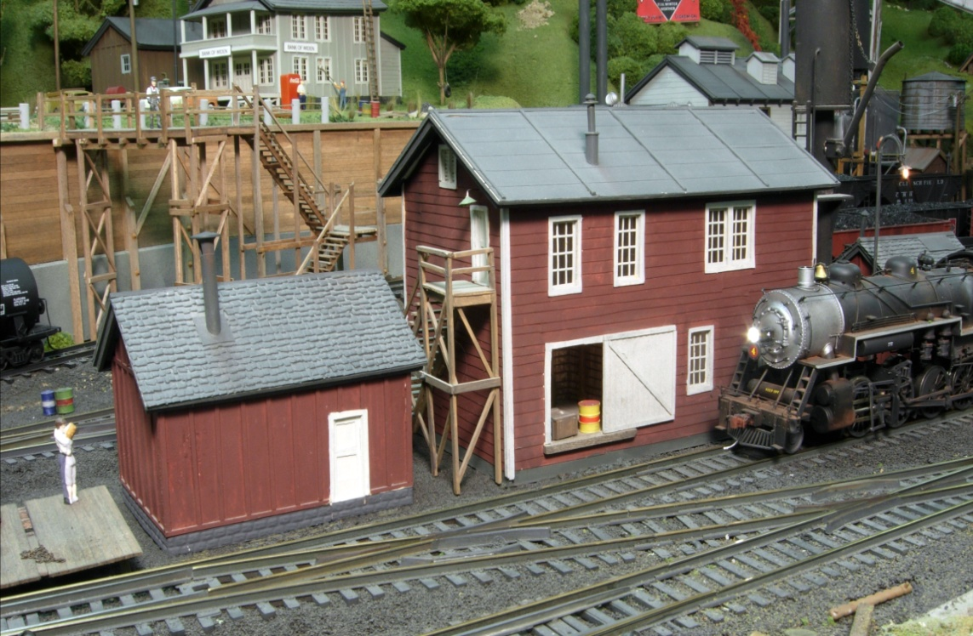
45+ Structures on My BC&G Layout Use Just These
THREE Basic FORMS!

Slide 14
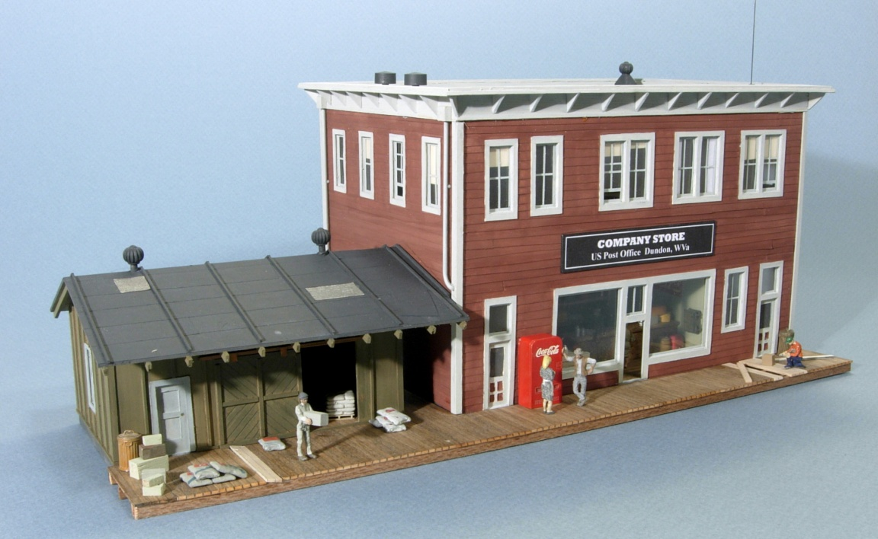
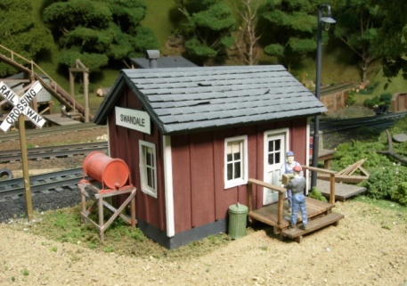
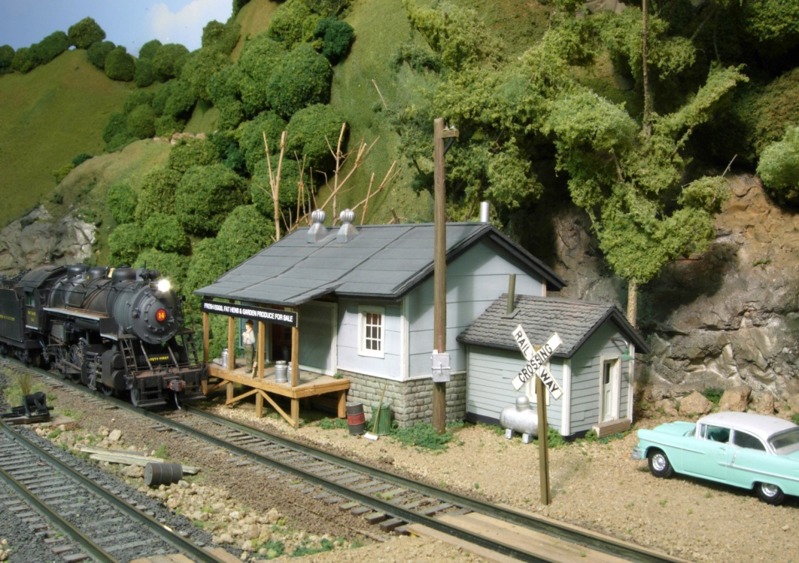
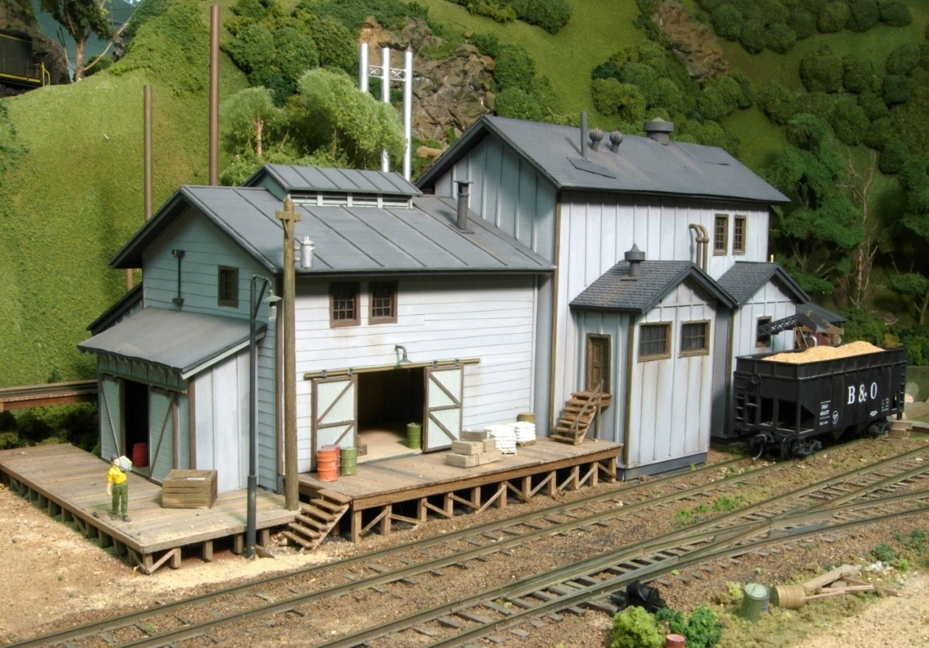
The 40 Structures on My BC&G Layout Use
Just These
THREE Basic Forms!
Most interesting structures use a combination of the 3 forms...

Slide 15
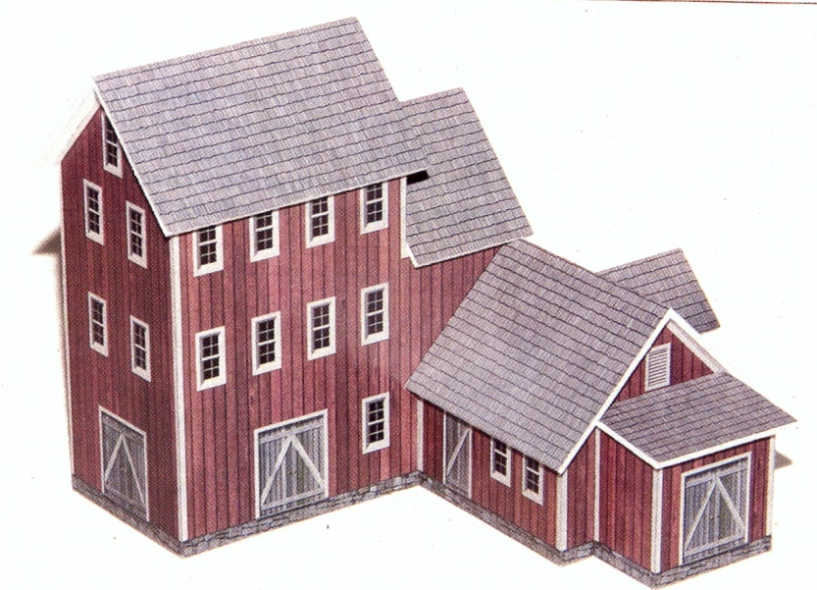
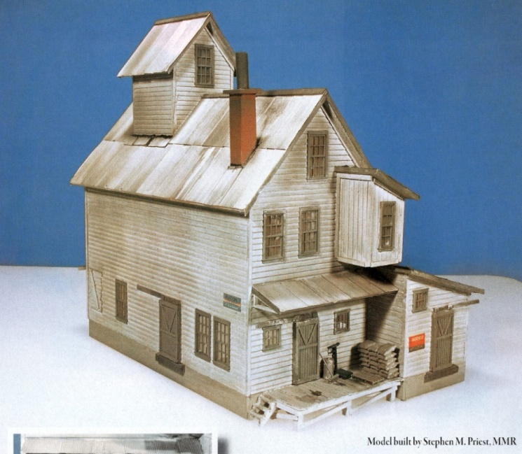
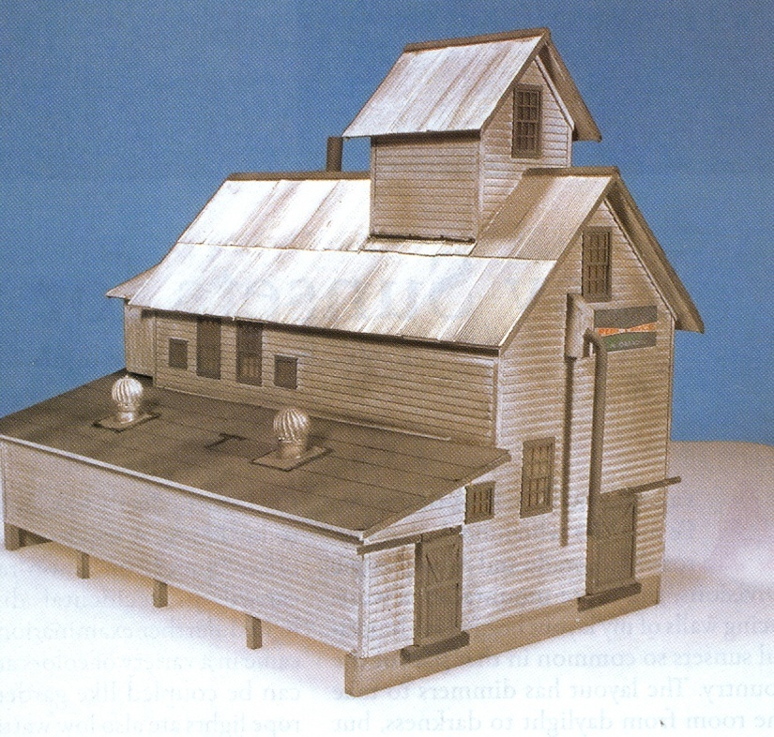
I enjoy finding the three forms in the structures others build…

Slide 16
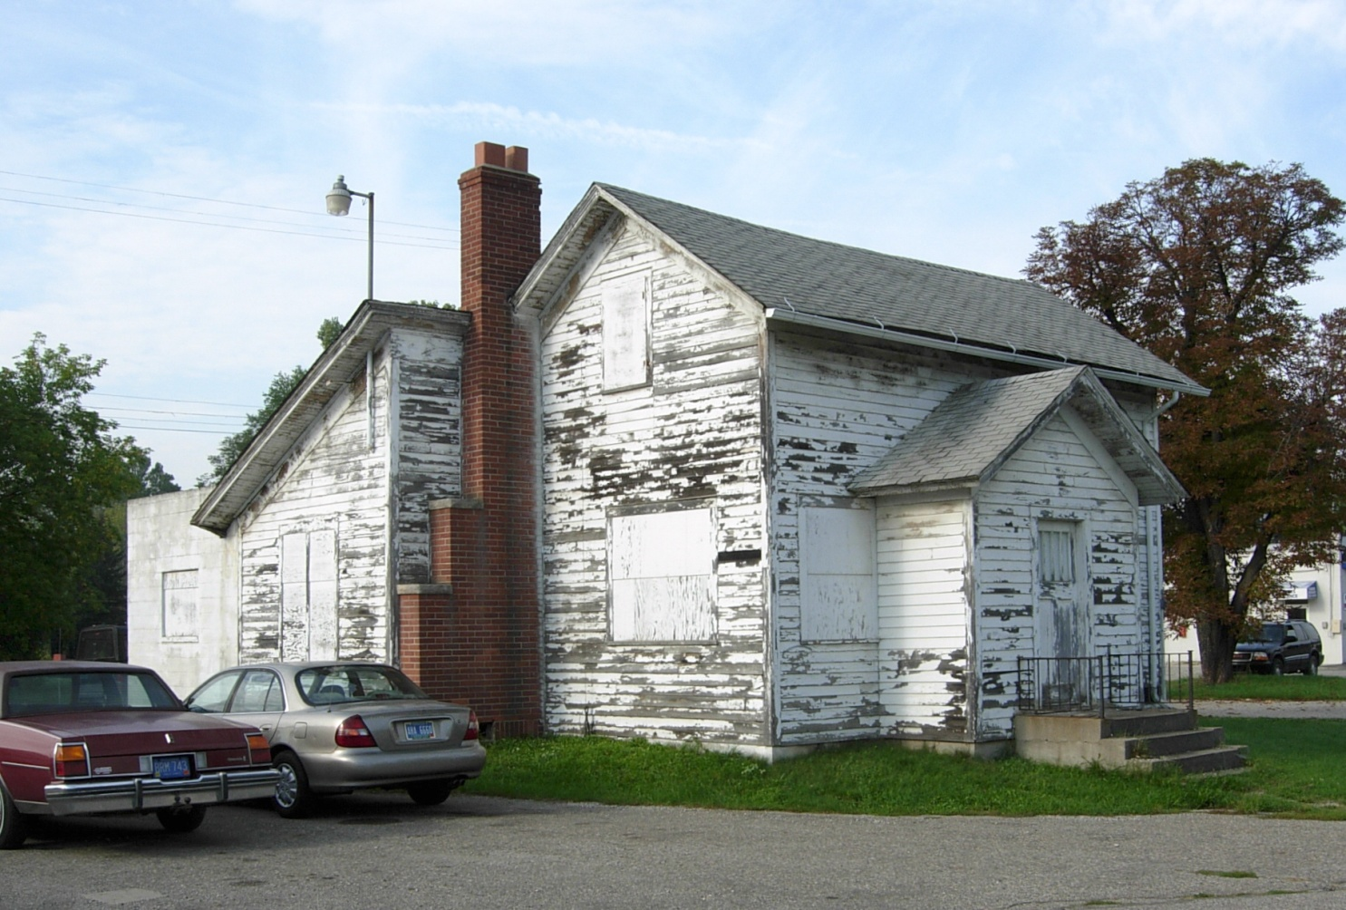
And in real structures…

Slide 17
Learn to build these 3 basic forms and you can build almost any wood-frame structure!
SHED Roof
PITCHED Roof
FLAT Roof
And there’s really little difference between these 3!

Slide 18
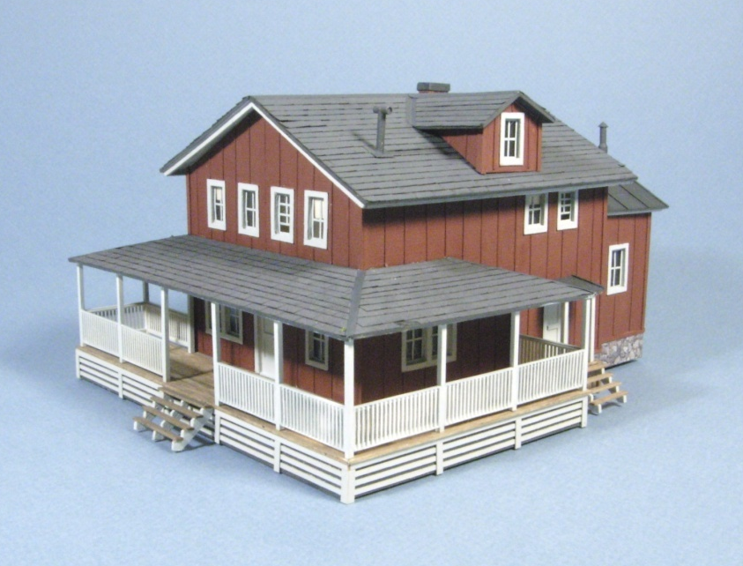
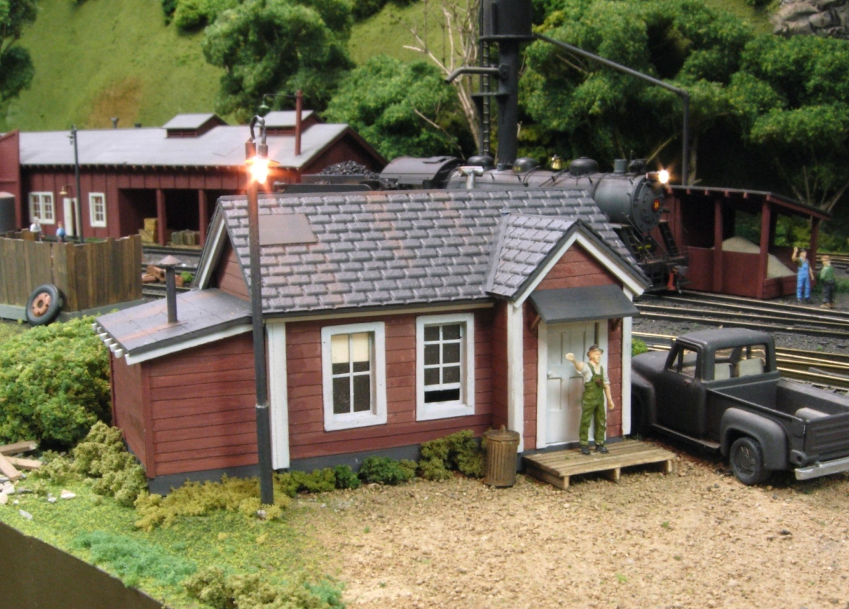
Only 2 structures on my layout have “intersecting roofs”
J.G. Bradley’s House
Dundon Shop’s Office

Slide 19
OUTLINE
DESIGN
A. THREE BASIC “FORM Elements”
B. SIX BASIC “TEXTURE Elements”
CONSTRUCTION
C. Inexpensive MATERIALS
D. CONSTRUCTION Step by Step

Slide 20
B. SIX “TEXTURE” ELEMENTS
“Add Visual Variety to the 3 Form Elements”
Wall Construction
Lap Siding
Board & Batten
Roofing Material
Tar Paper
Shingles
Roof Construction
Exposed Rafters
Roof Fascia Boards

Slide 21
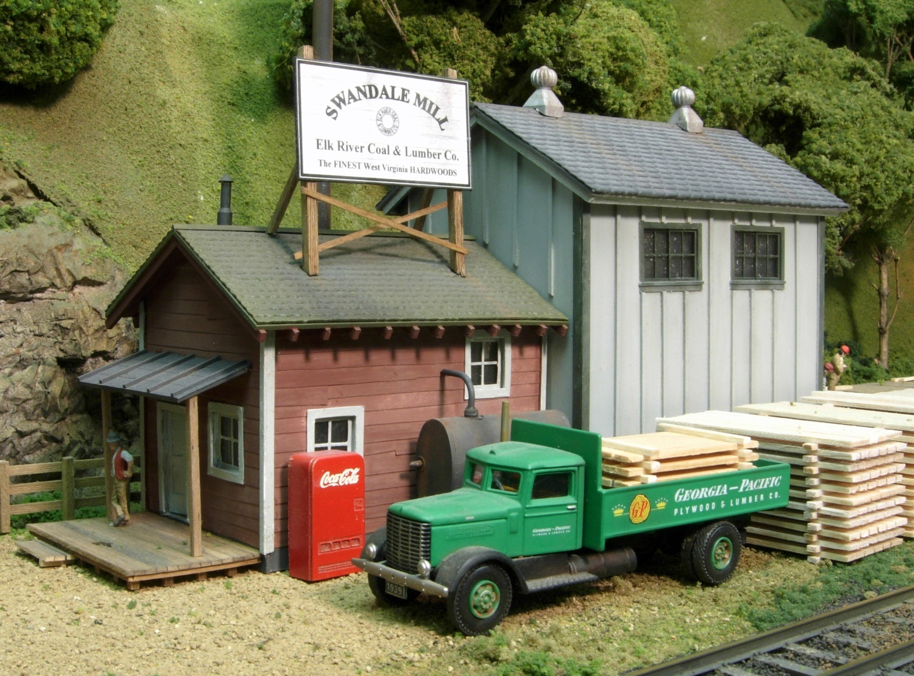
TEXTURE ELEMENT – “Wall Construction”
Board & Batten
(vertical)
Lap Siding
(Horizontal)

Slide 22
TEXTURE ELEMENTS – “Roofing Material”
Shingles
Tar Paper

Slide 23
TEXTURE ELEMENTS – “Roof Construction”
Roof Fascia Boards
(‘smooth’)
Exposed Rafters
(‘rough’)

Slide 24
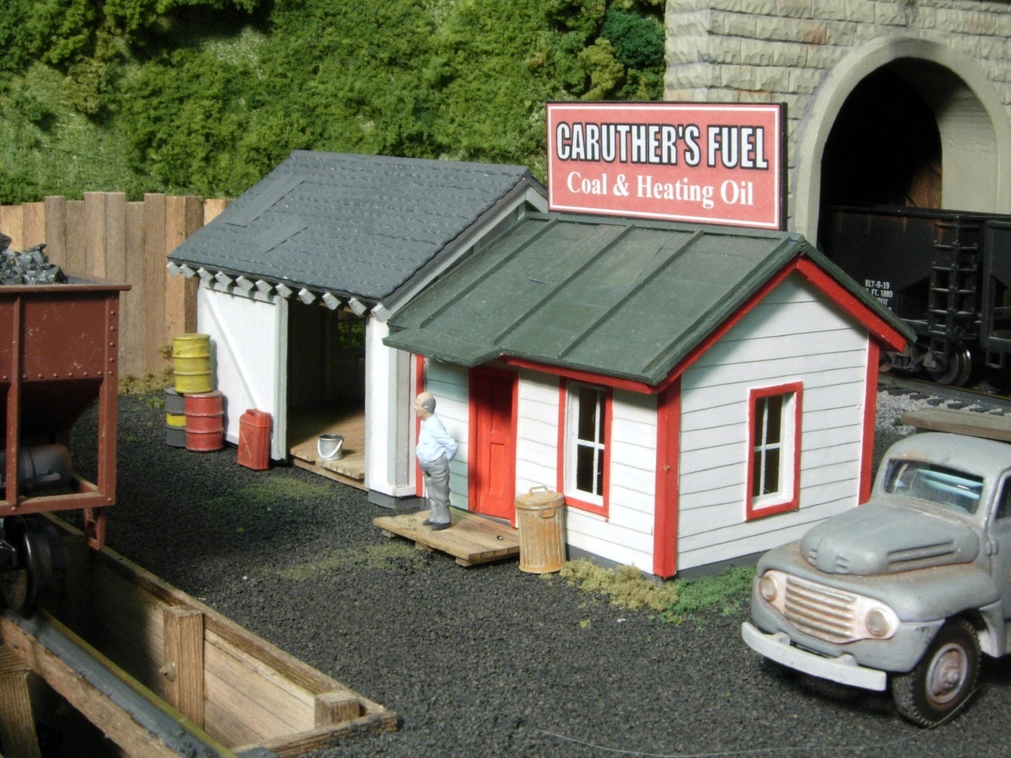
Incorporating a variety of TEXTURES on a structure adds visual interest

Slide 25
OUTLINE
DESIGN
A. THREE BASIC “FORM Elements”
B. SIX BASIC “TEXTURE Elements”
CONSTRUCTION
C. Inexpensive MATERIALS
D. CONSTRUCTION Step by Step

Slide 26
C. MATERIALS
“Old Fashioned” Paper and Wood
Inexpensive
Easy to Cut and Glue
Easy to Paint
Durable
“Old Fashioned” Tape and Glue

Slide 27
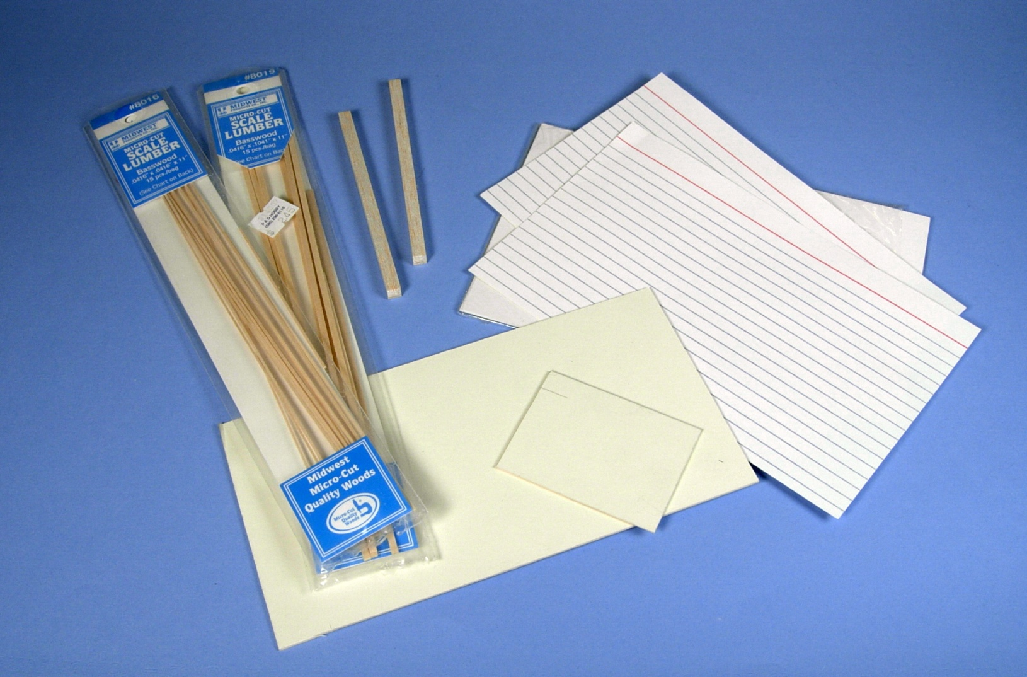
“Old Fashioned” Paper and Wood
“3 x 5” Cards
Standard Balsa and
Bass Stripwood
1/16” Mat Board

Slide 28
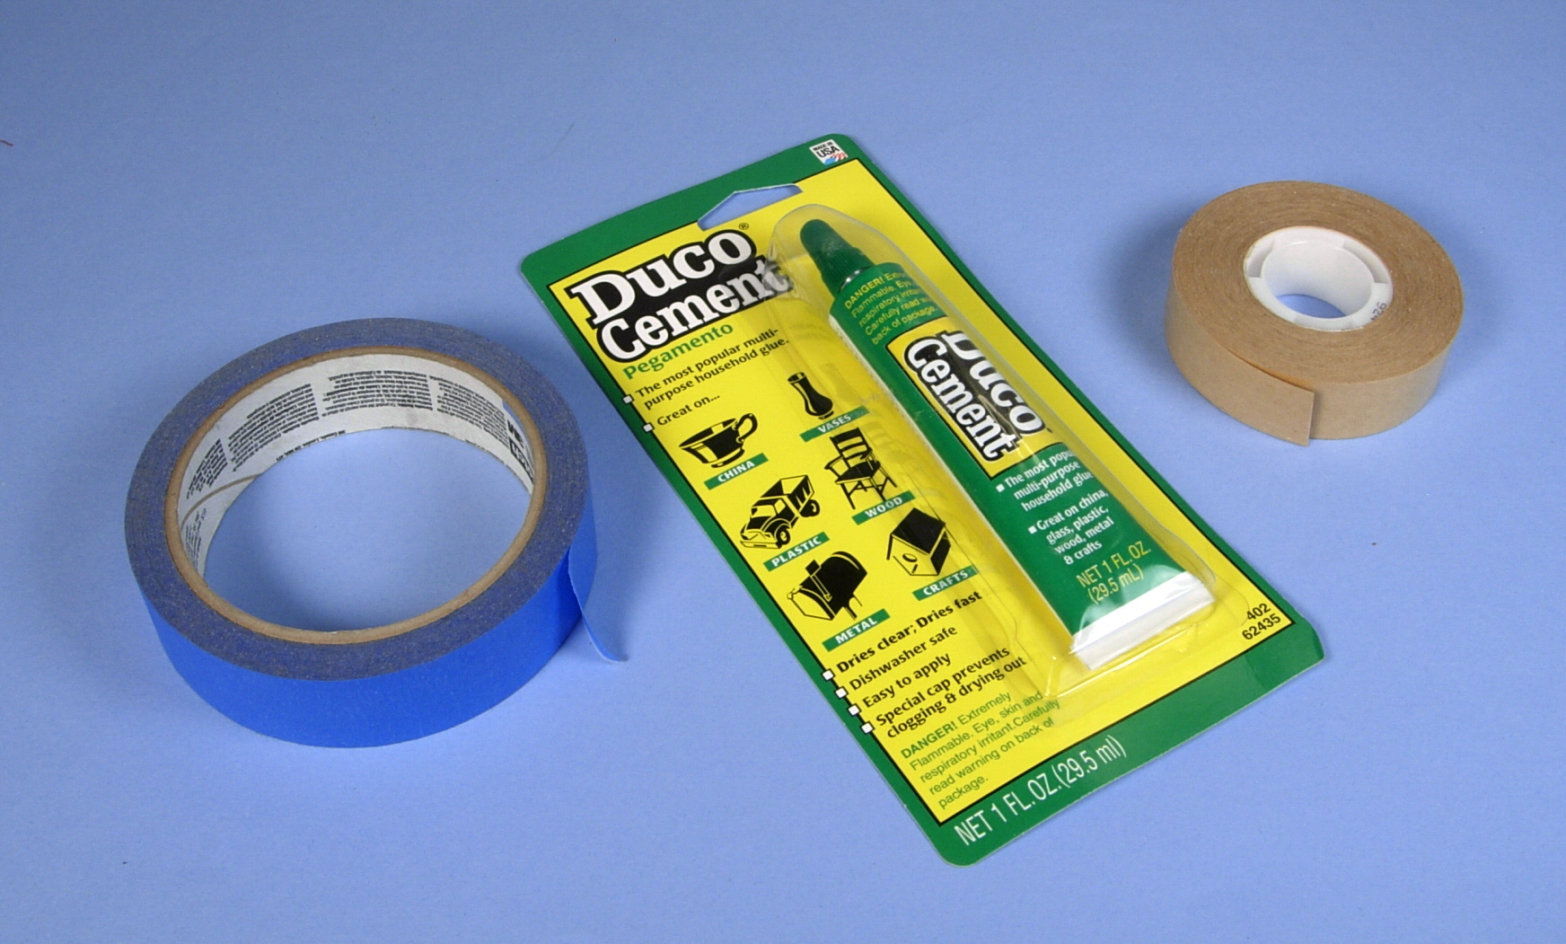
“Old Fashioned” Tape and Glue
3M Adhesive Transfer Tape
Adhesives
“Duco” Cement
“Blue Painter’s Tape”

Slide 29
OUTLINE
DESIGN
A. THREE BASIC “FORM Elements”
B. SIX BASIC “TEXTURE Elements”
CONSTRUCTION
C. Inexpensive MATERIALS
D. CONSTRUCTION Step by Step

Slide 30
D. CONSTRUCTION
Simple Office with 2 FORMS and all 6 TEXTURES
- Lap Siding - Batten Siding
- Shingles - Tarpaper
- Fascia Boards - Exposed Rafters

Slide 31
1. Lay out walls directly on Mat Board
Cut window and door openings to fit castings
Avoid centering windows or doors on walls for added interest

Slide 32
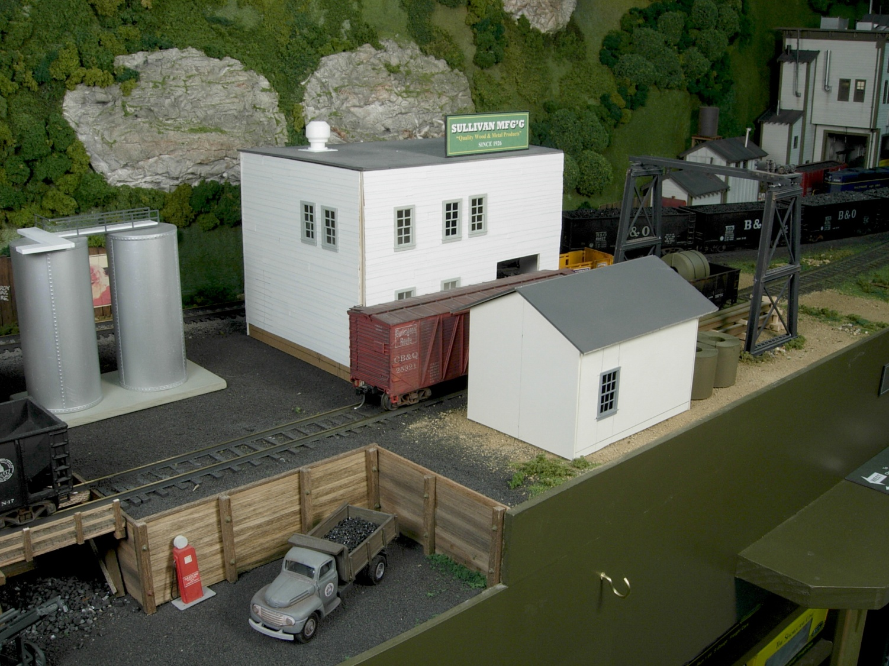
Cut out walls can be taped loosely together and placed on layout to confirm size, etc.
Roofs painted black

Slide 33
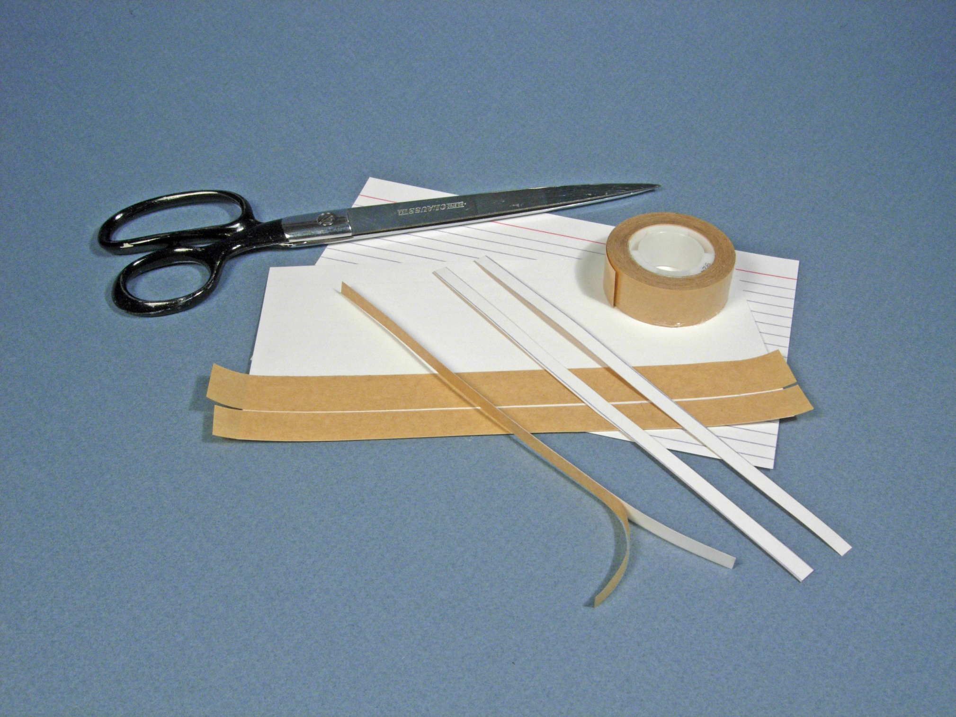
Making Lap Siding
2. Apply adhesive transfer tape to back of cards
3. Cut card stock in to strips about 1/4 “ wide

Slide 34
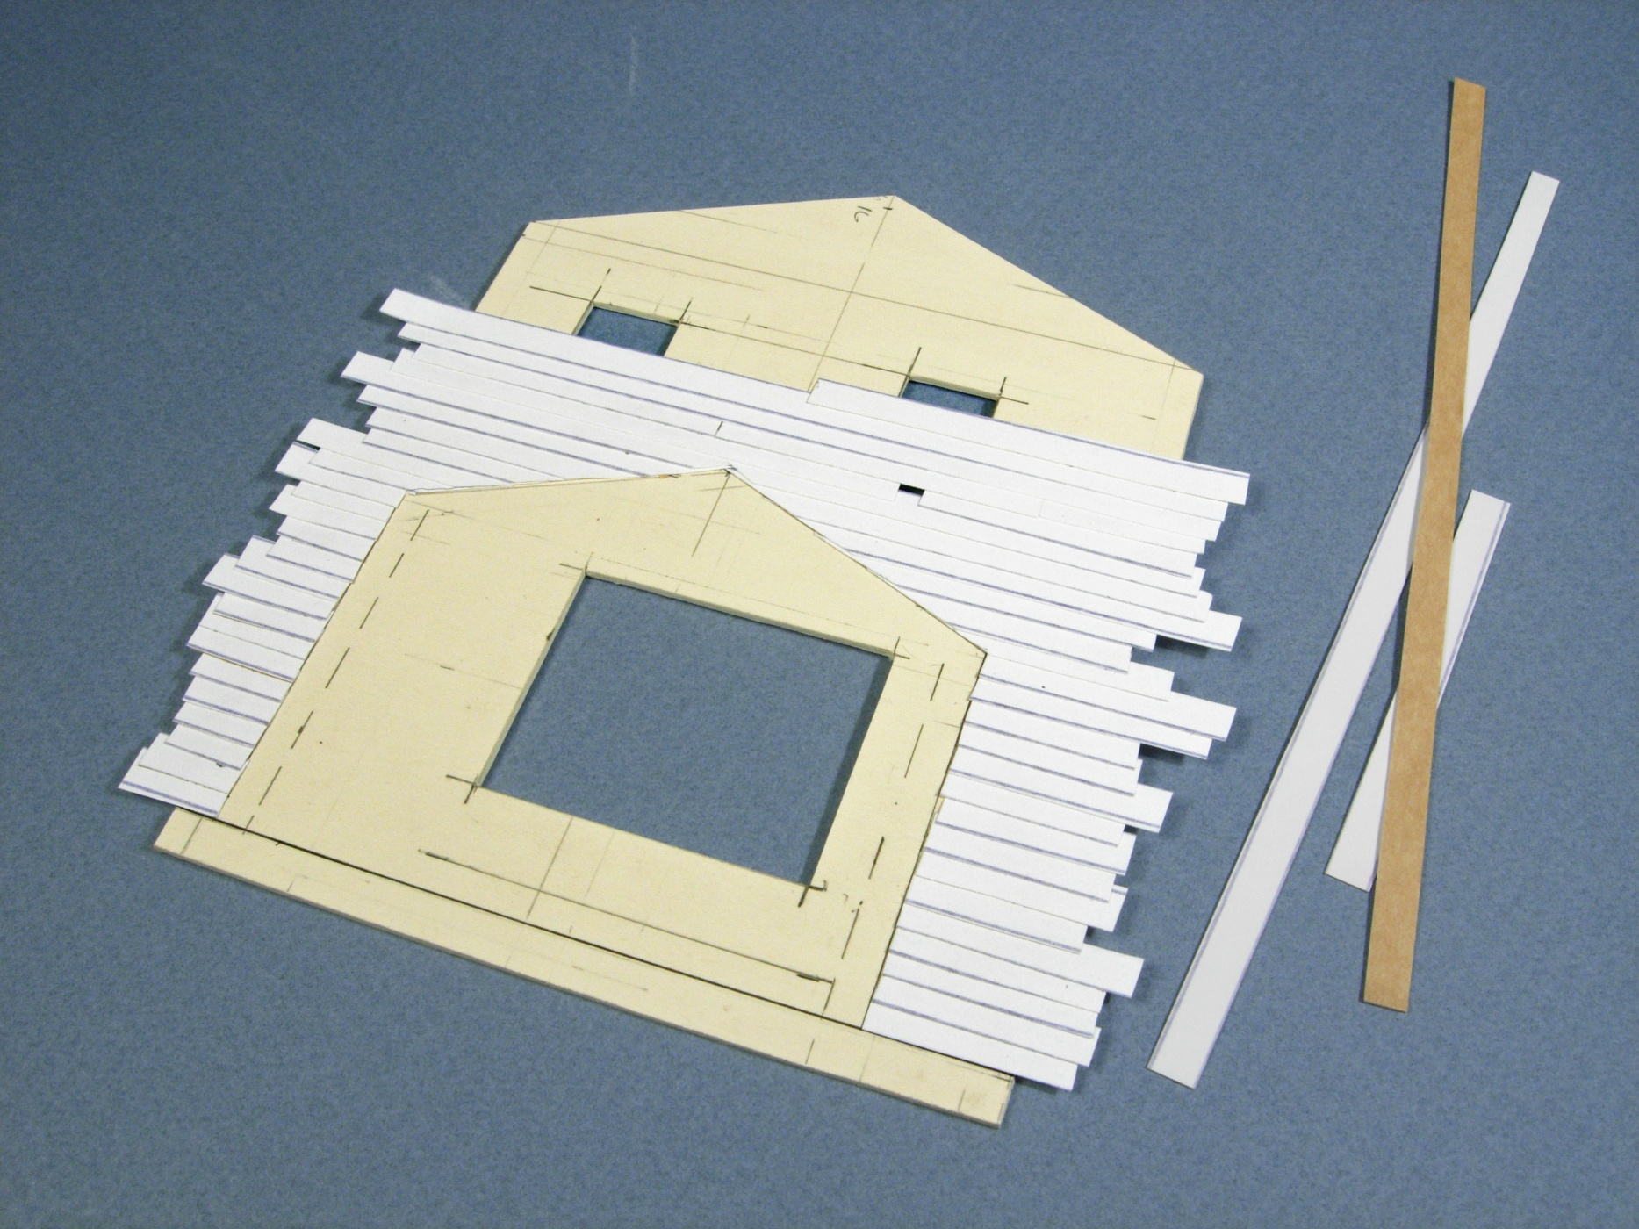
Cover window openings
Interior wall of adjoining form
4. Start at foundation line and apply ‘peel and stick’ strips, overlapping to obtain desired ‘board size’.

Slide 35
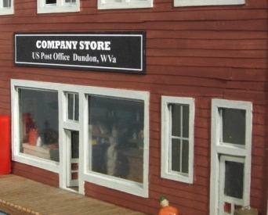
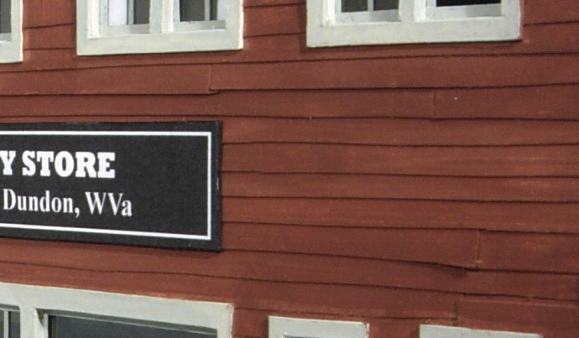
Cutting and applying siding irregularly creates look of aging building. Painted paper looks naturally weathered.

Slide 36
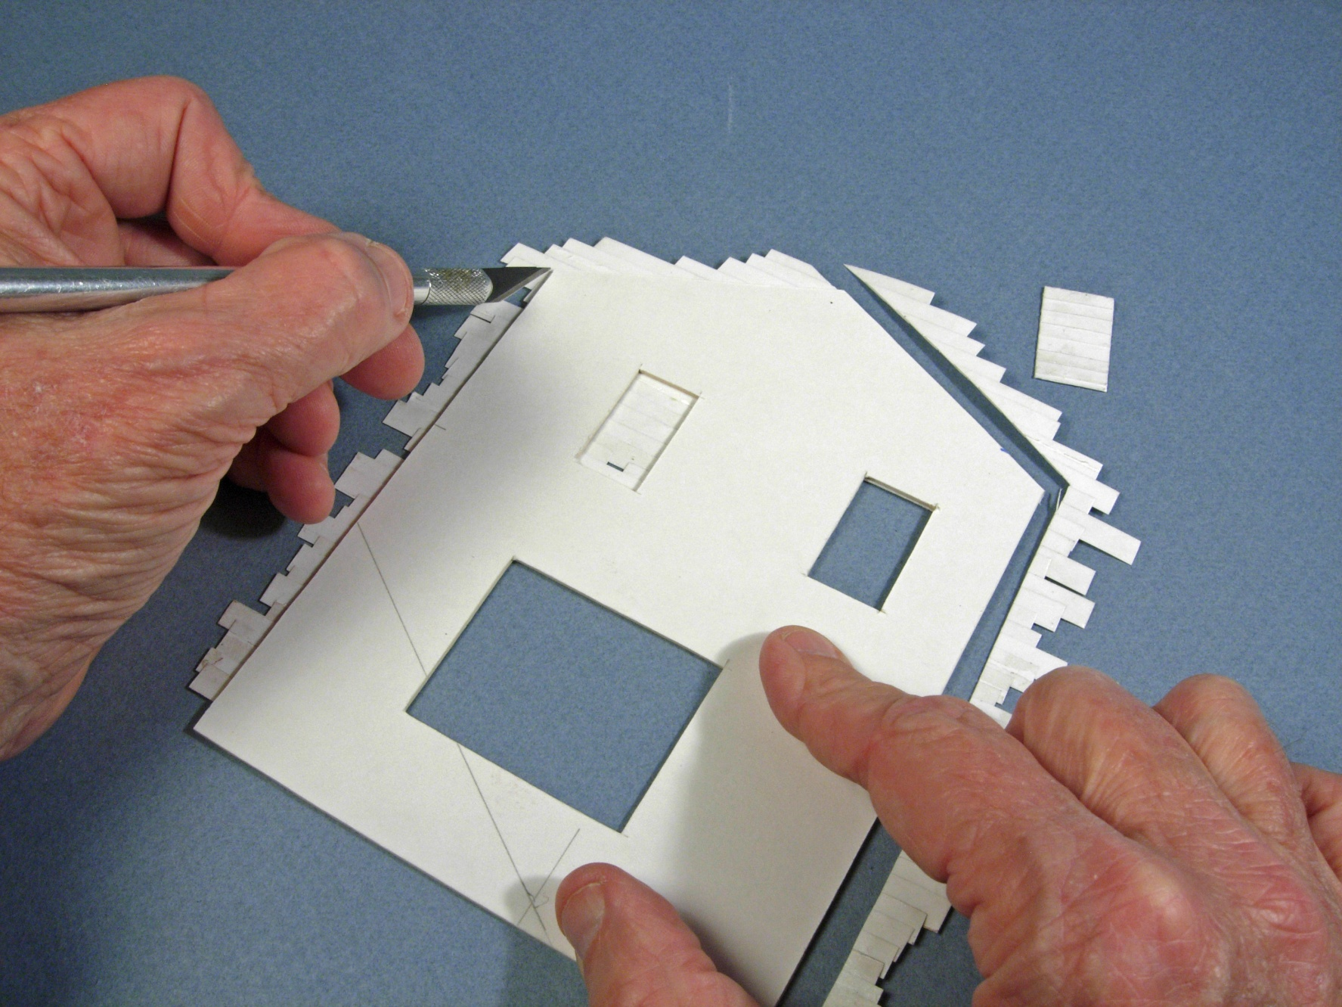
5. Turn wall over, trim edges and cut out windows

Slide 37
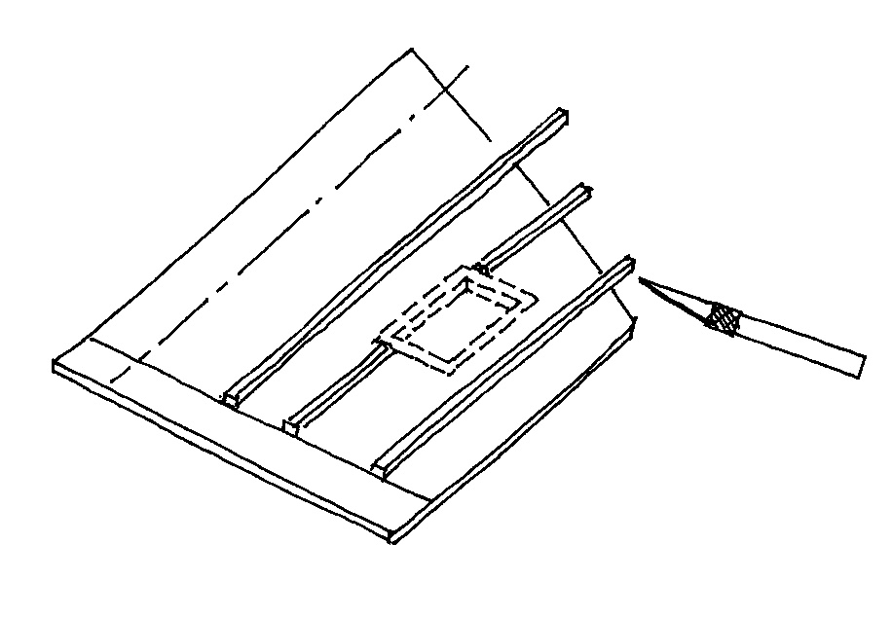
6. Applying Battens
Making Batten Siding
- Use strip wood for battens
- Leave clearance for window frames
- Trim after gluing
* Making own batten siding allows flexibility in spacing
* Batten construction even on larger buildings

Slide 38
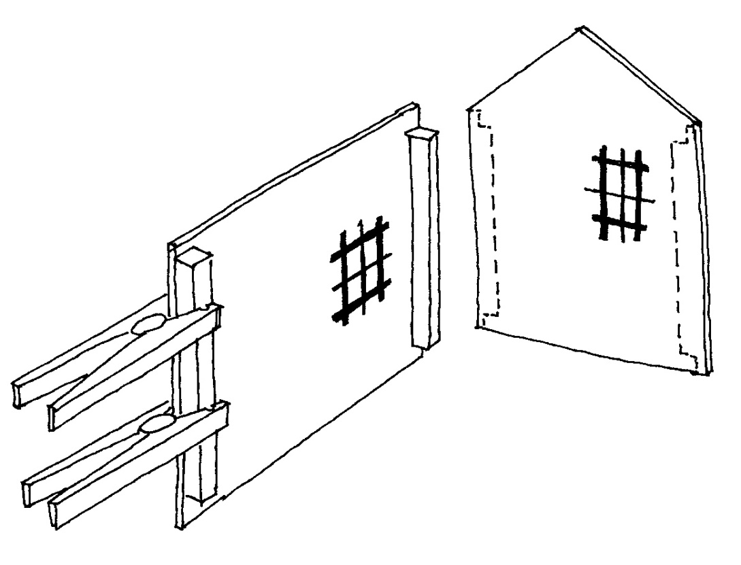
7 - 8. Install Corner ‘Braces” and Reinforce walls
a. Use 1/4” square balsa for corner joints
b. Reinforce large walls with additional 1/4” square balsa
* Fits at joints are not critical

Slide 39
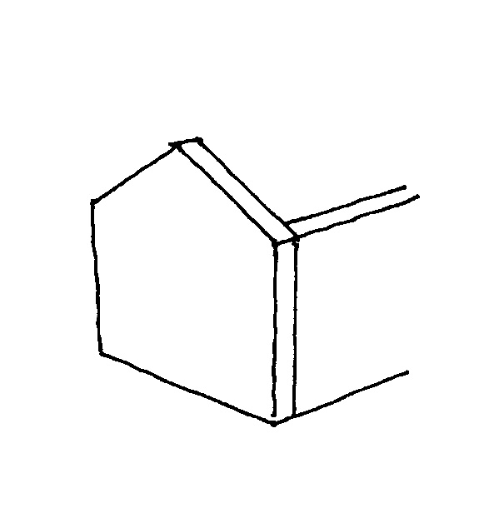
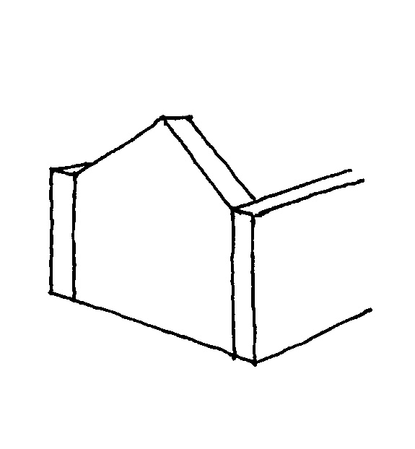
9 -10. Assemble walls together
This…
c. Be sure side walls fit INSIDE end walls
NOT this…
* Use gluing fixture to assure square corners

Slide 40
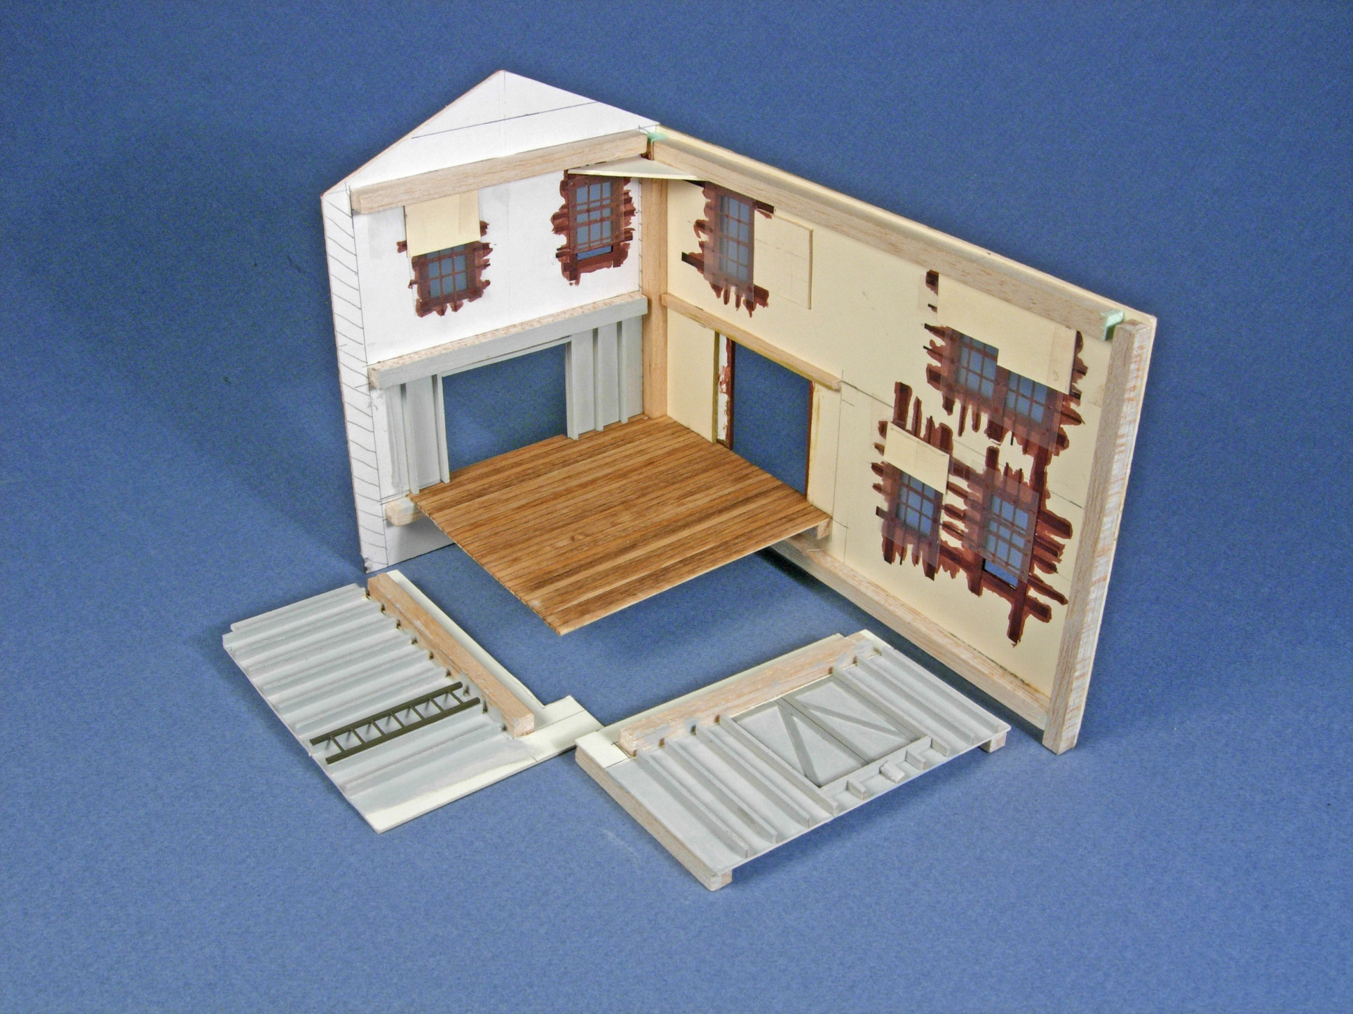
Interior walls use same basic techniques
Corner reinforcement
* Windows made from micro-tape
Mat board interior walls
Square wood bracing

Slide 41
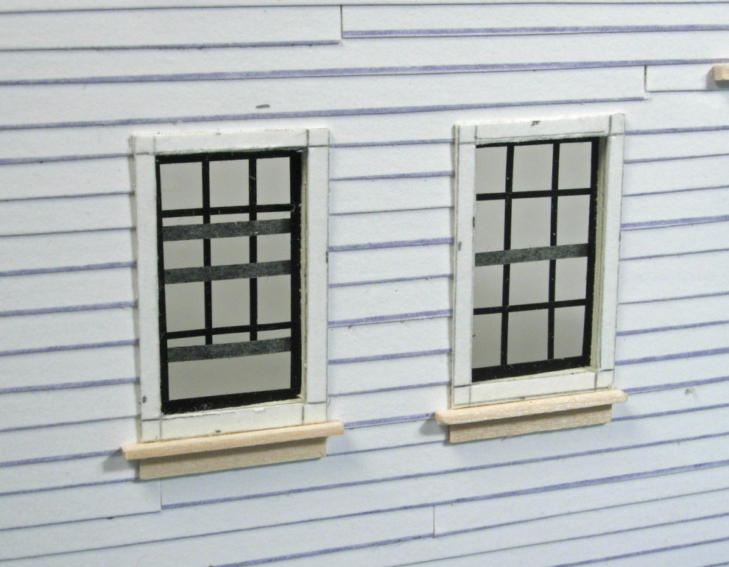
1
2
Scratchbuilding Windows
Chart Pak brand micro Tape
3

Slide 42
11. Final Assembly and Trim
Prepaint then install corner trim
Install windows

Slide 43
12-13. Roof and Roof Trim
a. Glue triangular pieces cut in first step to form roof
b. Add fascia board using strip wood
c. Apply roofing material and ridge beam of 1/16” square balsa

Slide 44
14 - 15. Roof and Roof Trim (con’t)
d. Make exposed rafters from small pieces of strip wood, typically 1/16 x 1/8” on scale 16” centers.

Slide 45
16-17. Roof Details & Porches
Add commercial roof details. Corrugated material makes great ‘patches’. Make porch roof from mat board with strip wood posts.

Slide 46
The FINISHED PRODUCT!

Slide 47
Cressmont Dairy

Slide 48
Widen Machine Shops

Slide 49
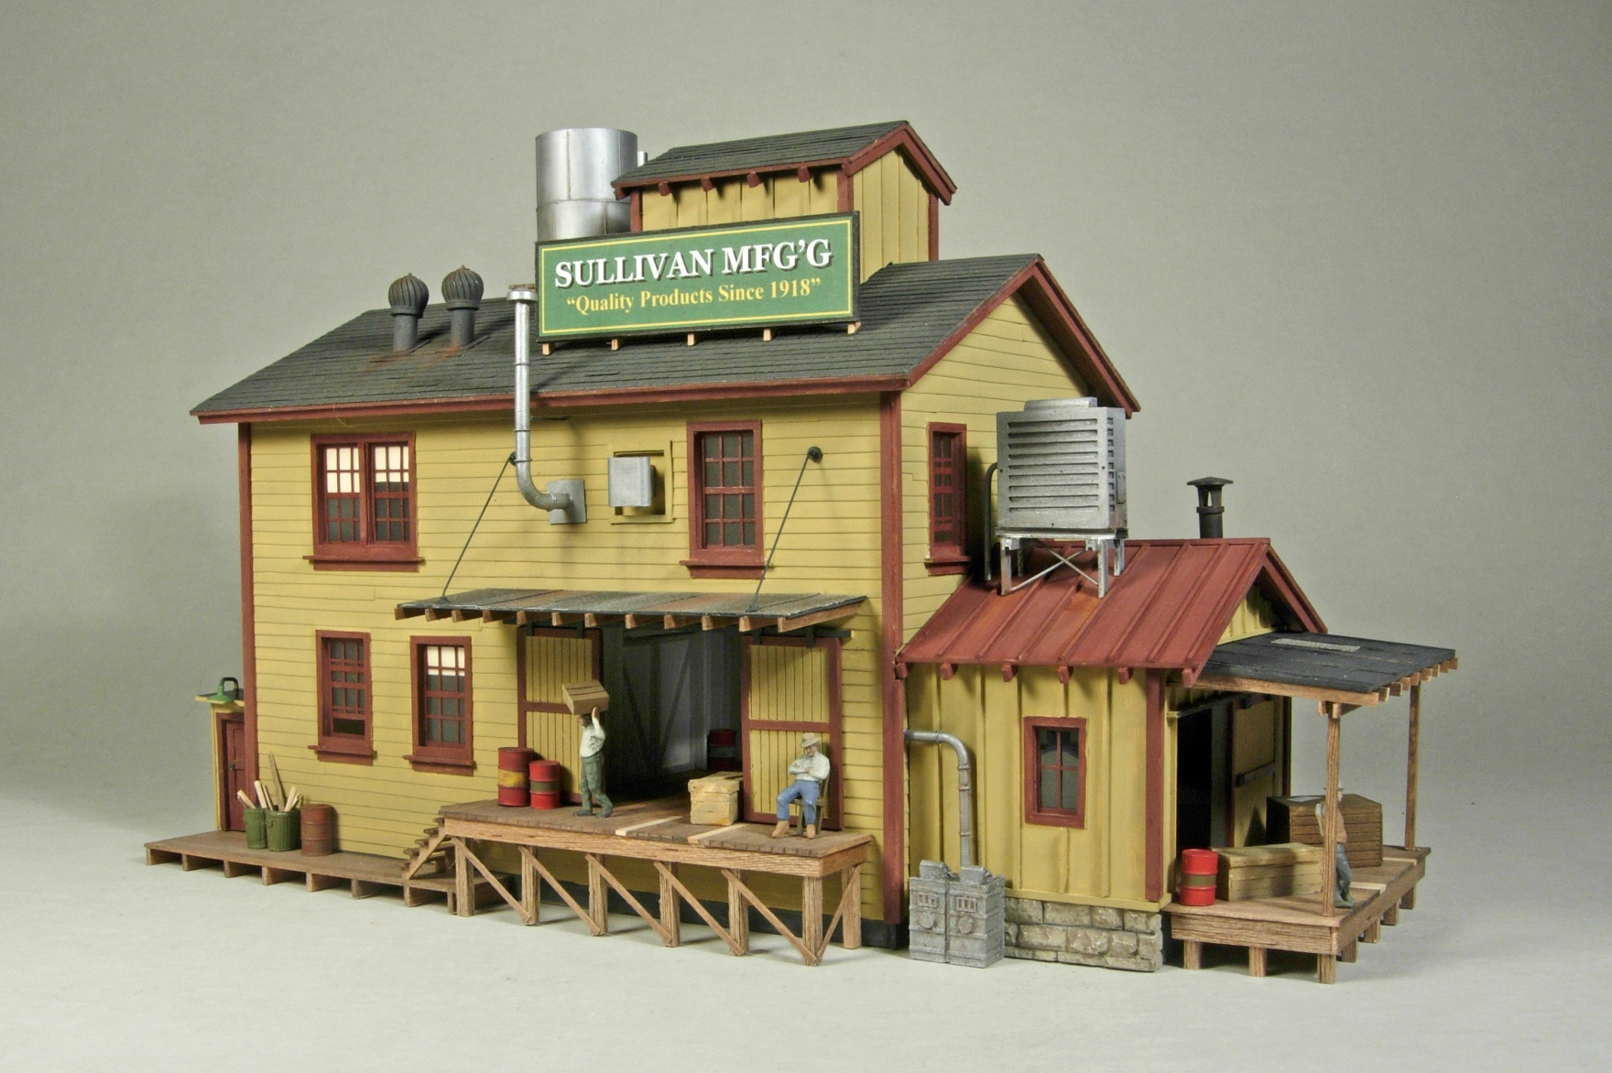
Sullivan Manufacturing
Model Railroader May 2013

Slide 50
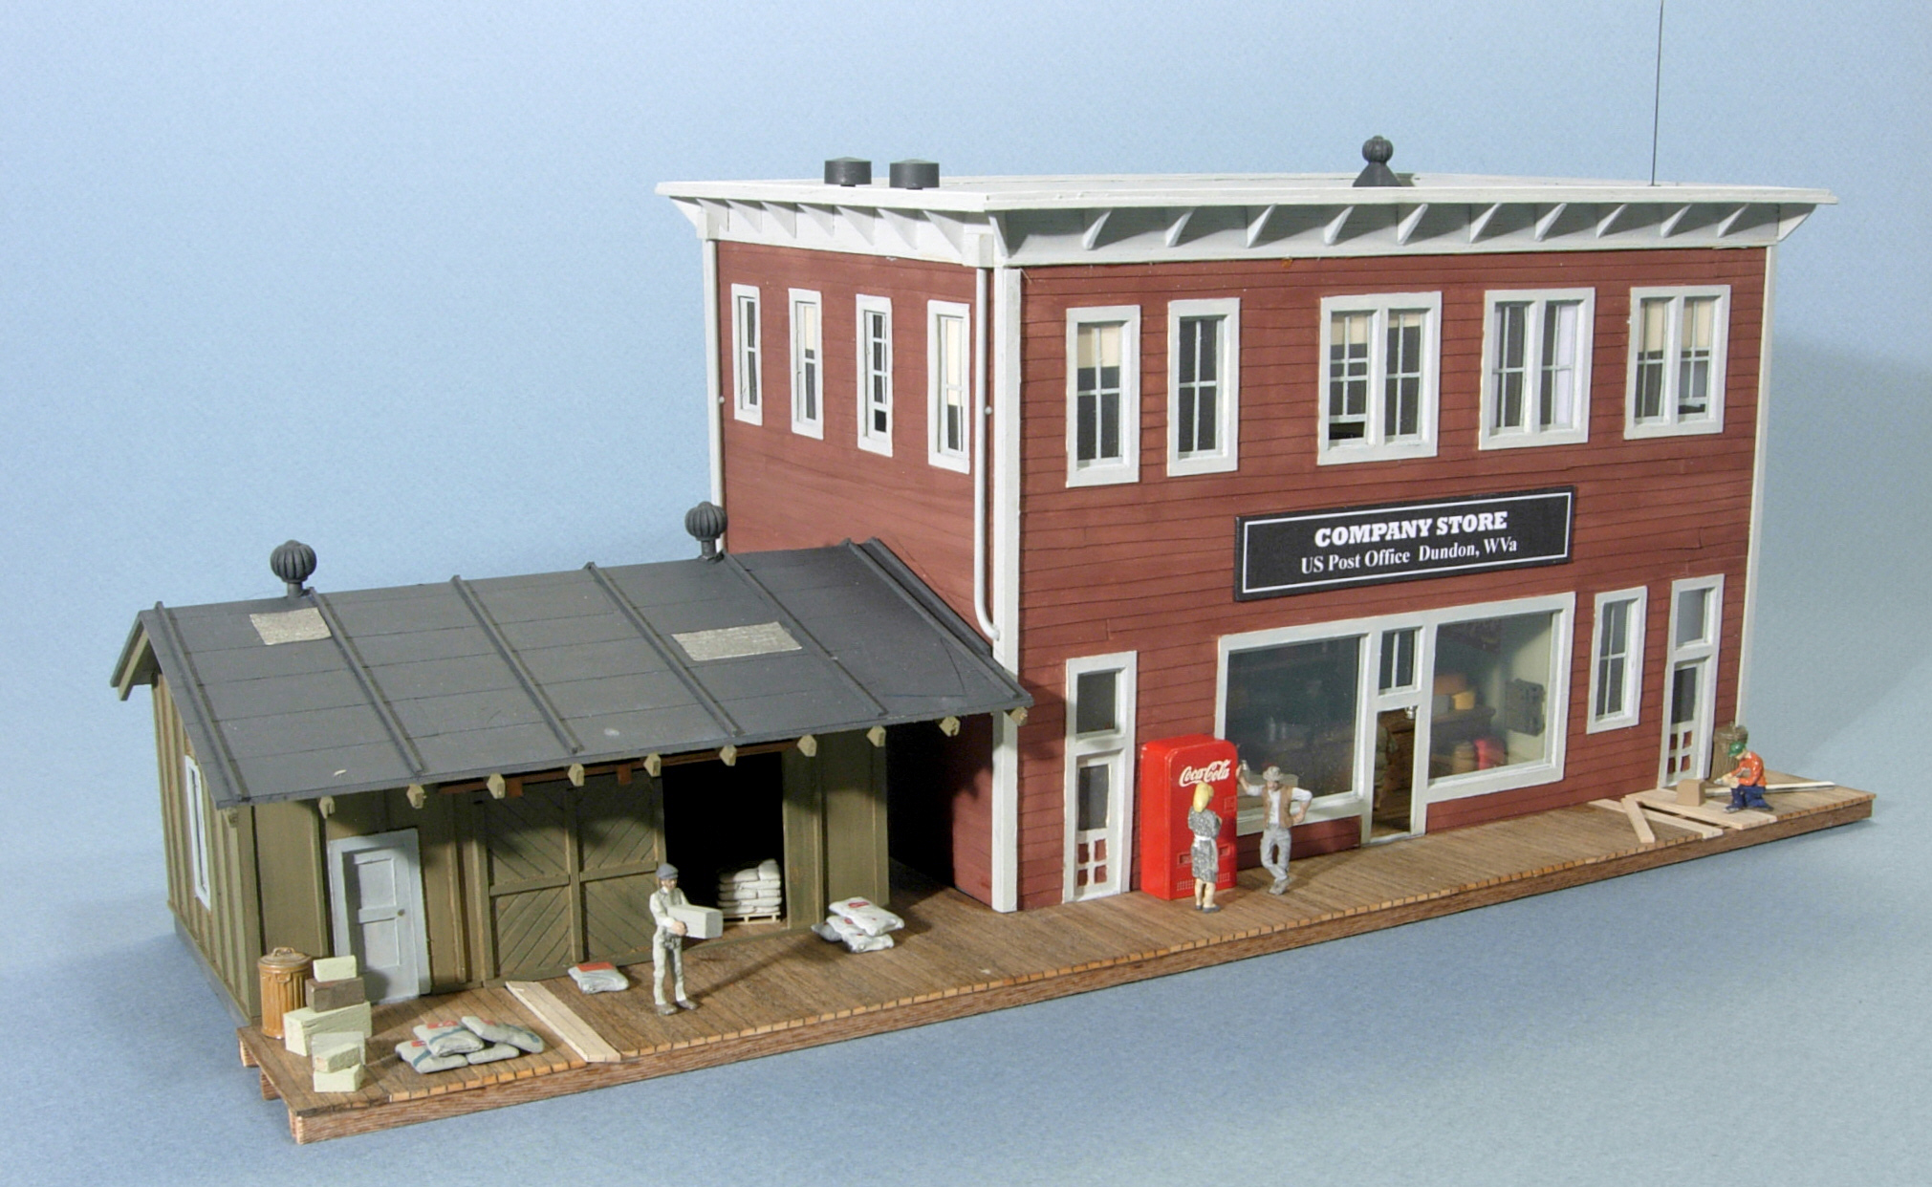
Dundon Company Store & Feed Storage Building

Slide 51
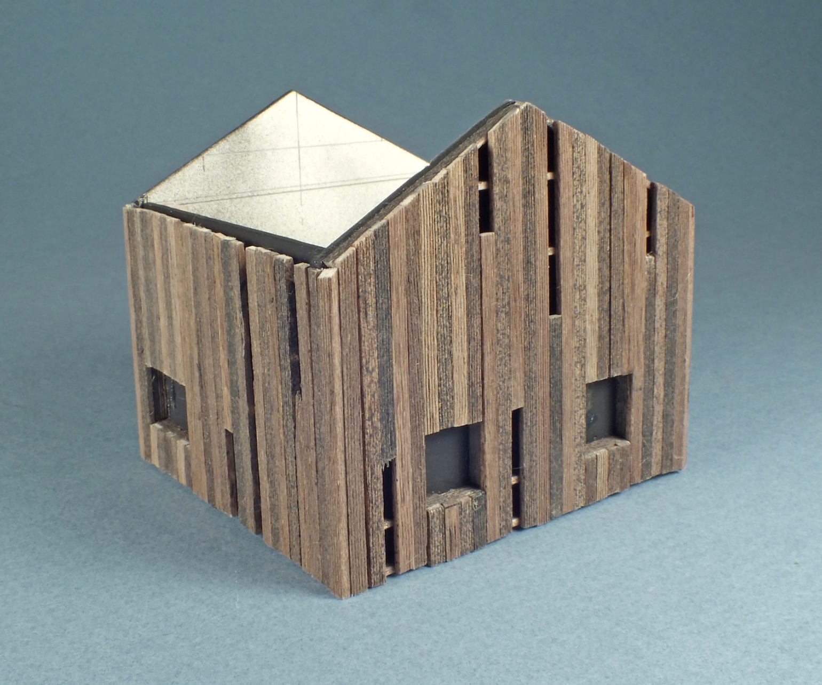
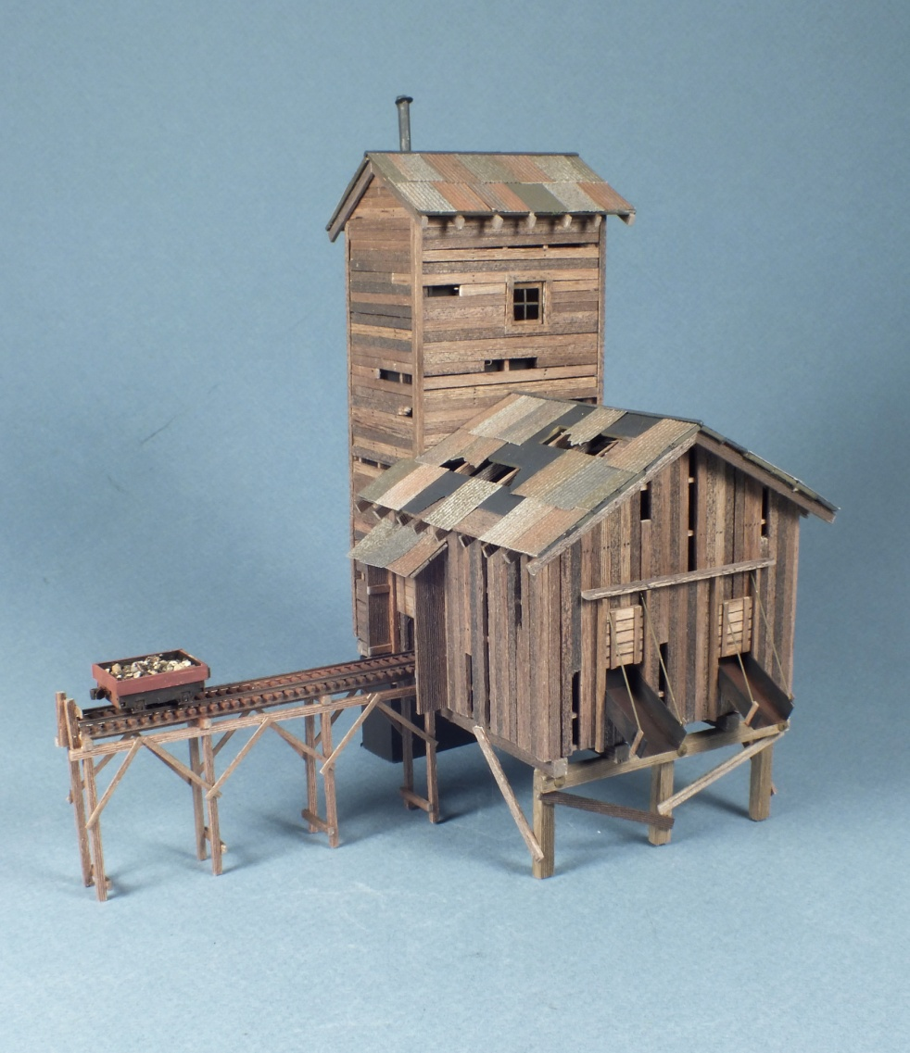
Board by Board
Abandoned Mine

Slide 52
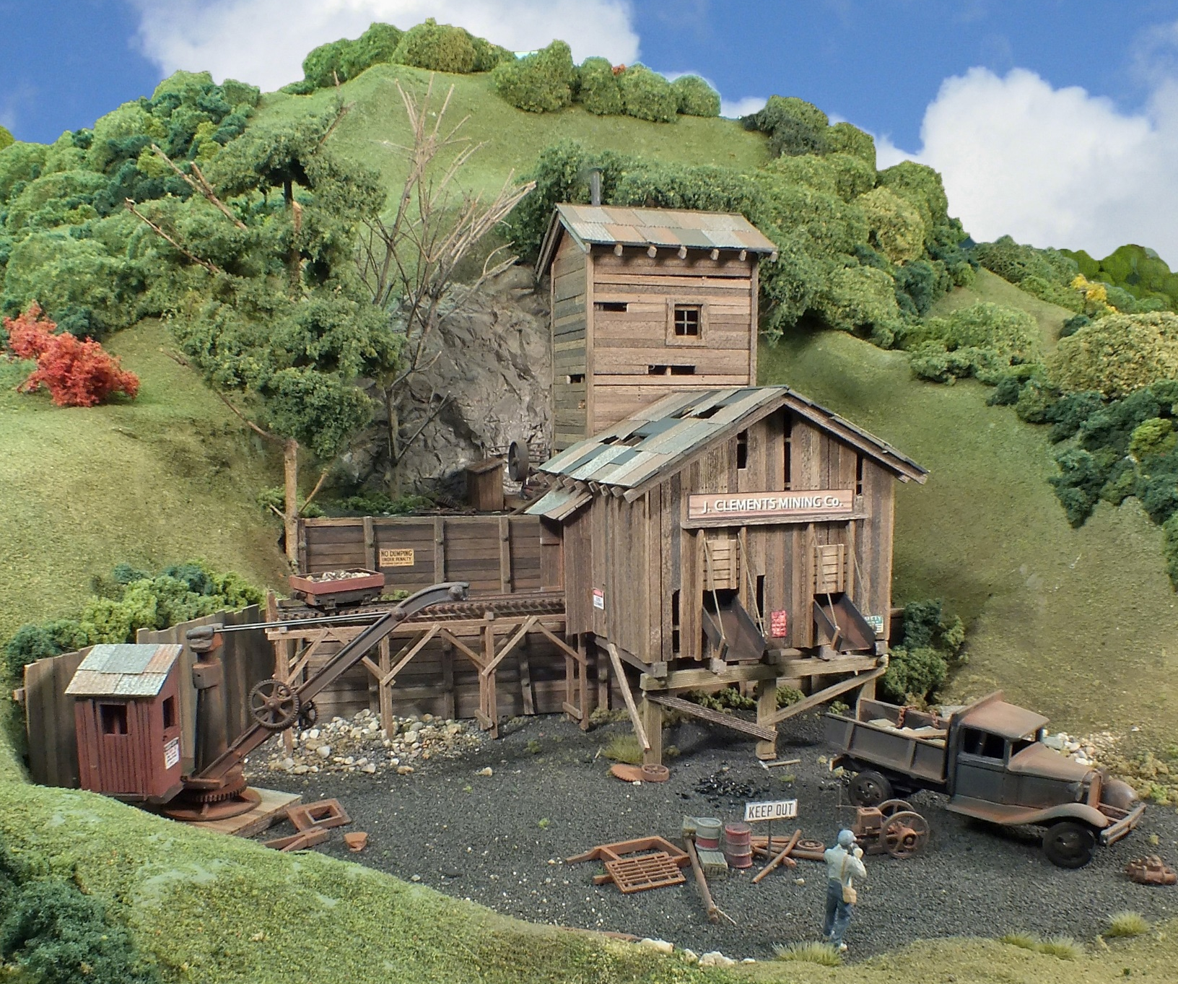
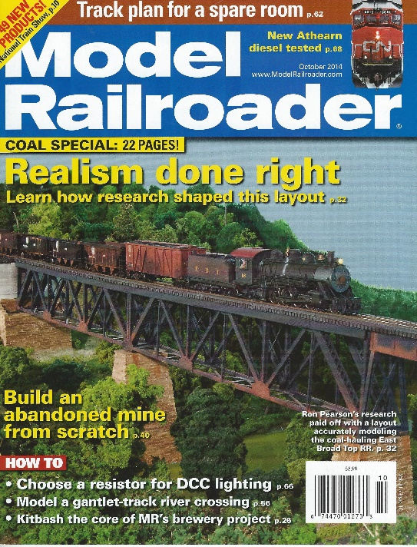
MODEL RAILROADER Oct. 2014
Clement’s Mining Company

Slide 53
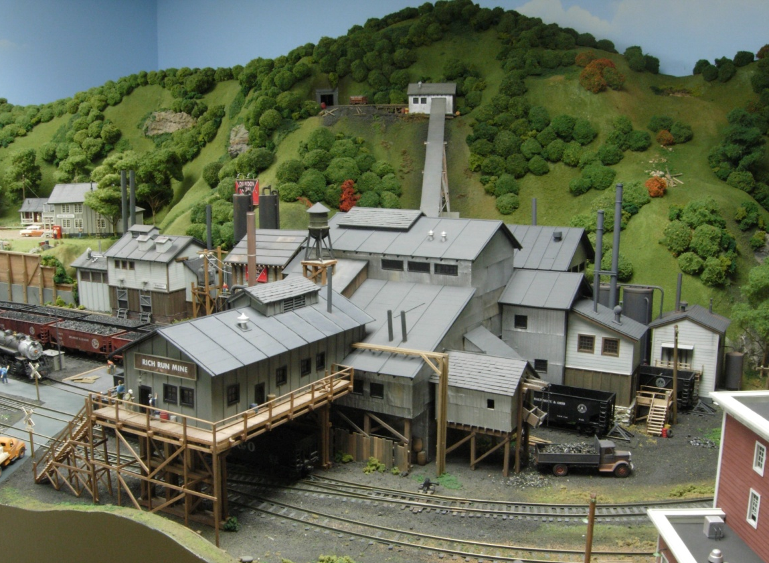
Rich Run Mine

Slide 54
SUMMARY
Most wood-frame structures can be built from just THREE BASIC FORMS.
Visual variety and interest can be added by varying the SIDING construction, ROOFING materials and EAVE details
PAPER products and WOOD are inexpensive yet make durable models.
There’s great satisfaction from having a structure you built yourself on your layout!
THREE BASIC “FORM Elements”
- Shed, Pitched and Flat Roof
B. SIX BASIC “TEXTURE Elements”
- Lap Siding and Board & Batten
- Shingles and Tar Paper
- Exposed Rafters and Fascia Trim
C. “Old Fashioned” Paper Materials

Slide 55
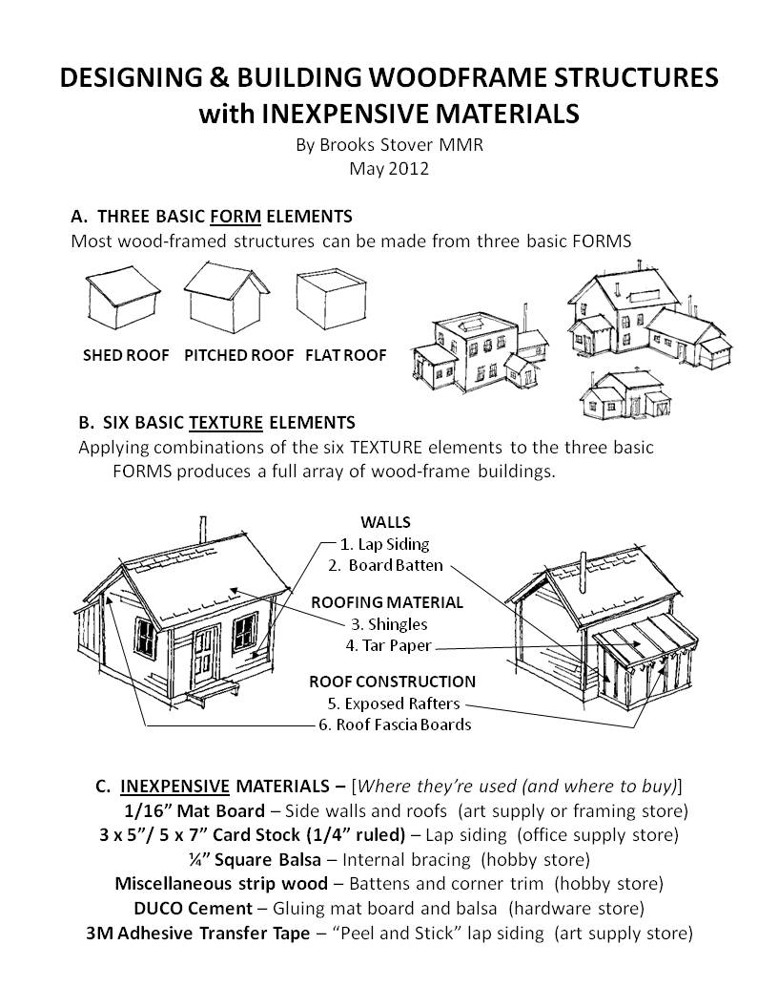
Clinic Handout

Slide 56
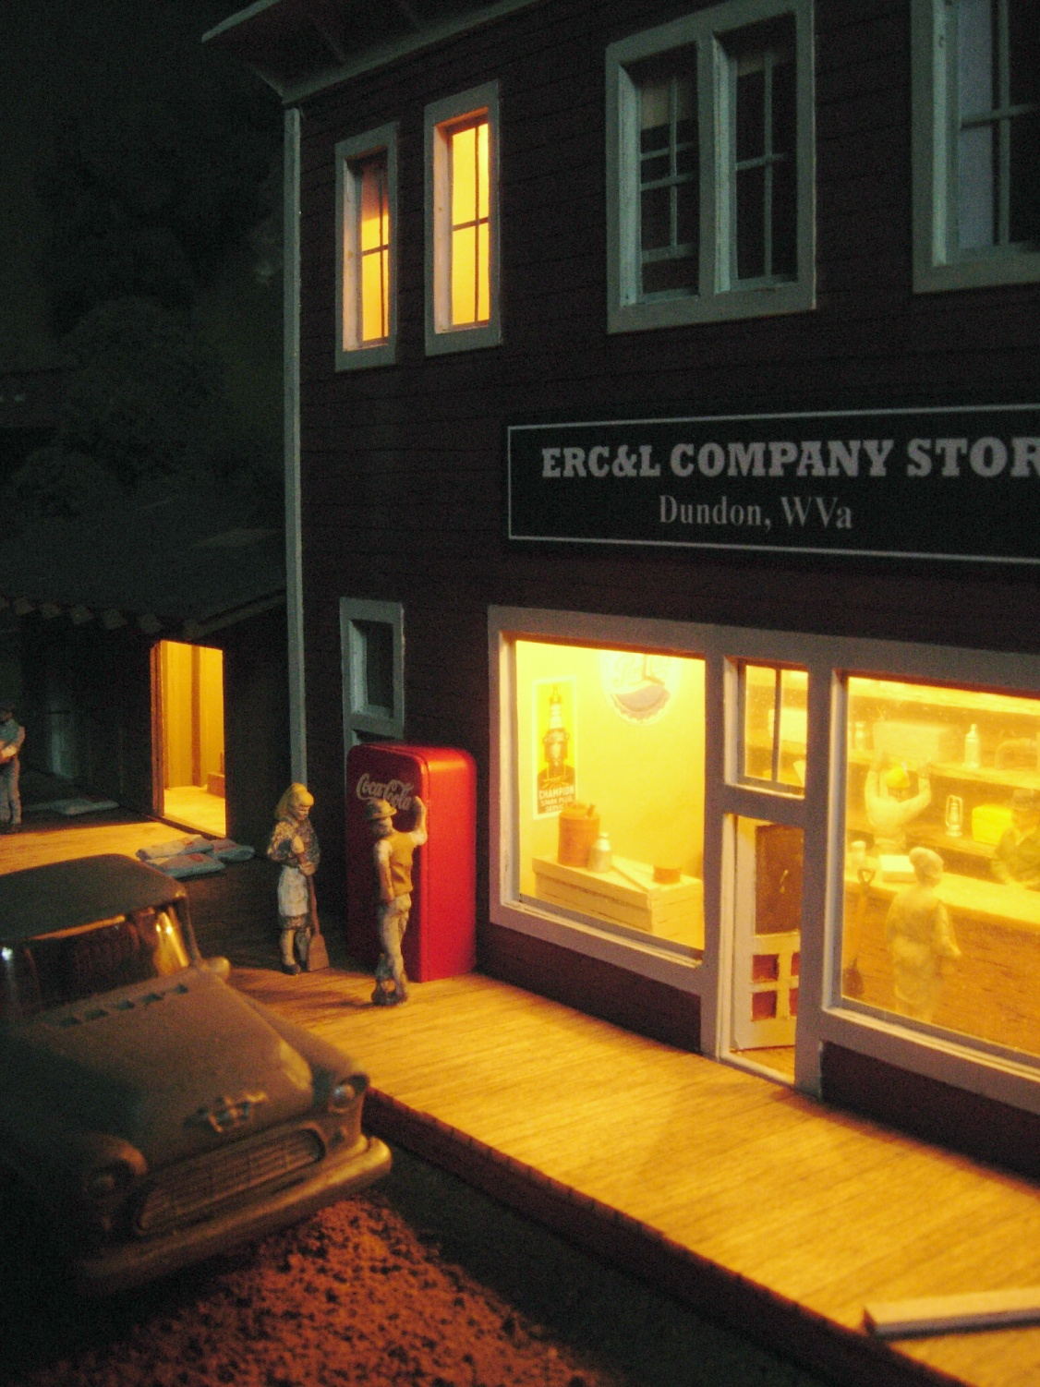
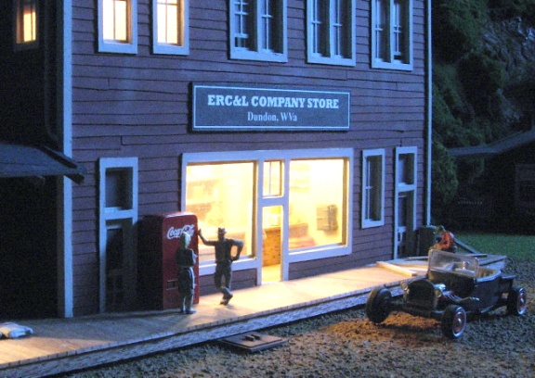
OPEN DISCUSSION

Slide 57

OPEN HOUSE
Friday 6 – 11 pm
Sunday Noon to 5 pm
Trick or Treat Snacks Available!

Slide 59
END

Slide 60

“MODELING THE BC&G”
Prototype Information
Modeling Philosophy
Complete Layout
Tour
Rolling Stock & Structures
Operating
Scheme
Scratchbuilding
Structures
Model
Photography
126 Pages, Full Color, Soft Cover

Slide 61
Making Lap Siding
Scrap paper
2. Apply adhesive transfer tape to back of cards
5 x 7 “ card
3. Cut card stock in to strips about 1/4 “ wide

Slide 62
“foundation”
4. Start at foundation line and apply ‘peel and stick’ strips, overlapping to obtain desired ‘board size’. Exaggerate ‘joints’.

Slide 63

5. Turn wall over, trim edges and cut out windows

