Slide 1
Adventures in Modular Railroading
Jim Martin and Andy Malette

Slide 2
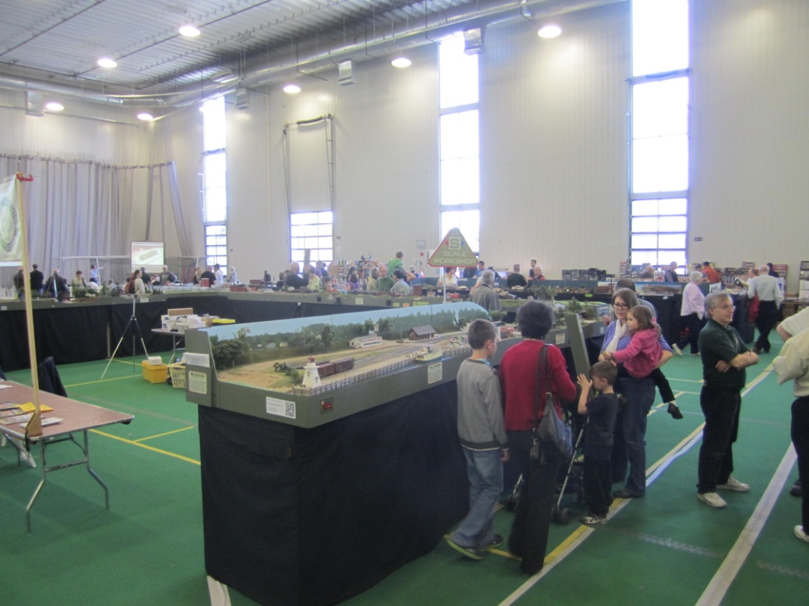
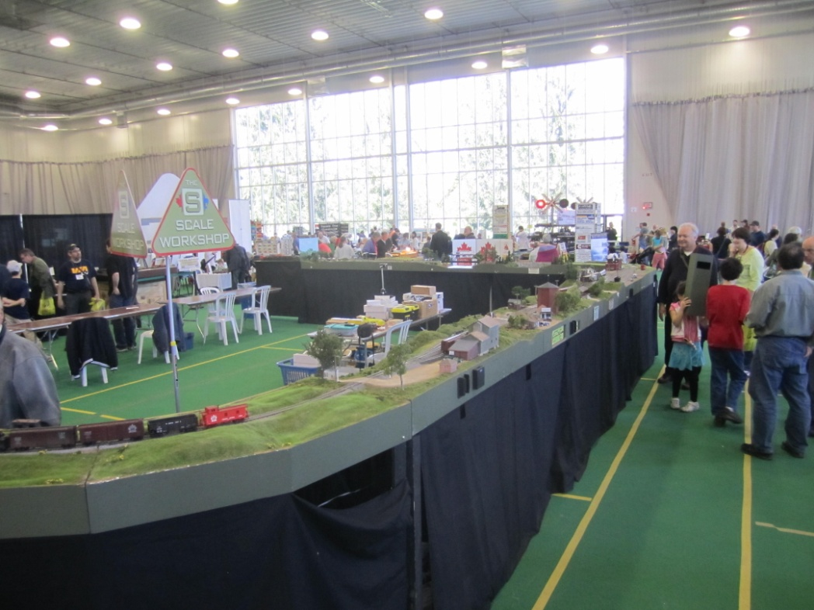
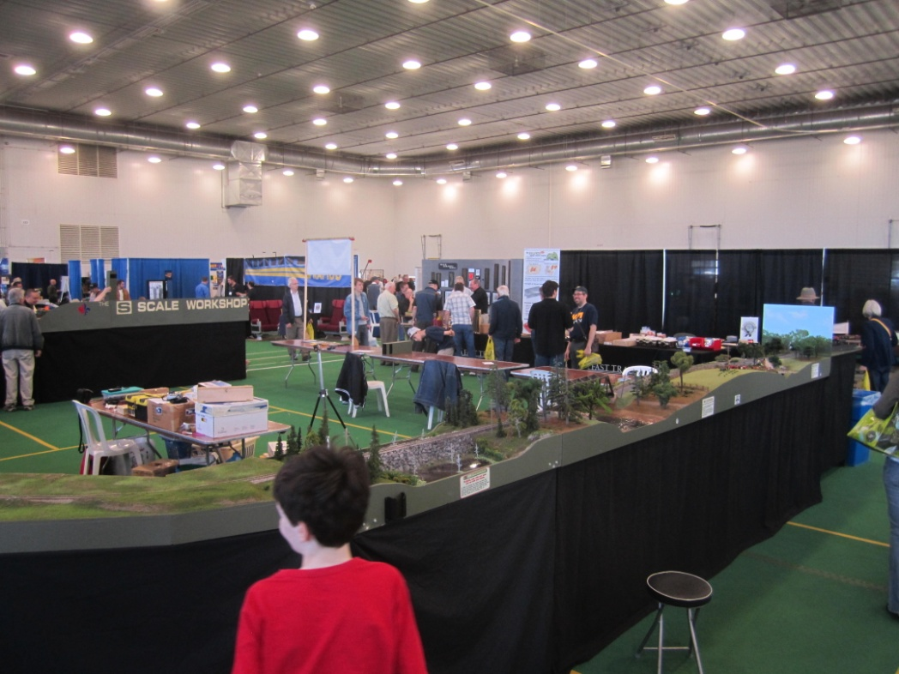
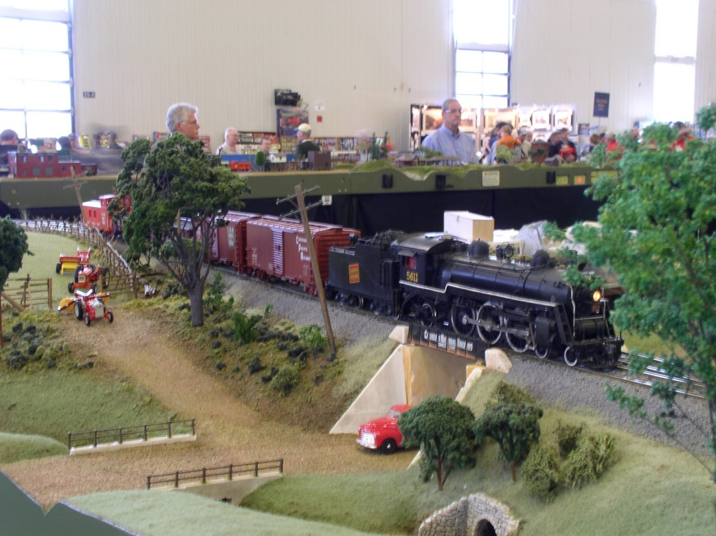
Notes:
These shots are of Ottawa Expo May 3, 2012 fade in.

Slide 3
Introduction
Members of the S Scale Workshop from Canada
9 members from various parts of Ontario and Quebec
Building, Transporting and Presenting Model Railway Modules
Mistakes
Lessons learned
Fun?

Slide 4
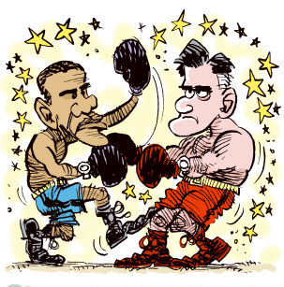

Group Structure
Club – bylaws good for large group structure.

Slide 5
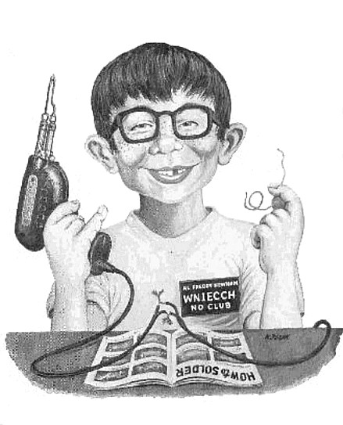
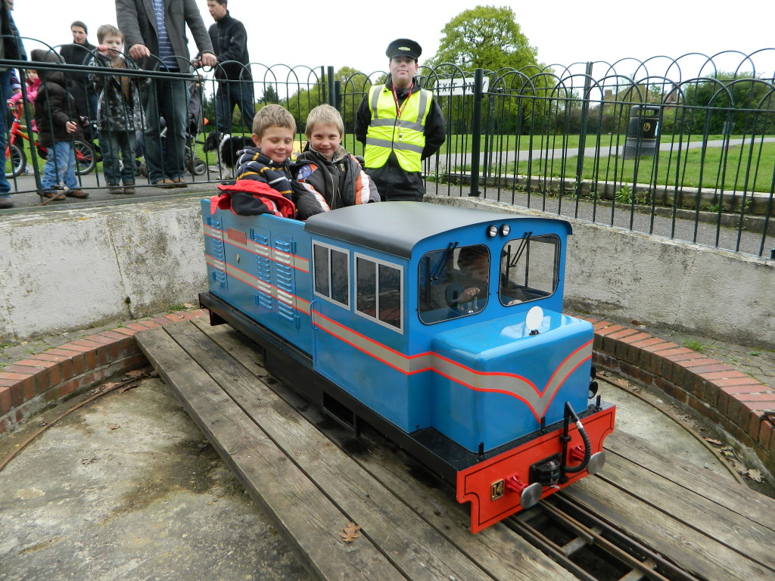
Group Structure
Informal – good for small groups
Choose members carefully

Slide 6
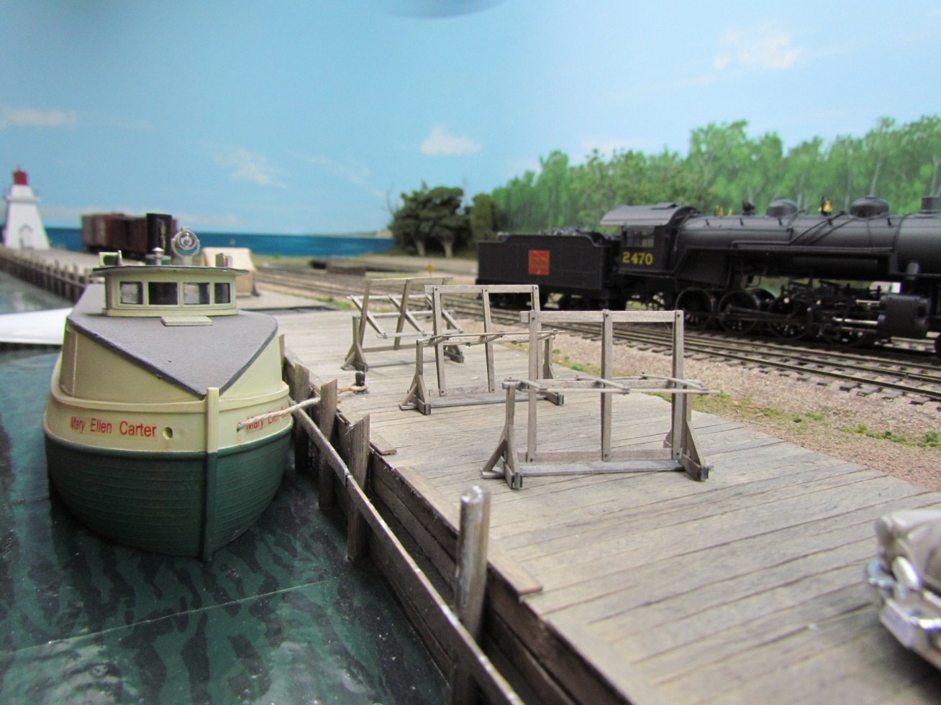
Establishing a Credo
What are the messages to be sent to the public?
Port Dover, Ontario 1956
Prototype Locale

Slide 7
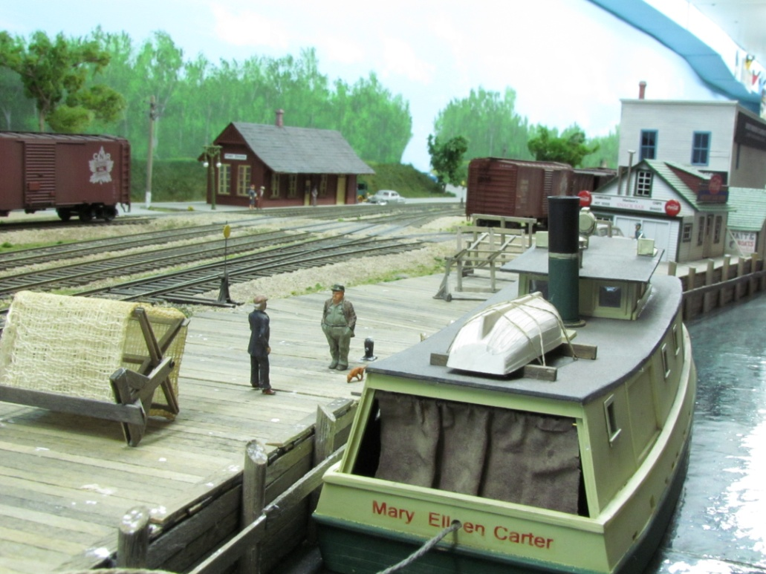
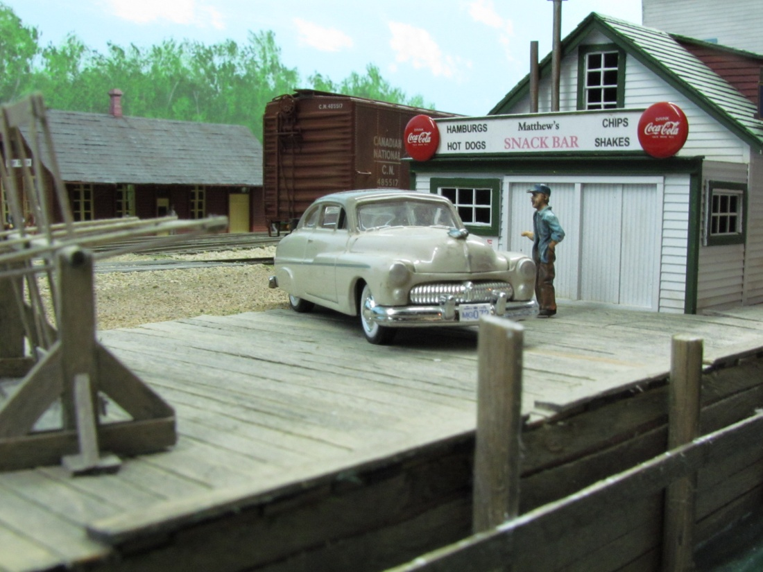
Port Dover, Ontario 1956
Prototype Locale
Notes:
Jim’s Historical Modules

Slide 8
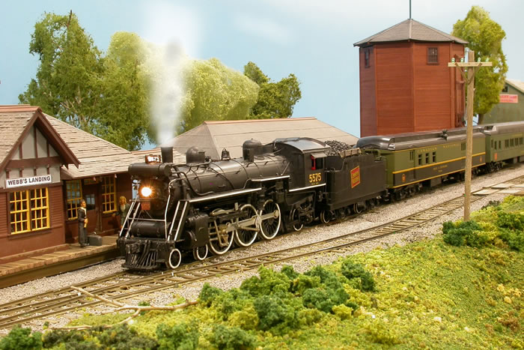
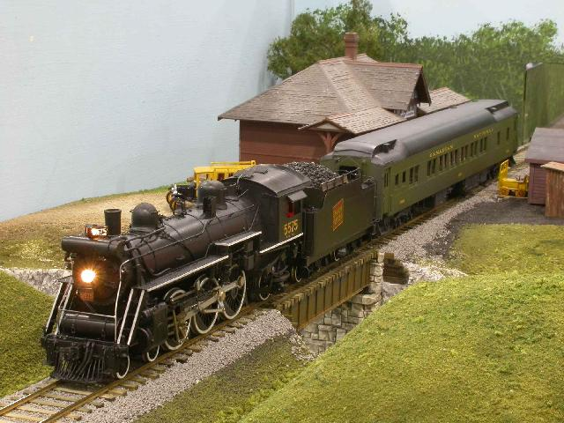
Webb’s Landing
Proto-freelanced Locale

Slide 9
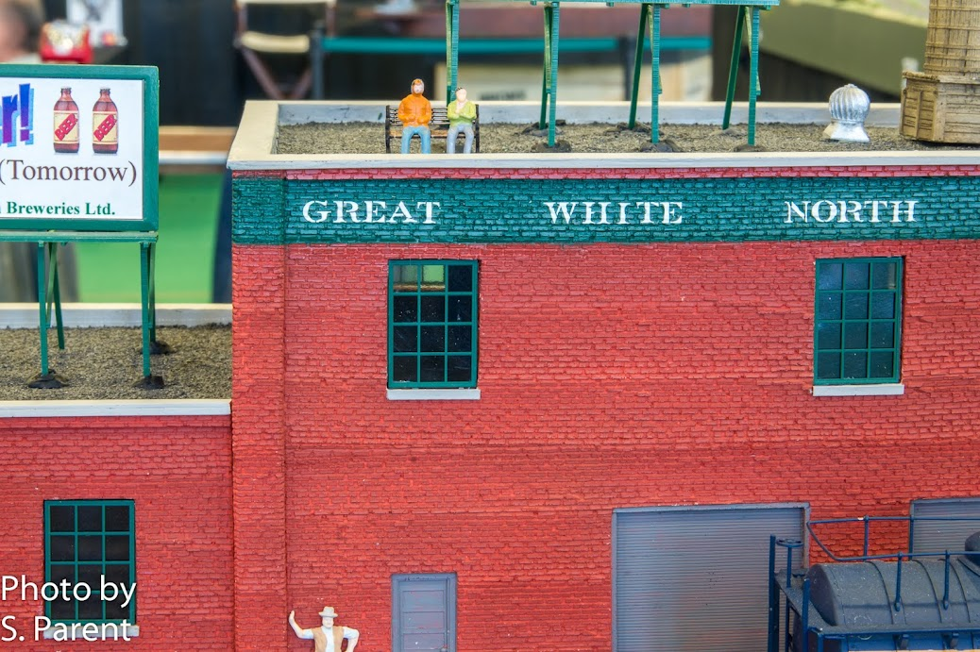
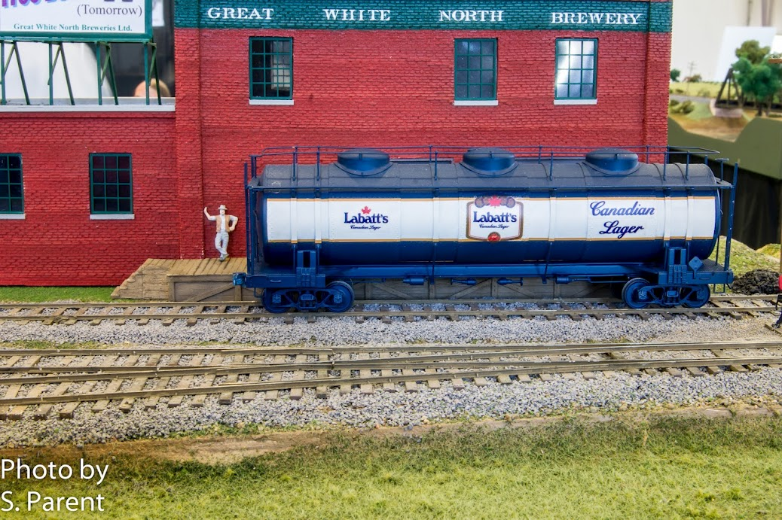
Great White North Brewery
Fantasy Industry and Fantasy Car

Slide 10
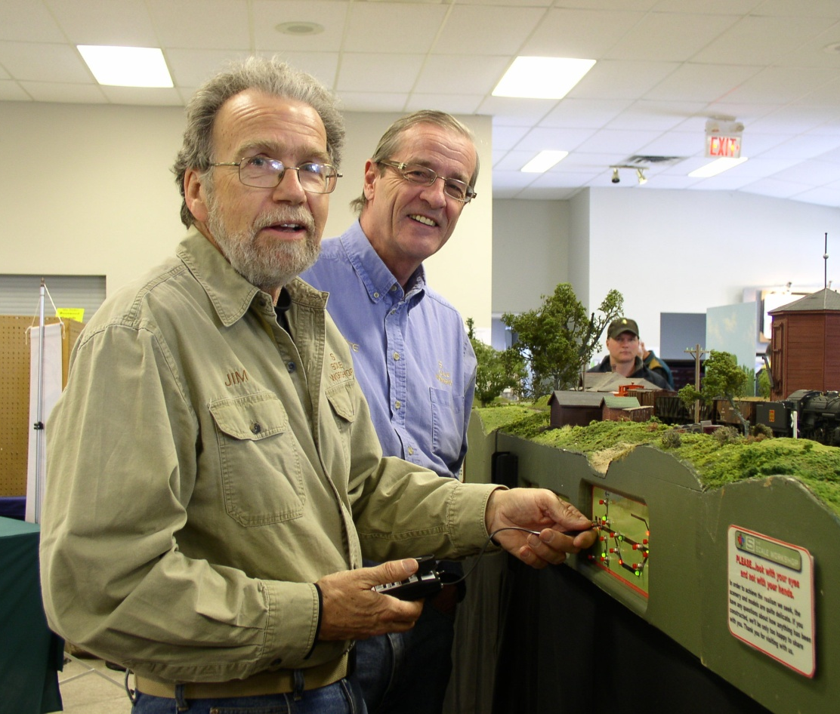
Who comes first?
Is it you?

Slide 11
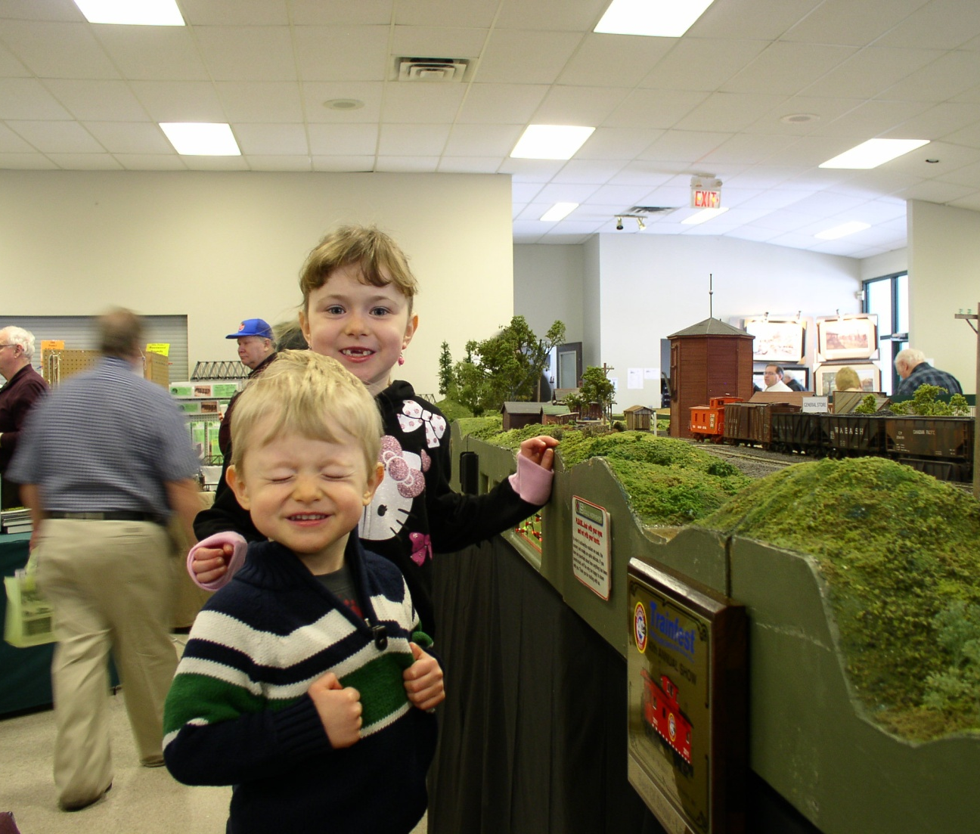
Or
The Public?

Slide 12
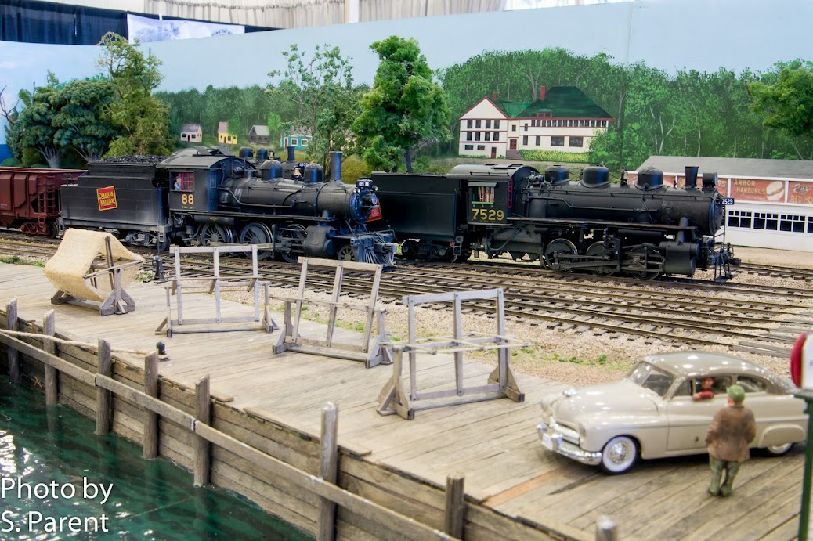
How Will the Trains Be Run?
Ops Session?

Slide 13
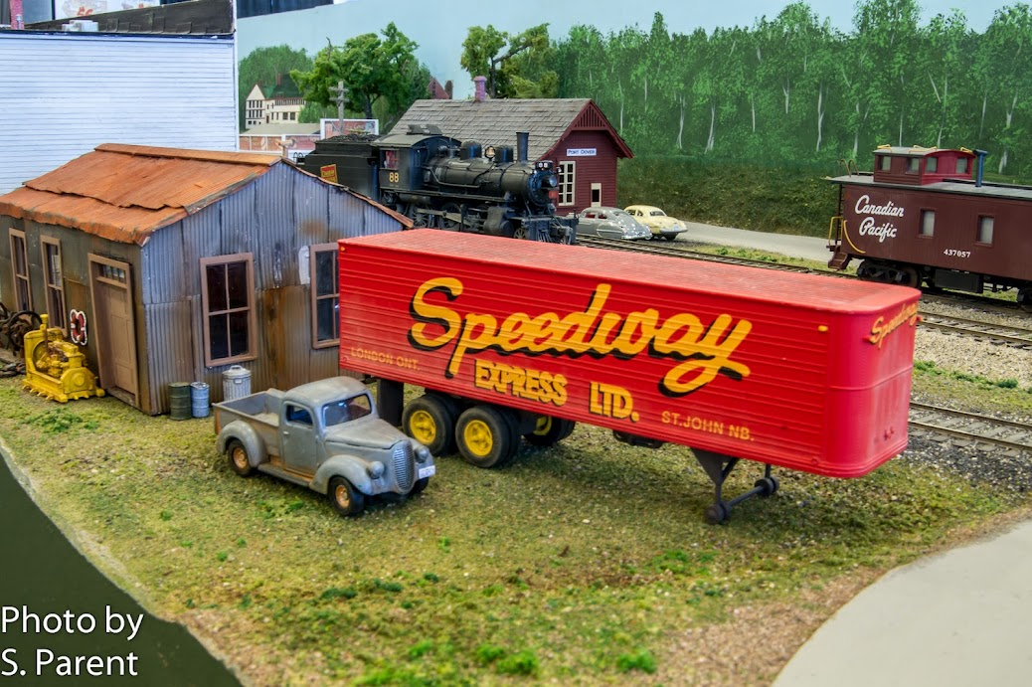
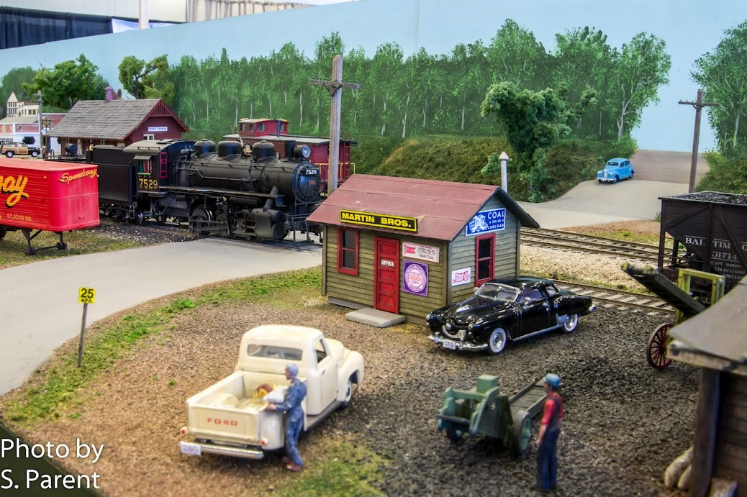
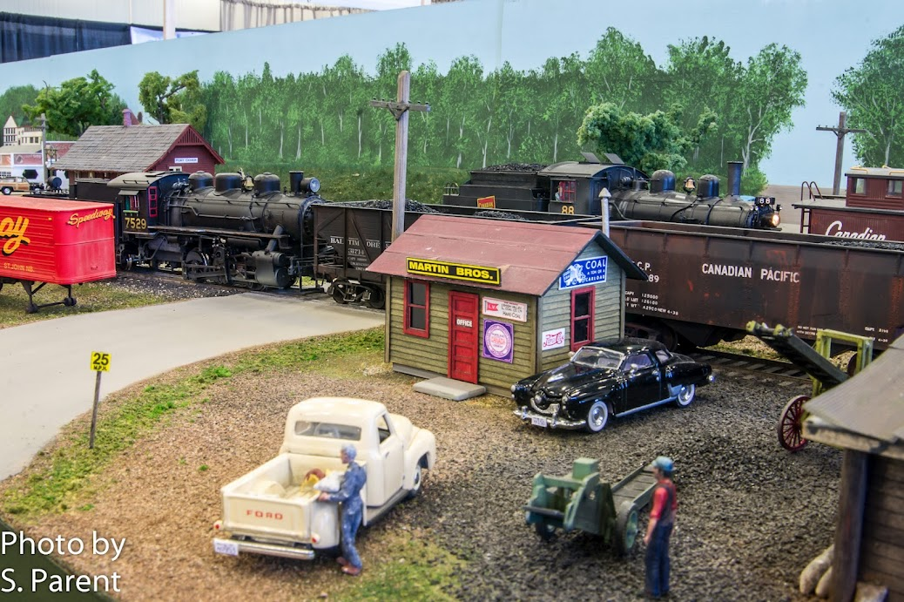

Slide 14

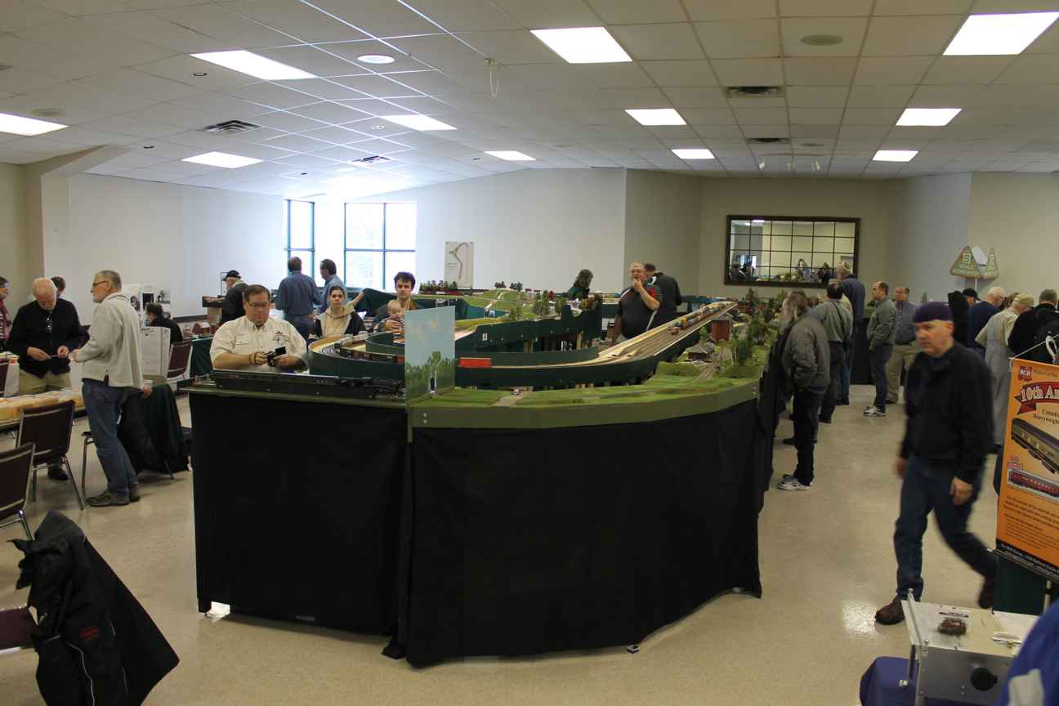
Operational script?
Brake for Railfans?

Slide 15
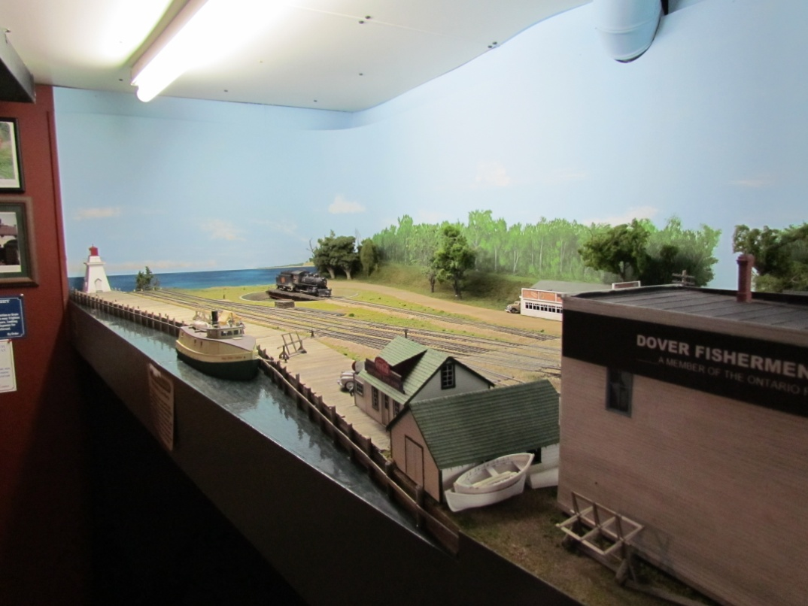
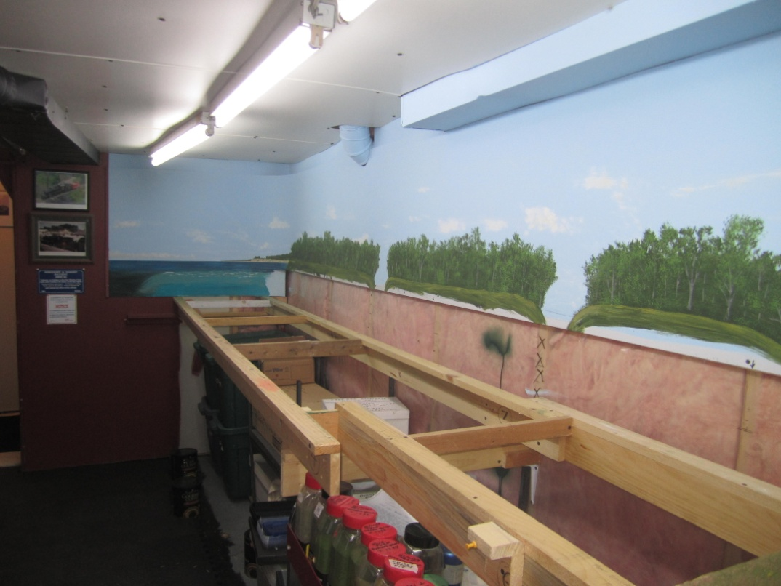
Modular Vs Portable
Portable…scenically cohesive but can demand group ownership

Slide 16
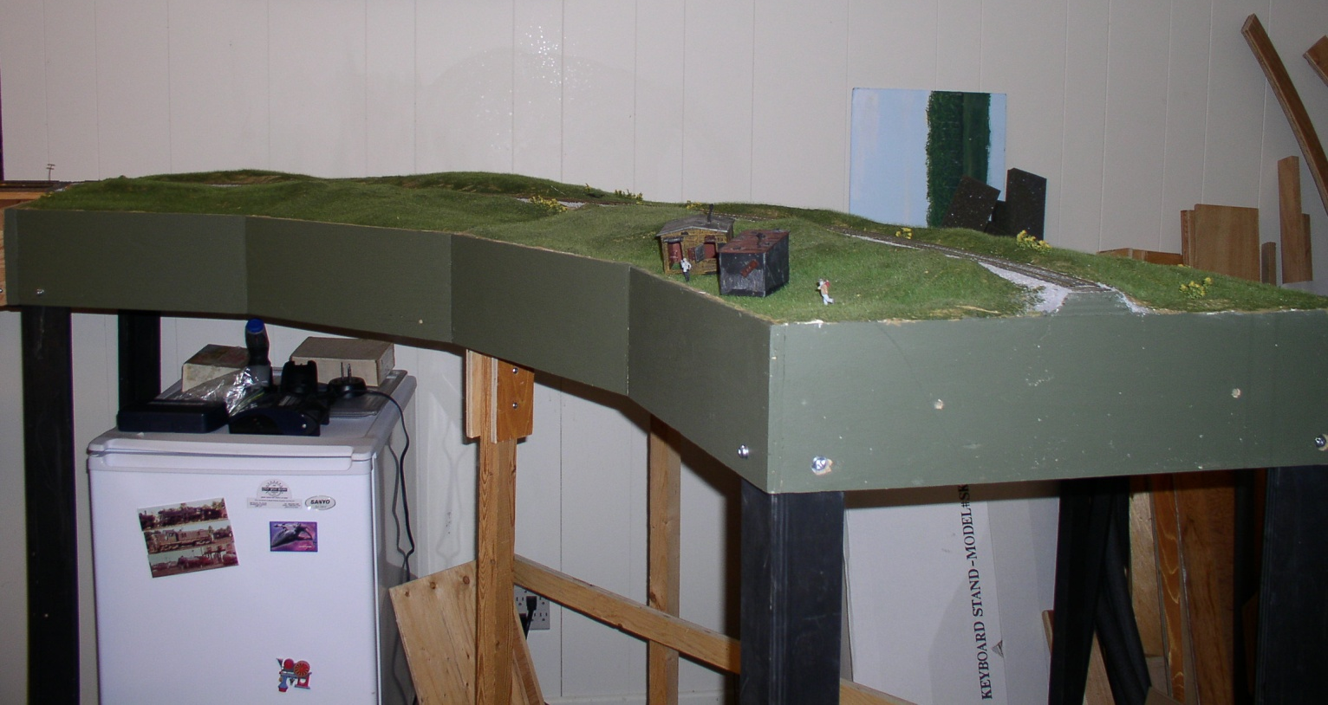
Modular vs. Portable
S-Mod…continuous running is good for public shows…who owns the corners?
Green Fuzzy Corner

Slide 17
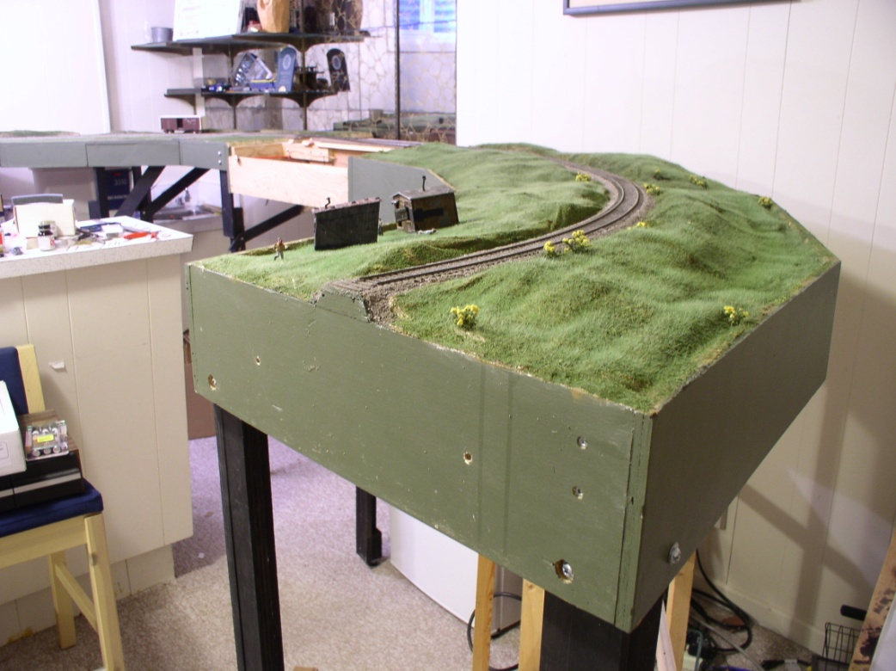
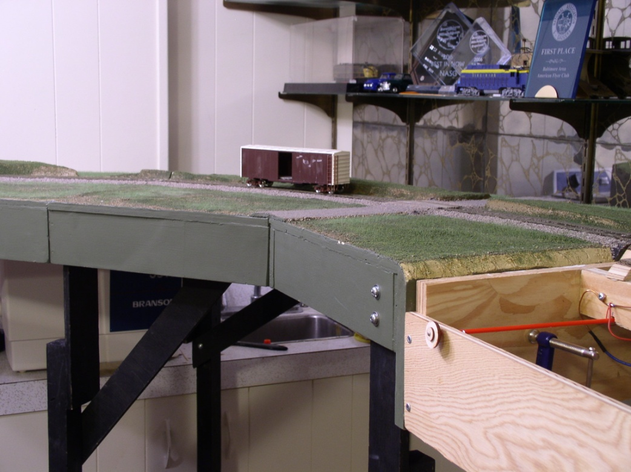
Green Fuzzy Corner
Caines’ Corner

Slide 18
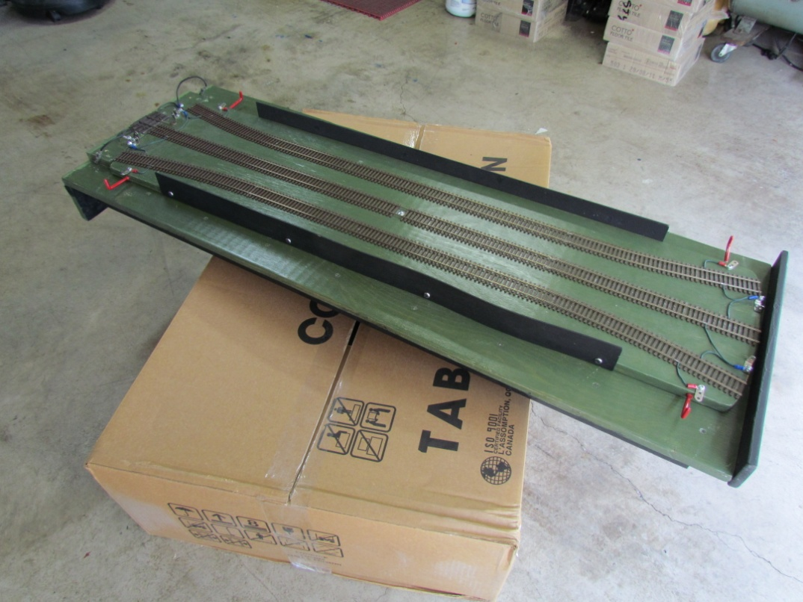
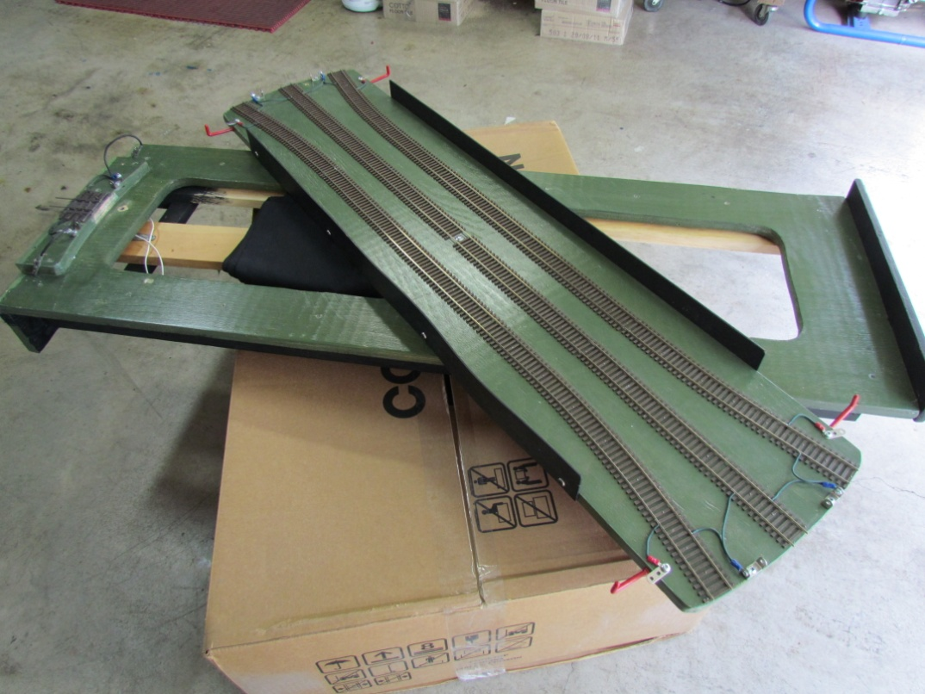
Portable vs. Modular
Free-mo…very flexible set…point to point challenges for public shows. (train turntable or return loop?)
Train Turntable

Slide 19
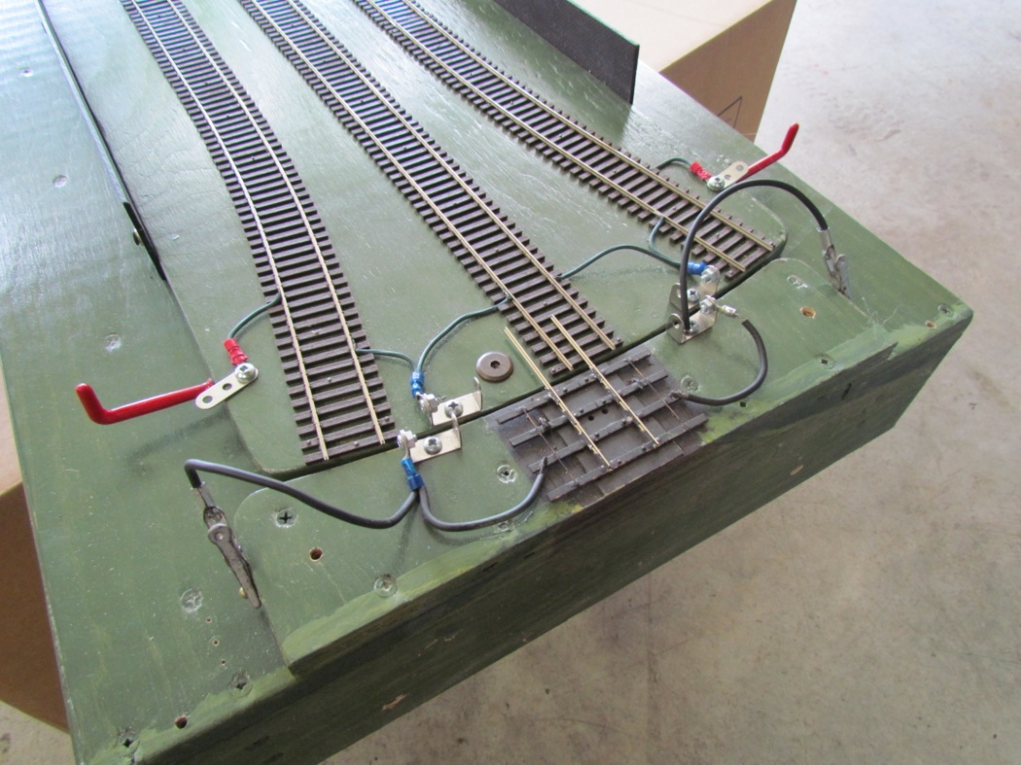
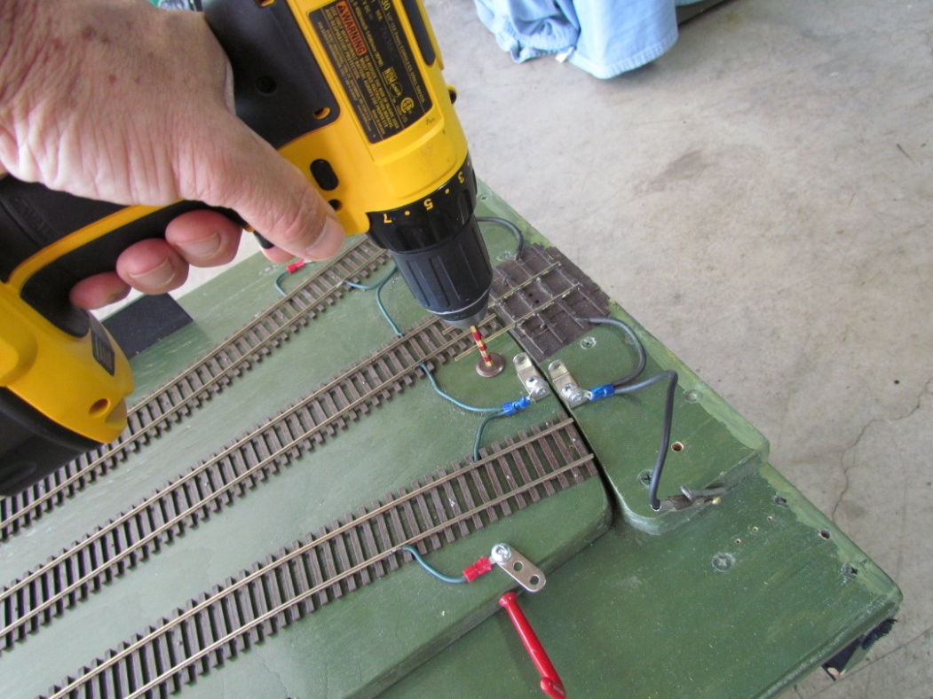
Train Turntable End

Slide 20
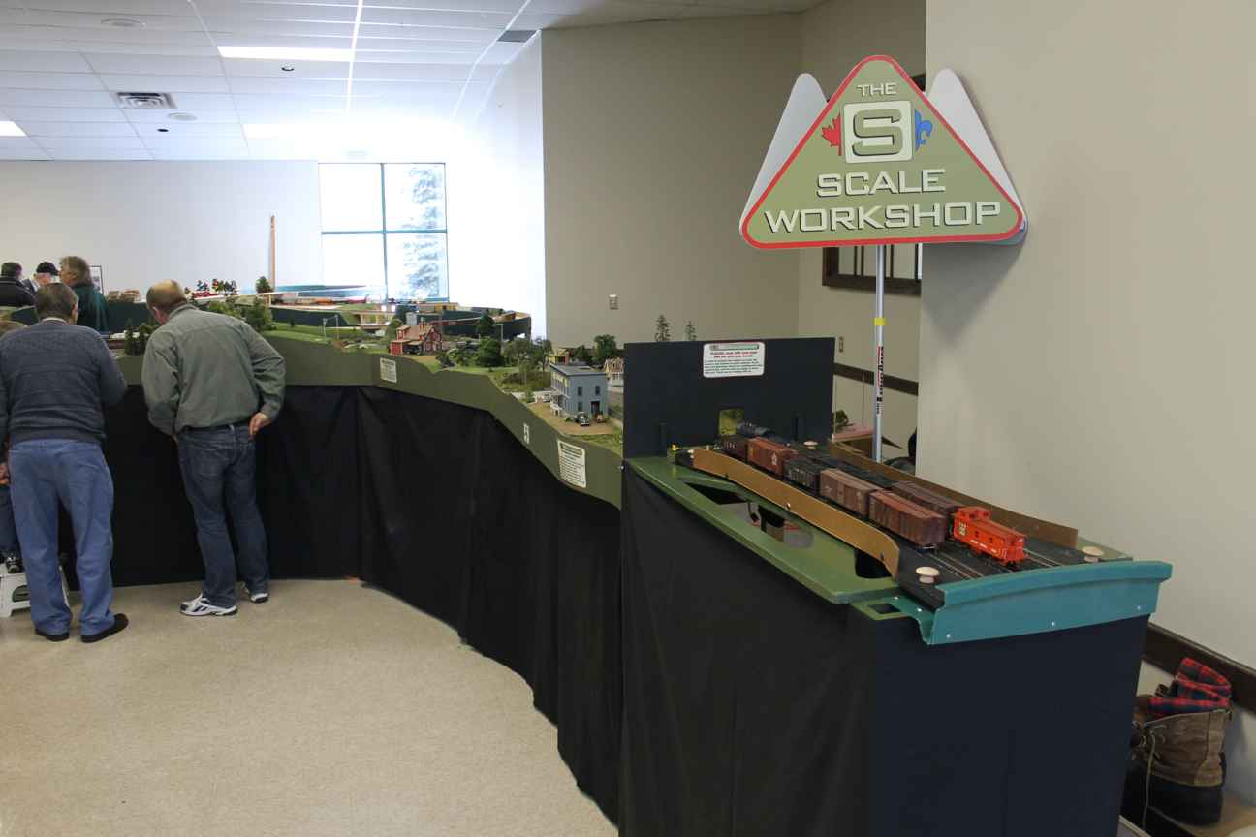
Two Turntables in Use
On Point to Point Layout

Slide 21
Pre-Planning
Establish Standards…make your own or off the rack.
Avoid assumptions…end pins
Assessing group strengths and weaknesses (scenery, carpentry, experience, etc.)
Do not start building without group standards

Slide 22
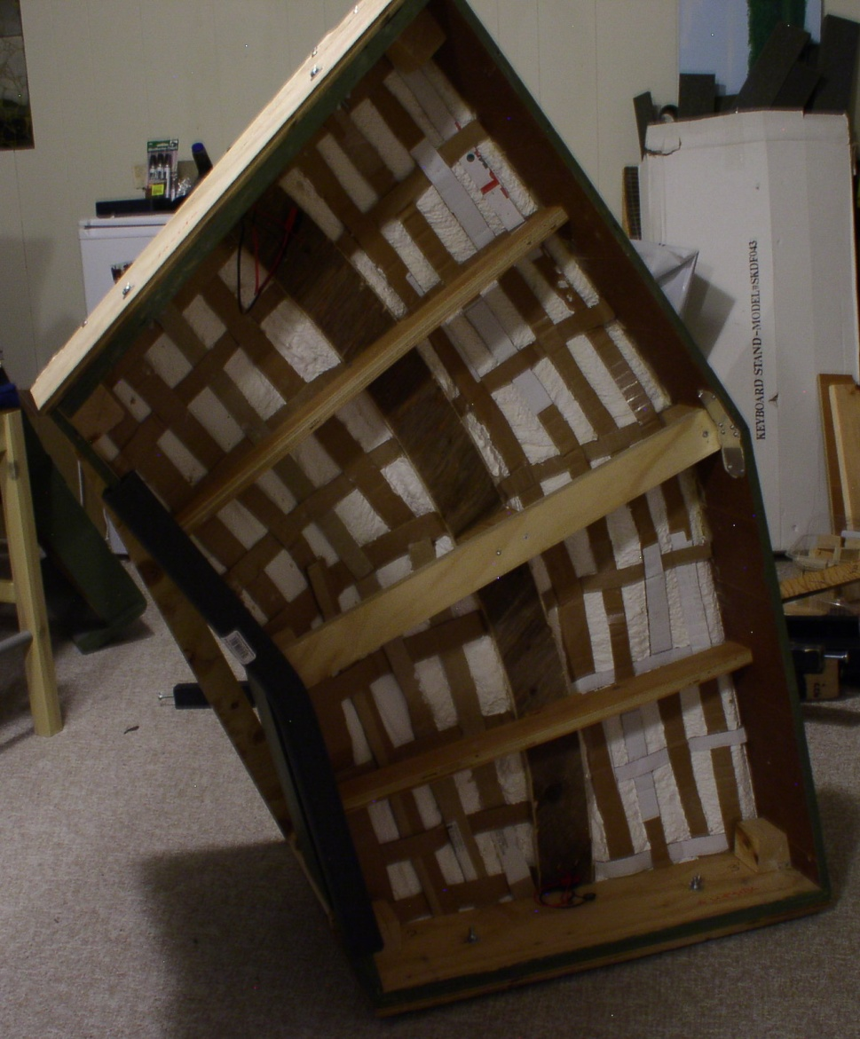
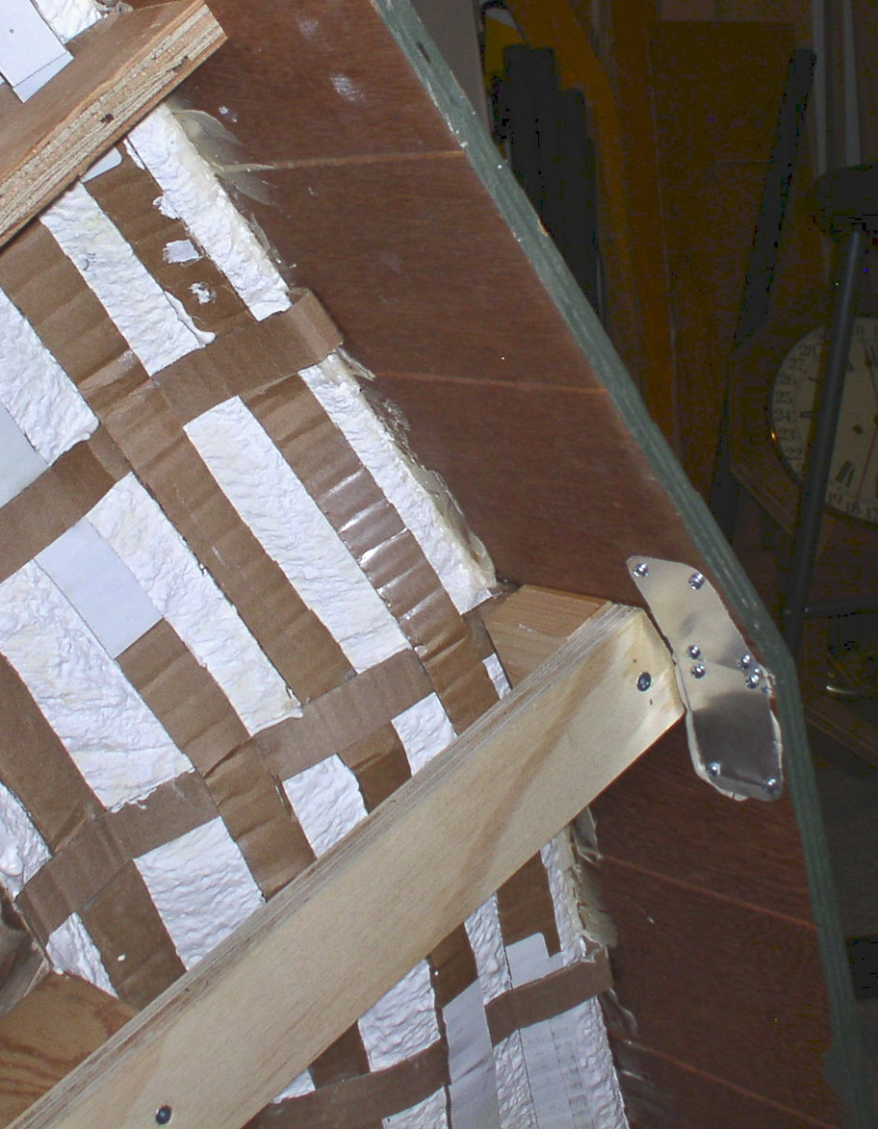
Building Techniques
Weight vs.. Strength - cardboard lattice lightweight

Slide 23
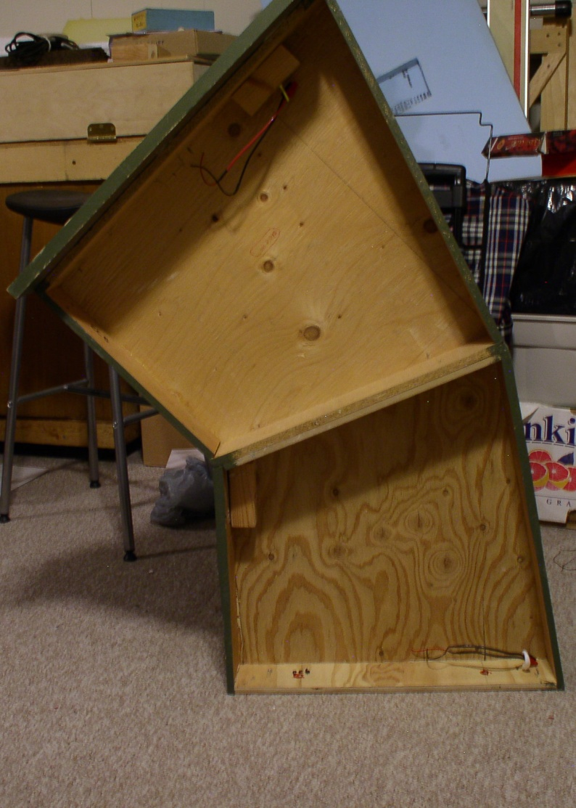
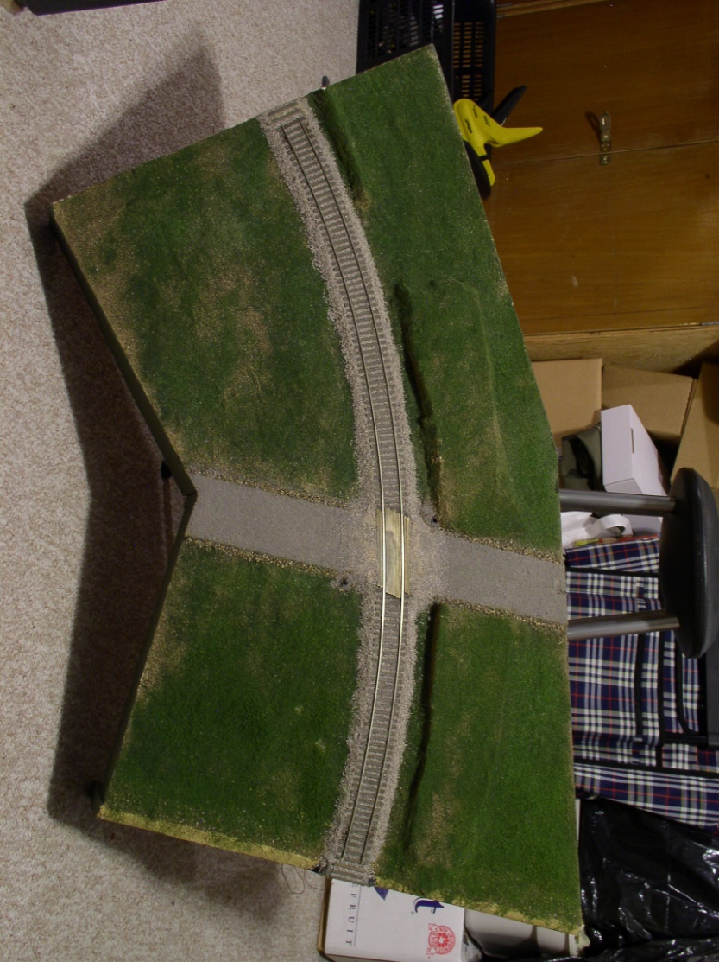
Weight Vs Strength – heavyweight and conventional

Slide 24
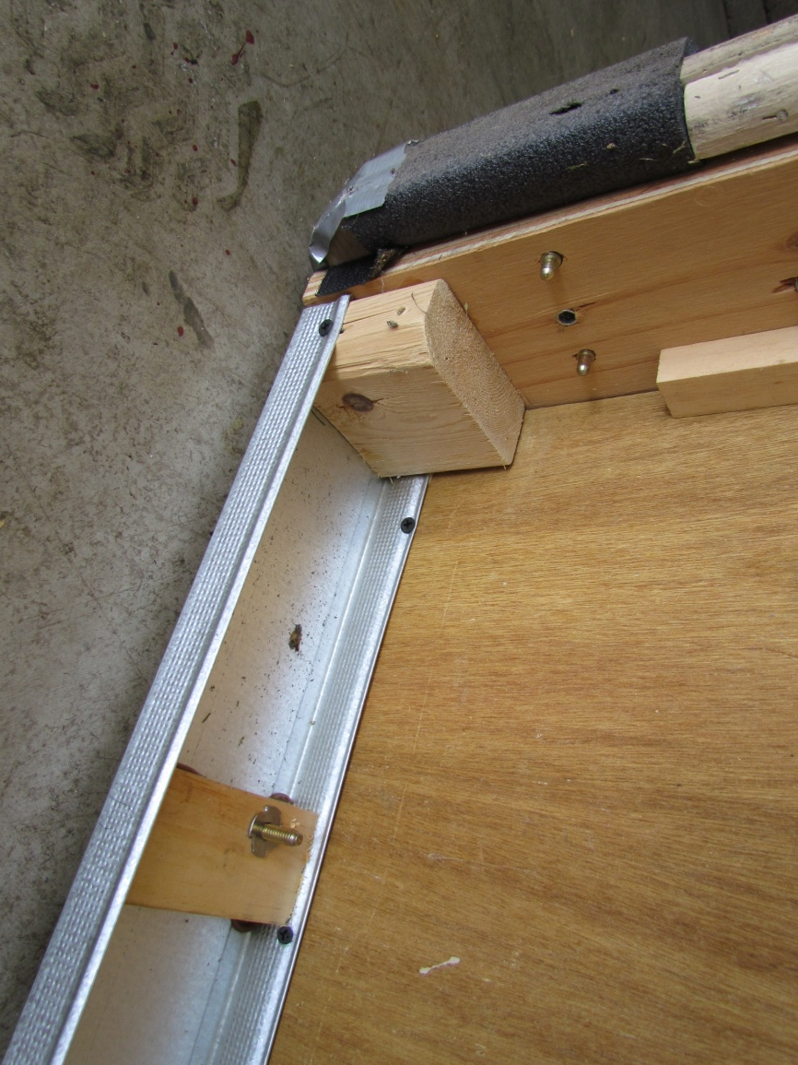
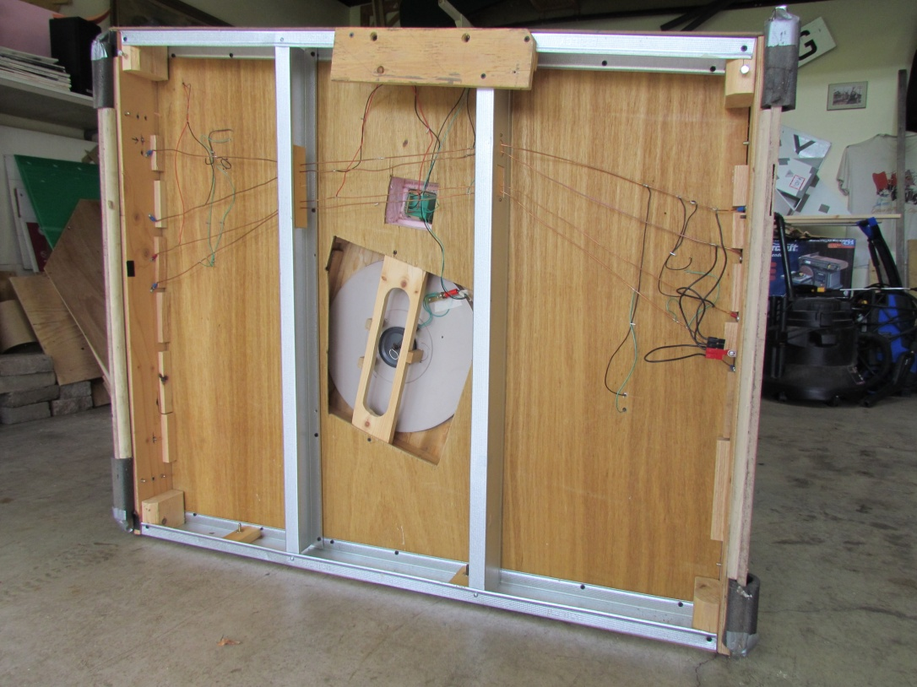
Hybrid

Slide 25
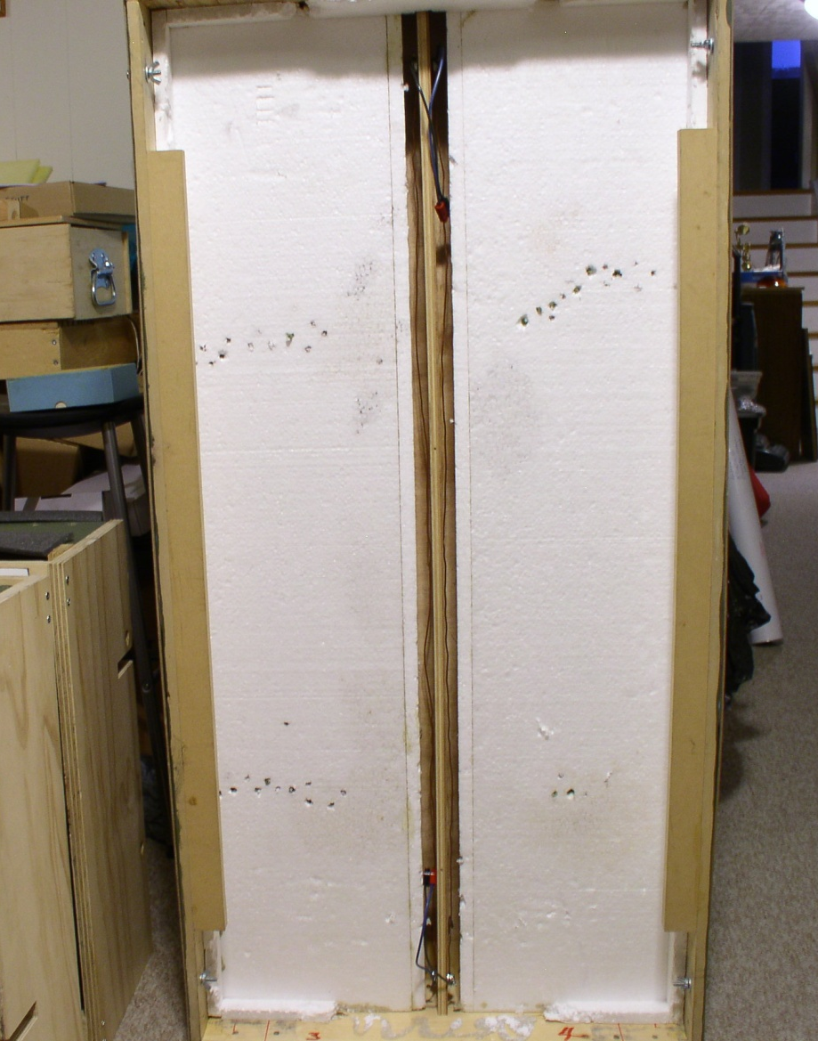
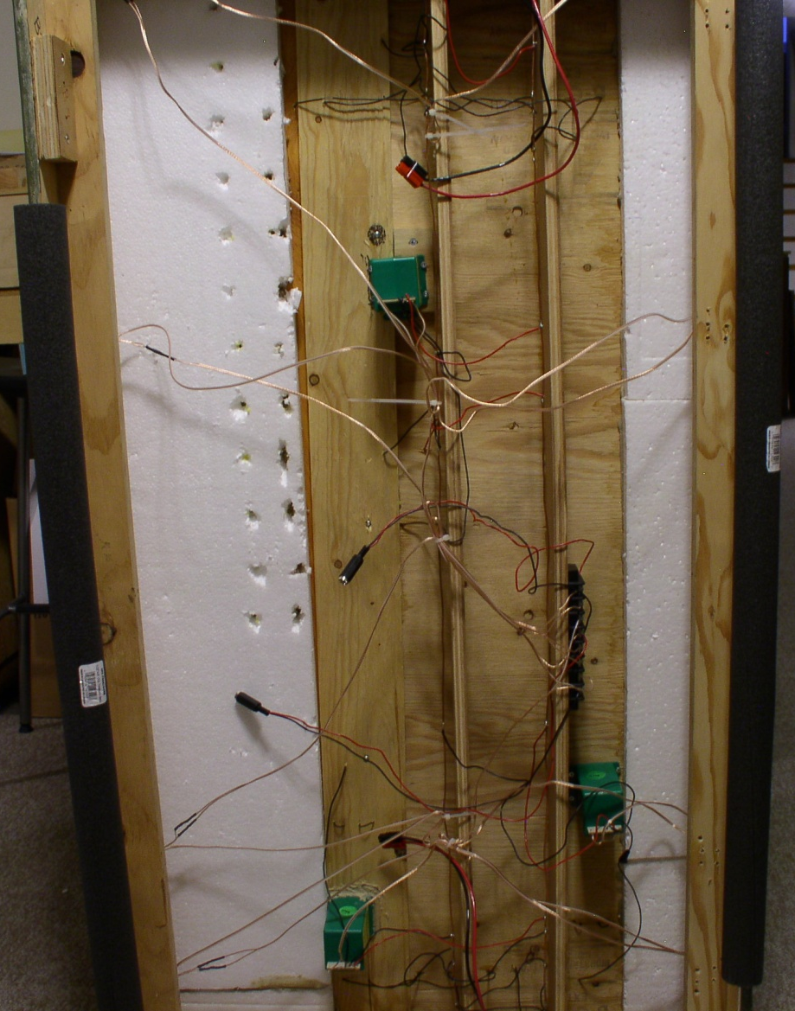
Hybrid

Slide 26
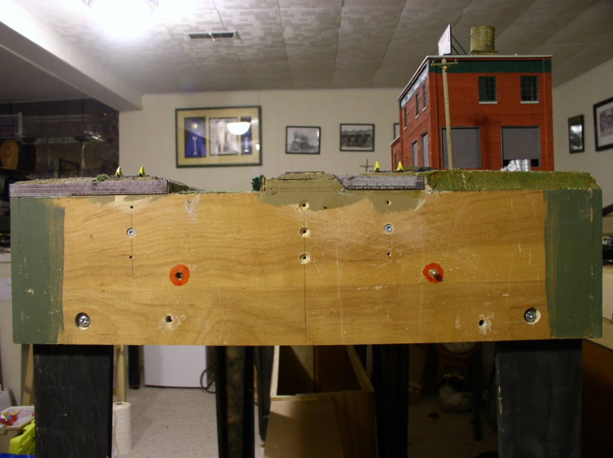
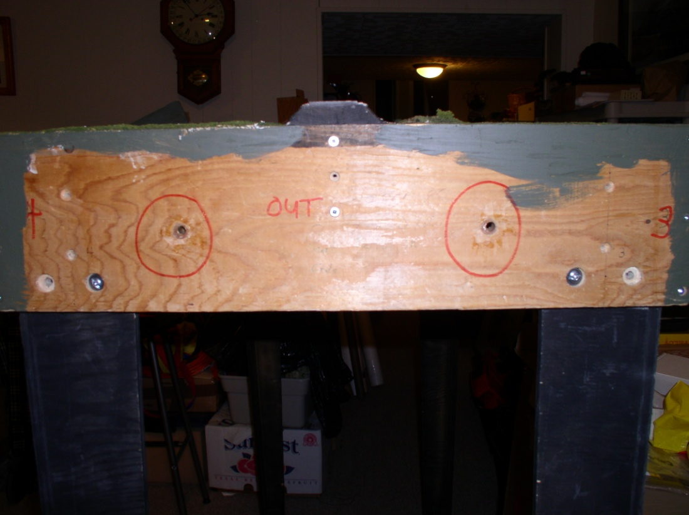
Honeycomb
Gator Board/Roof Insulation
One person builds the end panels
If using locating pins, one accurate machined metal drilling fixture is necessary. (Tom Knapp…Feb 2011 R)
Good
Re-drilled and Still Bad

Slide 27
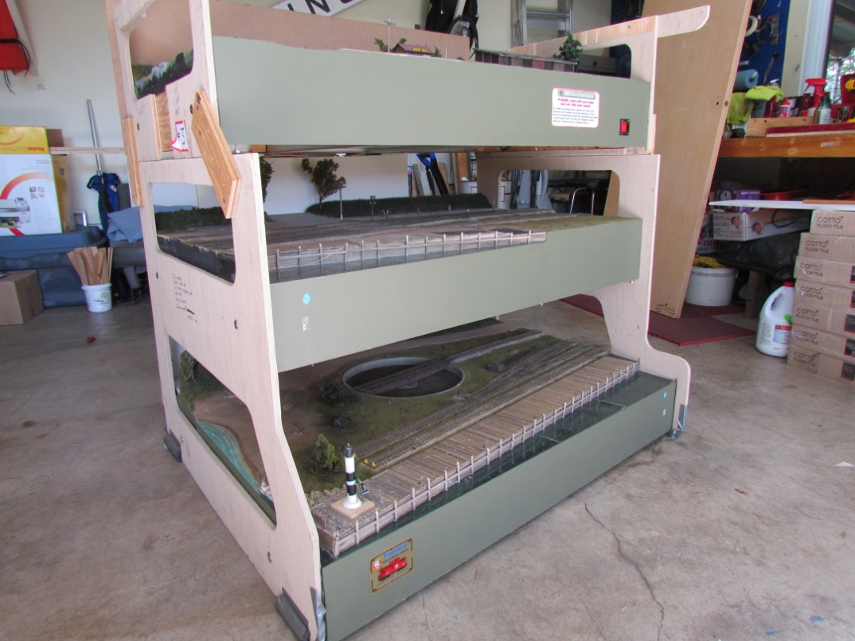
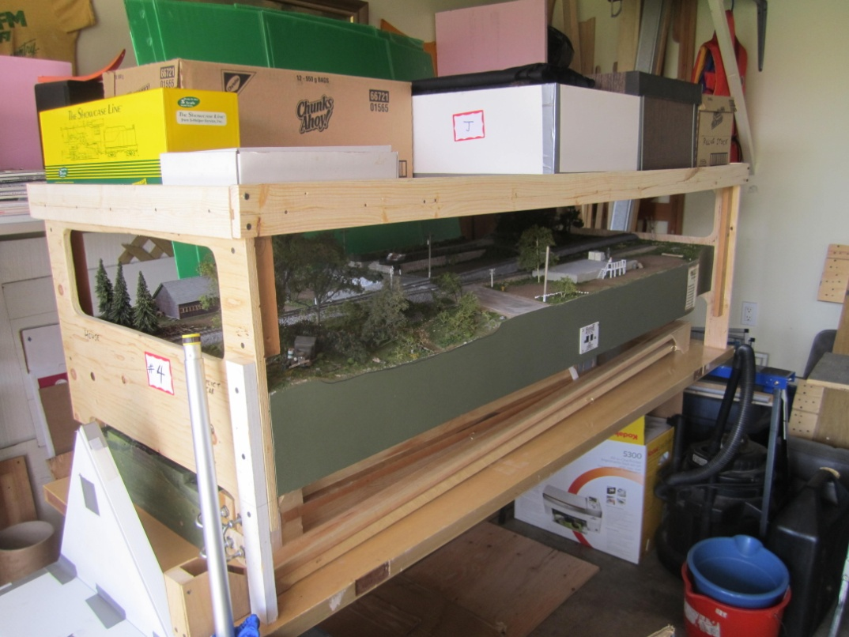
Storage and Transportation
How big is too big?
Packaging and Protection

Slide 28
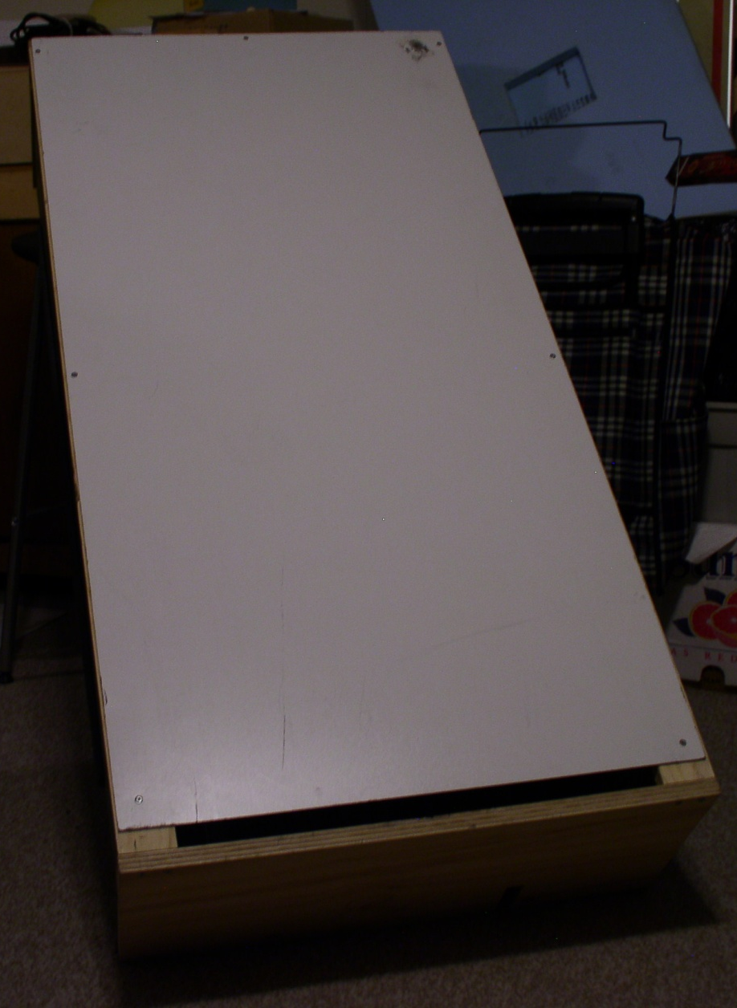
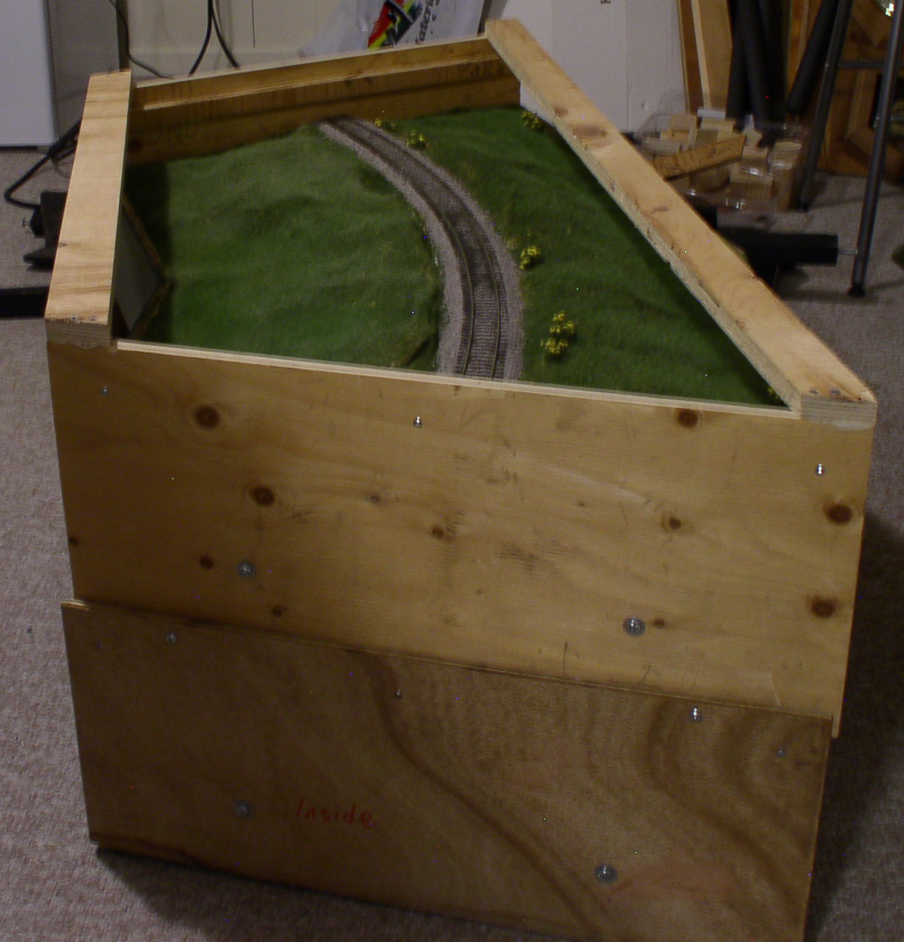
Packaging and Protection

Slide 29
Build to fit your storage space?
Building as part of your home layout.
Do you need to rent a van or trailer?
Do you need a cross border manifest?

Slide 30

Setup
Establish a group liaison person.
Know your space requirements.
Pete Moffet

Slide 31
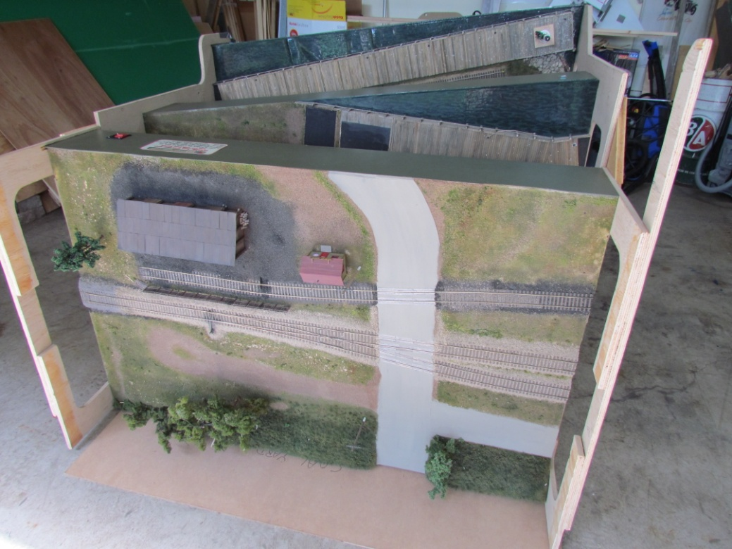
Setup
Figure out what you need to take…limit rolling stock and tool box size.
Do all members have rolling stock to bring?
You can never have enough tools!!!
Fasten small details and buildings to layout surface

Slide 32
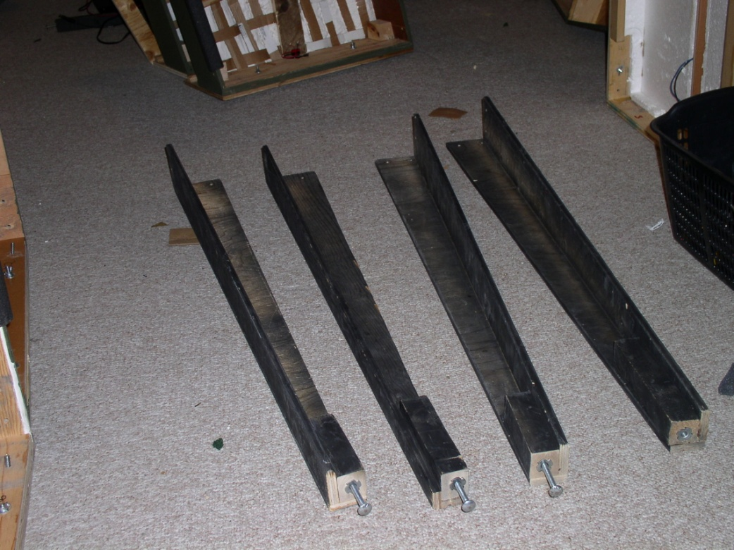
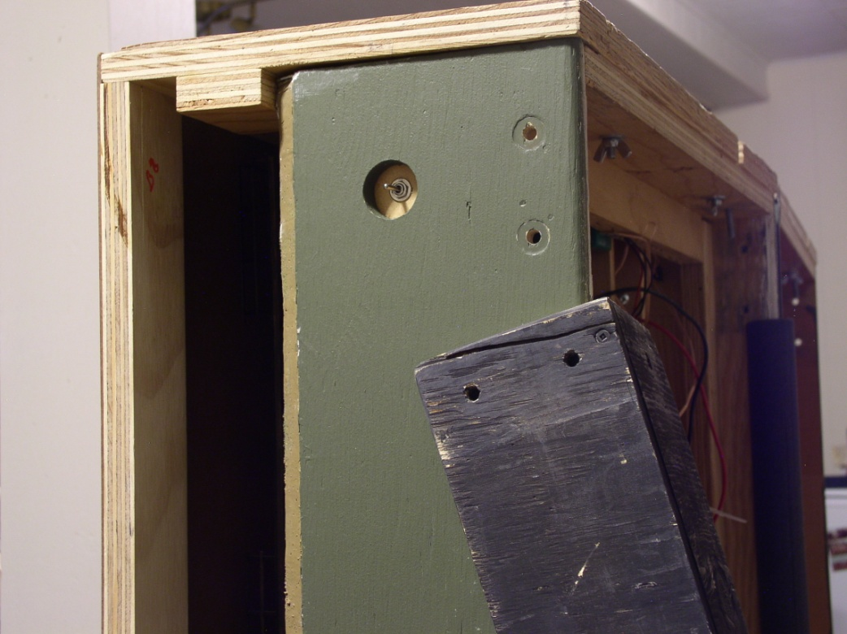
Setup
Organize your stuff …see-through plastic boxes
Speeding assembly
Bolt On Legs – Sturdy but slow to medium speed assembly

Slide 33
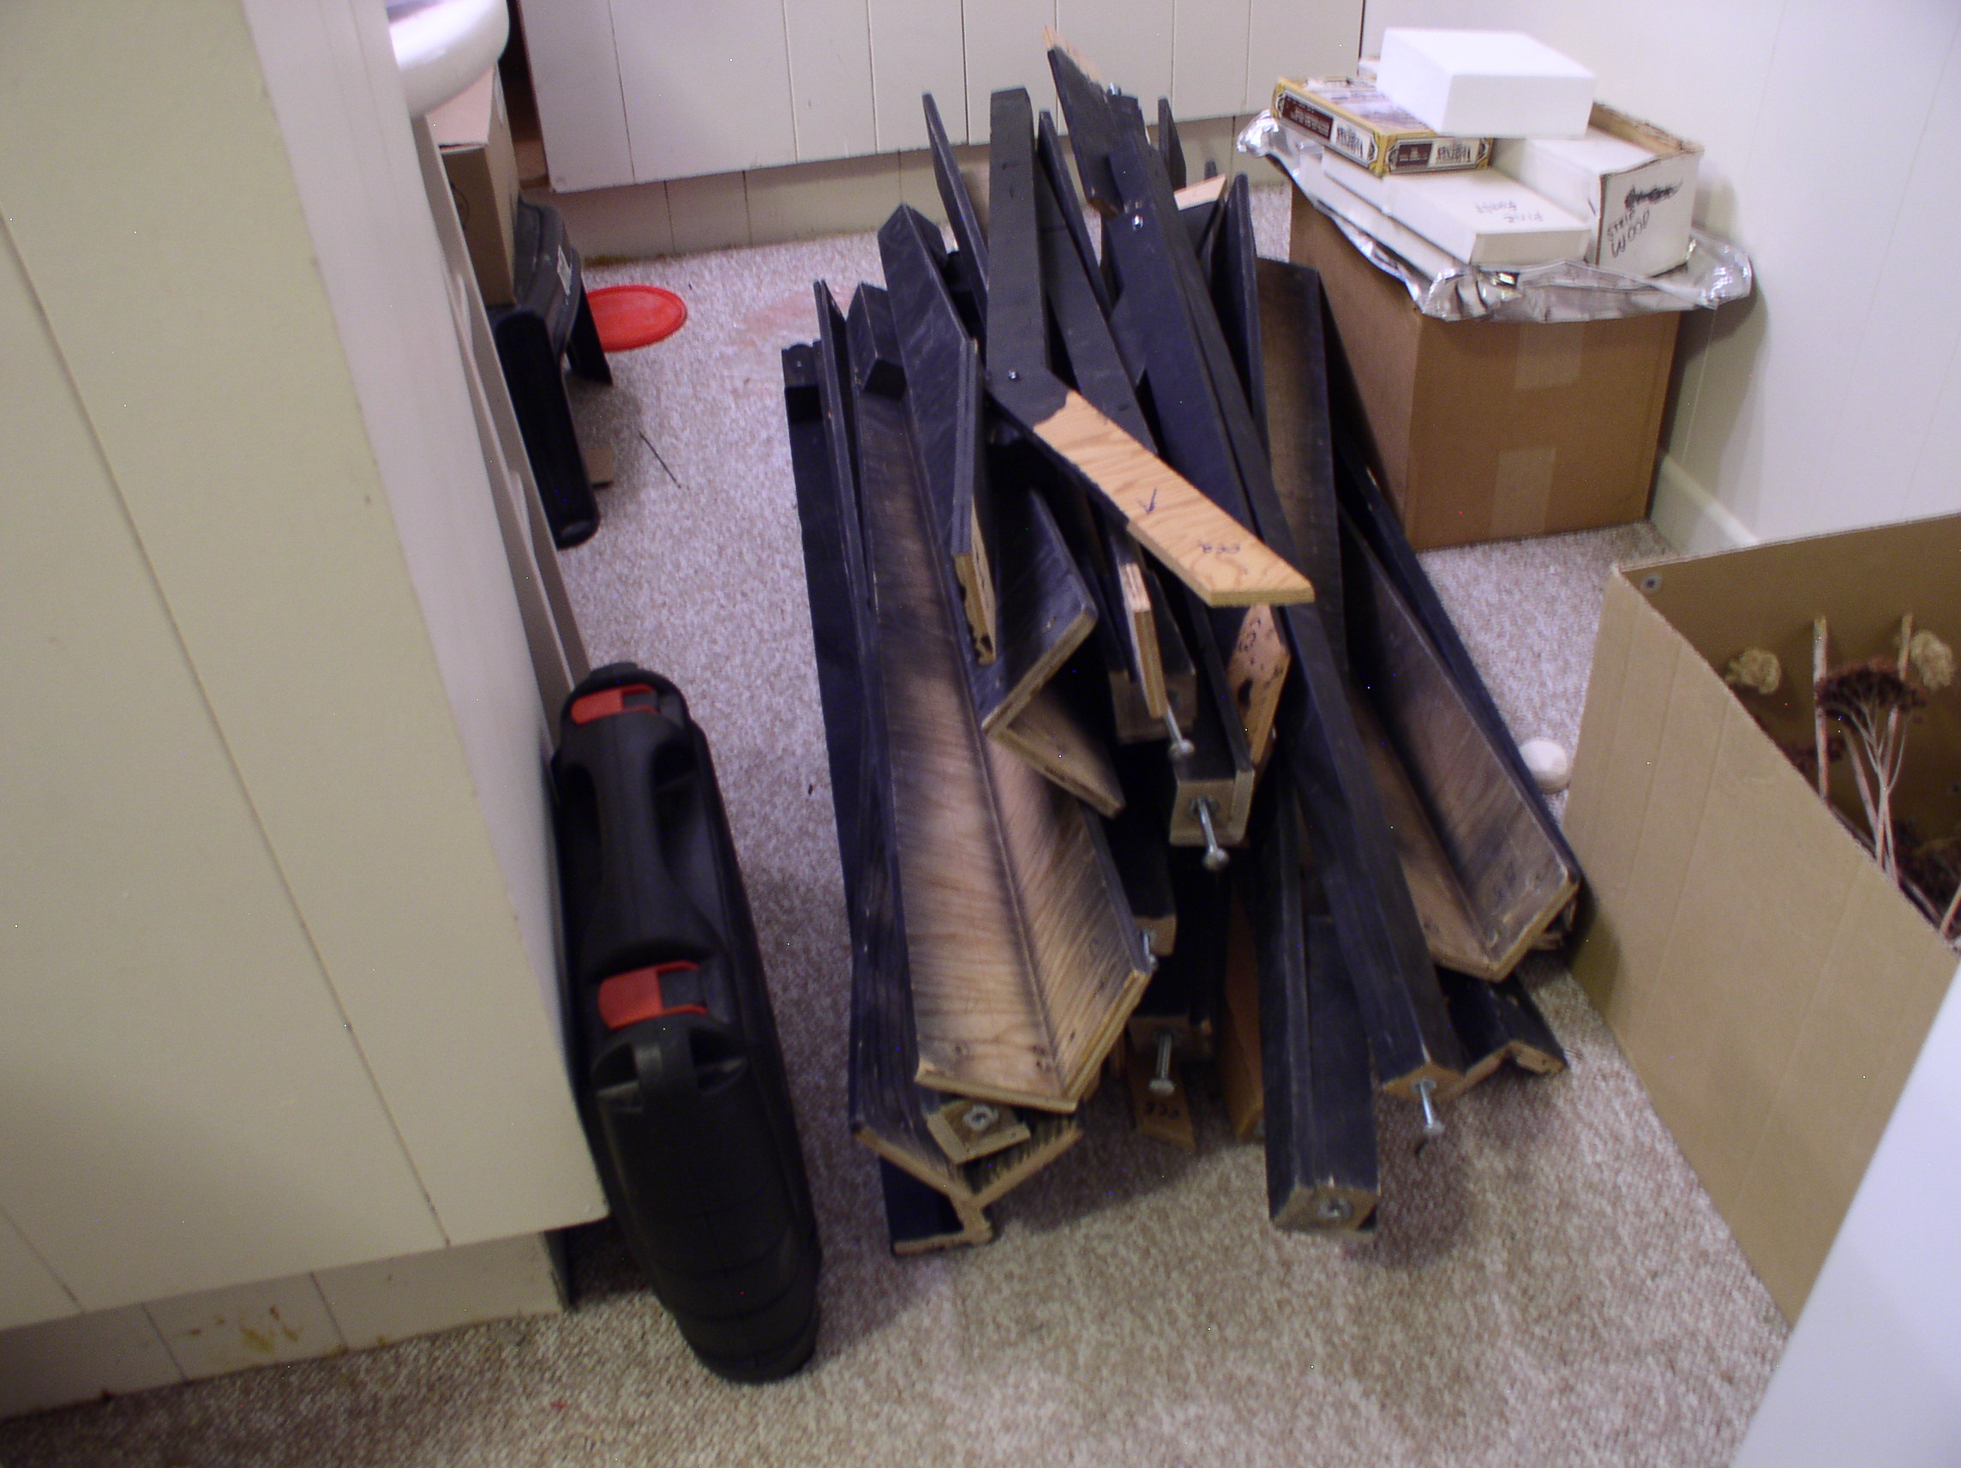
A Pile of Legs that take up a lot of space when being transported.

Slide 34
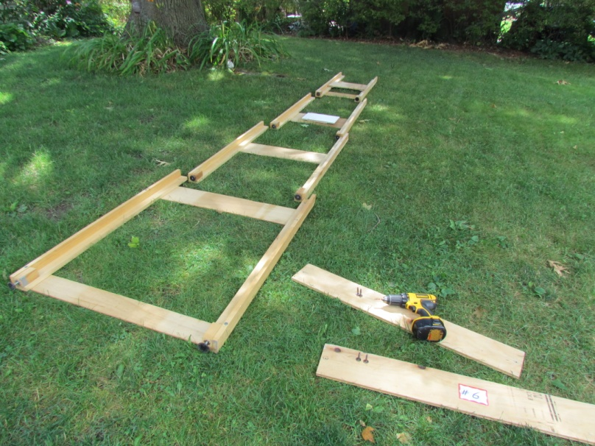



Fold Down Legs Stacked and Secured Nicely For Transport

Slide 35


Slide 36


Speeding Assembly cont’d
Locating pins
Connecting Rails or Butt-Joints
Connecting Rails
Butt-Joints

Slide 37
Speeding Assembly cont’d.
Furniture Screws
Pre-Assembled Power Supply

Slide 38


Presentation
Visual Conformity of Sections

Slide 39

Presentation cont’d.
Backdrops?
Continuous
Segmented

Slide 40


Presentation cont’d.
No Backdrop

Slide 41



Presentation cont’d.
Are you operating on one side or both sides?

Slide 42



Presentation cont’d.
Modules must look finished even early on

Slide 43


Presentation cont’d.
Signage…uniform format…signs on each module.

Slide 44

Presentation cont’d.
NASG Banner
Promotional Handouts
Interpretive Displays…scenery samples for touching
Personal appearance and demeanour…no unkempt curmudgeons

Slide 45


Presentation cont’d.
Periscopes…people in wheelchairs are people too

Slide 46
Presentation cont’d.
Website and QR code…impress the youngsters
http://sscaleworkshop.blogspot.ca/
http://www3.sympatico.ca/bobcatt/ssw/

Slide 47
After the Show
Dinner, drinks, post mortem and forgiveness (what worked and what didn’t)
Follow-up observations
Make necessary post show repairs etc. ASAP because we are getting old and I know that I forget.

Slide 48
The Good
Incentive to build things and get things done. A great way to move PMP into the background.
Part of group of like minded modellers provides a sense of fellowship…agony loves company.
A great way to learn and implement new skills and new ideas from others.

Slide 49
The Bad
As time goes on, it is harder to carry things.
Standing on concrete floors for great periods of time becomes very tiresome and in some cases painful.
The modules and buildings are showing their wear and tear more each time presented.
Equipment also takes a lot of wear and tear even when packed well.
Maintenance is an on-going battle.

Slide 50

The Fun

Slide 51

Starting Over?
Why?…dissatisfaction, aging, changing tastes and standards.
A clean break?
Evolving from the present.
And that’s the End of the Line, cheers eh?

